Slide 1
Bangladesh Climate-Resilient Ecosystem Curriculum (BACUM)
Module 2: REDD+ in Climate Change Context

Slide 2
Module 2: REDD+ in Climate Change Context
SECTION II: ASSESSING CURRENT CONDITIONS OF REDD+
2.1. Drivers of Deforestation and Forest Degradation

Slide 3
REDD+ in Climate Change Context (REDD+)
ENABLING ENVIRONMENT OF REDD+
1.1. Forests, Forest Carbon and Climate Change
1.2. Fundamentals of REDD+ and the UNFCCC
1.3. Stakeholder Engagement
ASSESSING CURRENT CONDITIONS OF REDD+
2.1. Drivers of Deforestation and Forest Degradation
2.2. Fundamentals of Forest (Emission) Reference Levels
2.3. National Forest Monitoring Systems (NFMS) for REDD+
ANALYZING FUTURE OPTIONS FOR REDD+
3.1. Policies and Measures for REDD+ Implementation
3.2. REDD+ Safeguards under the UNFCCC
3.3. The Costs and Benefits of REDD+
DEVELOPING REDD+ STRATEGIES AND ACTION PLANS
4.1. Negotiation in REDD+
4.2. National Strategies and Action Plans
4.3. Approaches for Incentive Allocation System
MONITORING, EVALUATION AND ADAPTATION
5.1. Establish M&E Framework for REDD+ Action Plan
5.2. Monitor and Measure Implementation Progress
5.3. Evaluate, Report and Adapt

Slide 4
Acknowledgements
EXPERT CONTRIBUTORS | SPECIFIC INPUTS
Prof. (Dr.) Manzoor Rashid | Curriculum Development for all topics
Prof. (Dr.) Md. Danesh Miah | REDD+, Forest Carbon
Prof. (Dr.) Md. Jakariya | Community NR Management, Climate Change, Natural Resources Management
UNIVERSITIES
Bangladesh Agricultural University
University of Chittagong
Dhaka University
Independent University, Bangladesh
Khulna University
Noakhali University of Science and Technology
Shahjalal University of Science and Technology
Sher-e-Bangla Agriculture University
North South University
CREL STAFF | CREL STAFF
John A Dorr | Utpal Dutta
Abu Mostafa Kamal Uddin | Ruhul Mohaiman Chowdhury
Kevin T. Kamp | Rahima Khatun
Paul Thompson | Sultana Razia Zummi
Abdul Wahab | Shams Uddin
Shahzia Mohsin Khan
DESIGN, LAYOUT AND CONTENT DEVELOPMENT: Ms. Chi Pham, Curriculum Development Expert, Bangkok, Thailand

Slide 5
Learning Objectives
By the end of this module, you should be able to:
Define and give examples of the drivers (direct and indirect) of deforestation and forest degradation in the context of REDD+;
Explain trends that will affect drivers in the future;
Explain the importance of analyzing and prioritizing direct and indirect drivers;
Describe challenges in identifying and finding solutions to drivers of deforestation and forest degradation.

Slide 6
What are Drivers?
Drivers are processes that result in deforestation and forest degradation.
Direct drivers, (‘proximate causes’), human activities or immediate actions that directly impact forest cover and loss of carbon
Indirect drivers, (‘underlying causes’ or ‘driving forces’), complex interactions of fundamental social, economic, political, cultural and technological processes.
Notes:
References:
UNEP. 2014. Forests in a Changing Climate: A Sourcebook for Integrating REDD+ into Academic Programmes. United Nations Environment Programme. Nairobi, Kenya. http://www.unep.org/Training/docs/Forest_in_a_Changing_Climate.pdf
UNEP. 2015. REDD+ Academy Learning Journal. Edition 1. www.un-redd.org/REDDAcademy

Slide 7
Examples of Direct Drivers
Deforestation: change in land use
subsistence and large- and small-scale commercial agriculture
mining
infrastructure development and urban expansion
Forest degradation: reduced health of ecosystems and services
legal and illegal timber extraction
forest fires
livestock grazing in forests
fuelwood collection and charcoal production, long-fallow shifting cultivation
Notes:
References:
UNEP. 2014. Forests in a Changing Climate: A Sourcebook for Integrating REDD+ into Academic Programmes. United Nations Environment Programme. Nairobi, Kenya. http://www.unep.org/Training/docs/Forest_in_a_Changing_Climate.pdf
UNEP. 2015. REDD+ Academy Learning Journal. Edition 1. www.un-redd.org/REDDAcademy

Slide 8
Examples of Indirect Drivers
International level:
markets, commodity prices, exchanges
National level:
population growth
domestic markets
national policies, fiscal incentives and subsidies
weak governance and institutions
poor cross-sectoral coordination
poverty
Local level:
change in household behaviour
Notes:
References:
UNEP. 2014. Forests in a Changing Climate: A Sourcebook for Integrating REDD+ into Academic Programmes. United Nations Environment Programme. Nairobi, Kenya. http://www.unep.org/Training/docs/Forest_in_a_Changing_Climate.pdf
UNEP. 2015. REDD+ Academy Learning Journal. Edition 1. www.un-redd.org/REDDAcademy

Slide 9
Examples of drivers : Bangladesh contexts
Category | Direct | Indirect | Factors
Deforestation | Shrimp farming in coasts | Global demand for seafood | Economic
Deforestation | Settlement | Poverty | Economic
Deforestation | Settlement | Poor interdepartmental cooperation | Governance
Degradation | Timber and woodfuel | Demand for wood products | Economic
Degradation | Increased salinity | Reduced flow of fresh water | International
Degradation | Timber and woodfuel | Demand for wood products | Economic
Deforestation | Industrial expansion | Poor interdepartmental cooperation | Governance
Degradation | Afforestation with exotic species | Demand for wood products | Governance
Deforestation | Expansion of Commercial agriculture | Demand for high value crop | Economic
Degradation | Illegal logging and fuelwood | Demand for high value crop | Economic
Notes:
General contexts of drivers of deforestation and forest degradation in Bangladesh

Slide 10
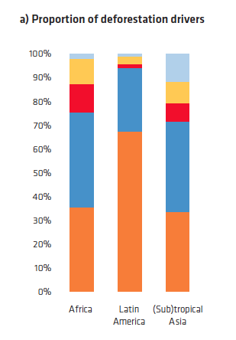
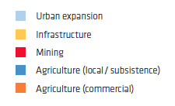
Apparent Deforestation Drivers by Region
Notes:
References:
UNEP. 2014. Forests in a Changing Climate: A Sourcebook for Integrating REDD+ into Academic Programmes. United Nations Environment Programme. Nairobi, Kenya. http://www.unep.org/Training/docs/Forest_in_a_Changing_Climate.pdf
UNEP. 2015. REDD+ Academy Learning Journal. Edition 1. www.un-redd.org/REDDAcademy

Slide 11
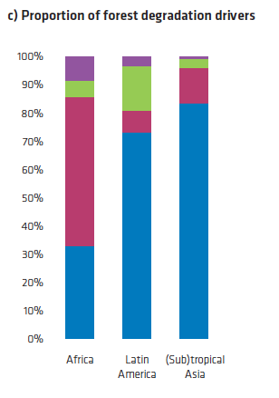
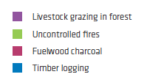
Apparent Deforestation Drivers by Region
Notes:
References:
UNEP. 2014. Forests in a Changing Climate: A Sourcebook for Integrating REDD+ into Academic Programmes. United Nations Environment Programme. Nairobi, Kenya.
http://www.unep.org/Training/docs/Forest_in_a_Changing_Climate.pdf
UNEP. 2015. REDD+ Academy Learning Journal. Edition 1. www.un-redd.org/REDDAcademy

Slide 12
What about the Future?
Global population increase
Economic growth patterns
Demand for agricultural commodities
Demand for products
Use of fuel wood and charcoal
Notes:
References:
UNEP. 2014. Forests in a Changing Climate: A Sourcebook for Integrating REDD+ into Academic Programmes. United Nations Environment Programme. Nairobi, Kenya. http://www.unep.org/Training/docs/Forest_in_a_Changing_Climate.pdf
UNEP. 2015. REDD+ Academy Learning Journal. Edition 1. www.un-redd.org/REDDAcademy

Slide 13
Why Analyze Drivers?
Several UNFCCC decisions refer to drivers, developing countries are required to:
Decision 4/CP.15: identify drivers of deforestation and forest degradation (DDFD)
Decision 1/CP.16: address these drivers in their national strategies or action plans
Decision 15/CP.19: ensure that the response to drivers are adapted to national circumstances
Notes:
References:
UNEP. 2014. Forests in a Changing Climate: A Sourcebook for Integrating REDD+ into Academic Programmes. United Nations Environment Programme. Nairobi, Kenya. http://www.unep.org/Training/docs/Forest_in_a_Changing_Climate.pdf
UNEP. 2015. REDD+ Academy Learning Journal. Edition 1. www.un-redd.org/REDDAcademy

Slide 14
Why Analyze Drivers
Effectively engage key stakeholders, especially non-forest sectors (in many countries the main drivers)
Define priorities for forest monitoring and MRV
Justify national circumstances for adjusting reference emission levels
Construct scenarios that may deviate from historical trends
Design results-based actions that generate results-based payments
Notes:
References:
UNEP. 2014. Forests in a Changing Climate: A Sourcebook for Integrating REDD+ into Academic Programmes. United Nations Environment Programme. Nairobi, Kenya. http://www.unep.org/Training/docs/Forest_in_a_Changing_Climate.pdf
UNEP. 2015. REDD+ Academy Learning Journal. Edition 1. www.un-redd.org/REDDAcademy

Slide 15
Comparing and Prioritizing Drivers
Four key indicators to support comparison:
The amount of deforestation for one unit
Benefits (social/economic/environmental) of one unit
Costs (social/economic/environmental) of one unit of driver
Access to REDD-compatible alternatives: e.g. smart or certified agriculture
Notes:
References:
UNEP. 2014. Forests in a Changing Climate: A Sourcebook for Integrating REDD+ into Academic Programmes. United Nations Environment Programme. Nairobi, Kenya. http://www.unep.org/Training/docs/Forest_in_a_Changing_Climate.pdf
UNEP. 2015. REDD+ Academy Learning Journal. Edition 1. www.un-redd.org/REDDAcademy

Slide 16
Challenges
Analyzing historical trends without looking at potential future scenarios
Not analyzing indirect drivers
Reductionist approaches that neglect non-forestry sectors and their plans for the future
Not separating the drivers of deforestation from the drivers of forest degradation (usually not the same)
Being fixated on particular solutions (e.g. community forestry) before the analysis
Notes:
References:
UNEP. 2014. Forests in a Changing Climate: A Sourcebook for Integrating REDD+ into Academic Programmes. United Nations Environment Programme. Nairobi, Kenya. http://www.unep.org/Training/docs/Forest_in_a_Changing_Climate.pdf
UNEP. 2015. REDD+ Academy Learning Journal. Edition 1. www.un-redd.org/REDDAcademy

Slide 17
TAKE HOME MESSAGES
A good understanding of direct and indirect drivers, as well as barriers, is necessary to design and implement effective results-based REDD+ actions
Indirect drivers very often influence the behavior of direct drivers and actors
Future drivers and barriers are in all likelihood different from yesterday’s and today’s drivers and barriers
Engaging key stakeholders in the analytical work fosters an inclusive dialogue, although countries should base what level of consultation or accommodation and agreement between stakeholders is suitable and required, on their own national circumstances
In order to safeguard public benefits it will not always be possible to obtain buy-in from and/or agreements from key drivers, such as the industrial and commercial sector.

Slide 18
Exercise: Identify Drivers by Forest types in the country
Forest types | Direct | Indirect | Factors
Coastal afforstation
Sundarbans Mangroves
Sal Forests
Hill Forests
Village grooves
Notes:
Each forest zone has specific drivers (direct and indirect) for both Deforestation as well as Forest Degradation;
Let us identify those and specify what factors are influencing those drivers

Slide 19
Exercise: Materials
ANALYSIS OF DRIVERS
Drivers of Deforestation & Degradation
Historical Trends & Future Scenarios
Direct & Indirect Drivers
Design RBAs that generate RBPs
Priorities for Forest Monitoring & MRV
Engage non-forest sectors
Barriers to the ‘+’

Slide 20
Exercise: Materials
Identification & design of
PAMs
Identification and prioritization of direct and indirect drivers
Refinement of strategic options
ANALYSIS OF DRIVERS
Notes:
Drivers Analysis: A dynamic process

Slide 21
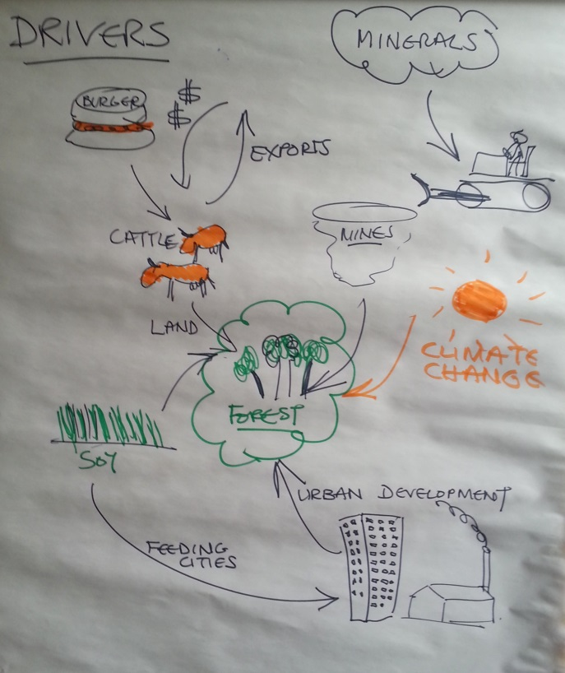
Exercise: Materials

Slide 22
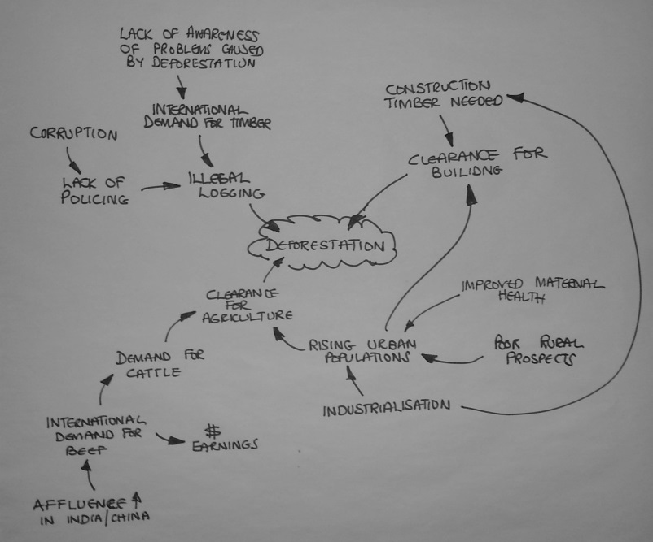
Exercise: Materials

Slide 23
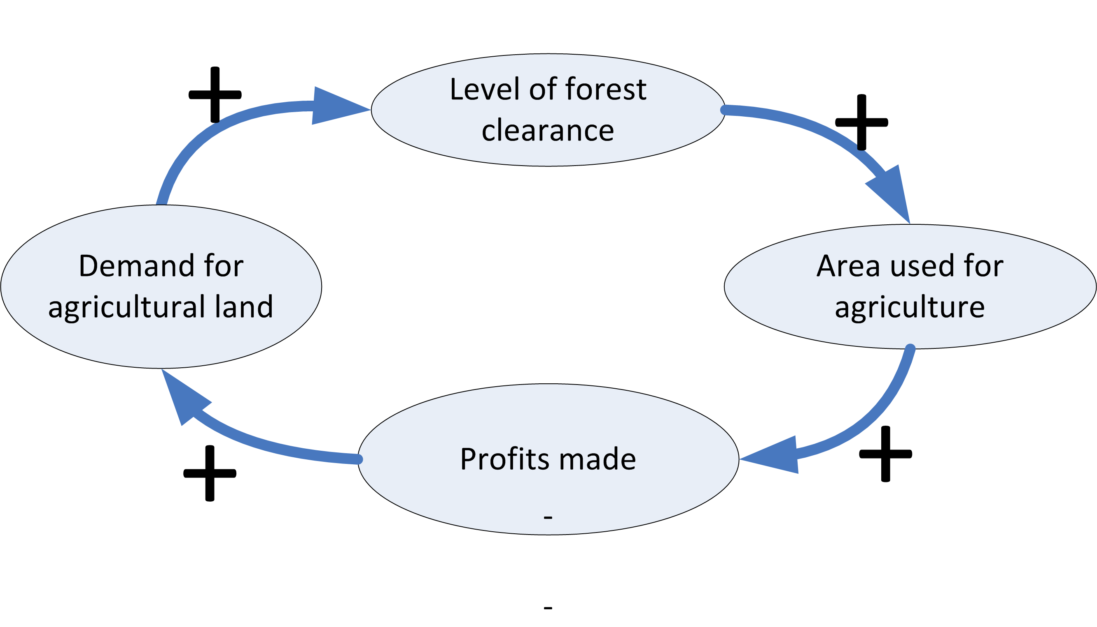
Exercise: Materials

Slide 24
References
UNEP. 2014. Forests in a Changing Climate: A Sourcebook for Integrating REDD+ into Academic Programmes. United Nations Environment Programme. Nairobi, Kenya. http://www.unep.org/Training/docs/Forest_in_a_Changing_Climate.pdf
UNEP. 2015. REDD+ Academy Learning Journal. Edition 1. www.un-redd.org/REDDAcademy

Slide 25
References and Resources
The curriculum of USAID’s Climate-Resilient Ecosystems and Livelihoods (CREL) in Bangladesh is a free resource of teaching materials for university professors, teachers and climate change training experts.
Reproduction of CREL’s curriculum materials for educational or other non-commercial purposes is authorized without prior written permission from the copyright holder, provided the source is fully acknowledged.
Suggested citation: Winrock International. 2016. USAID‘s Climate-Resilient Ecosystems and Livelihoods (CREL). Winrock International. Dhaka, Bangladesh.
Disclaimer: The CREL’s curriculum is made possible by the support of the American People through the United States Agency for International Development (USAID). The contents of the curriculum do not necessarily reflect the views of USAID or the US Government.

Slide 26
USAID's Climate-Resilient Ecosystems and Livelihoods (CREL) Project Winrock International Headquarters 2101 Riverfront Drive, Little Rock Arkansas 72202-1748 USA Tel: 1-501-280-3000 Web: www.winrock.org

