Slide 1
Bangladesh Climate-Resilient Ecosystem Curriculum (BACUM)
Module 1: Introduction to Climate Change

Slide 2
Module 1: Introduction to Climate Change
SECTION II: IMPACTS OF CLIMATE CHANGE ON PEOPLE AND THE ENVIRONMENT
2.5. Climate Change and Human Health

Slide 3
Introduction to Climate Change (ICC)
HOW AND WHY THE CLIMATE IS CHANGING
  1.1. Introduction to Climate Science and Climate Change
  1.2. Causes of Climate Change
  1.3. Climate Intensification: Floods, Droughts and Cyclone
IMPACTS OF CLIMATE CHANGE ON PEOPLE AND THE ENVIRONMENT
  2.1. Introduction to Climate Change Impacts
  2.2. Sea Level Rise
  2.3. Climate Change and Water Resources
  2.4. Climate Change and Food Security
  2.5. Climate Change and Human Health
  2.6. Climate Change and Terrestrial Ecosystems
RESPONSES TO CLIMATE CHANGE – MITIGATION AND ADAPTATION
  3.1. Climate Change and Forest Management
  3.2. Climate Change and Water Resources: Responses and Adaptation
  3.3. Principles and Practices of Climate Change Vulnerability Assessment
  3.4. Uncertainties in Climate Change
  3.5. Climate Change and Ecosystem Services
  3.6. Effective Communications in Climate Change

Slide 4
Acknowledgements
EXPERT CONTRIBUTORS | SPECIFIC INPUTS
Prof. (Dr.) Manzoor Rashid | Curriculum Development for all topics
Prof. (Dr.) Md. Danesh Miah | REDD+, Forest Carbon
Prof. (Dr.) Md. Jakariya | Community NR Management, Climate Change, Natural Resources Management
UNIVERSITIES
Bangladesh Agricultural University
University of Chittagong
Dhaka University
Independent University, Bangladesh
Khulna University
Noakhali University of Science and Technology
Shahjalal University of Science and Technology
Sher-e-Bangla Agriculture University
North South University
CREL STAFF | CREL STAFF
John A Dorr | Utpal Dutta
Abu Mostafa Kamal Uddin | Ruhul Mohaiman Chowdhury
Kevin T. Kamp | Rahima Khatun
Paul Thompson | Sultana Razia Zummi
Abdul Wahab | Shams Uddin
Shahzia Mohsin Khan
DESIGN, LAYOUT AND CONTENT DEVELOPMENT: Ms. Chi Pham, Curriculum Development Expert, Bangkok, Thailand

Slide 5
Learning Objectives
At the end of this session, students will be able to:
Describe the diseases likely to be exacerbated by climate change - from local, regional, and global perspectives
Identify the most vulnerable people and populations whose health could be affected by climate change
Propose possible adaptations to climate change-related human health issues, risks, and problems
Notes:
*

Slide 6
Outline
South Asia is disaster prone
The most vulnerable people
Climate-sensitive health outcomes
Exacerbating current burden of disease
General adaptation for health sector
Discussion questions
6

Slide 7
Key Reference
Portier CJ, Thigpen Tart K, Carter SR, Dilworth CH, Grambsch AE, Gohlke J, Hess J, Howard SN, Luber G, Lutz JT, Maslak T, Prudent N, Radtke M, Rosenthal JP, Rowles T, Sandifer PA, Scheraga J, Schramm PJ, Strickman D, Trtanj JM, Whung P-Y. 2010. A Human Health Perspective On Climate Change: A Report Outlining the Research Needs on the Human Health Effects of Climate Change. Research Triangle Park, NC:Environmental Health Perspectives/National Institute of Environmental Health Sciences. doi:10.1289/ehp.1002272 Available: www.niehs.nih.gov/climatereport

Slide 8
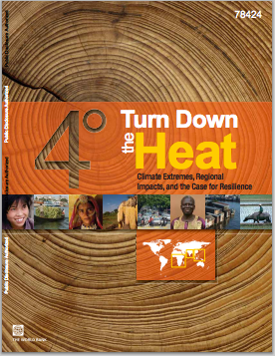
Assigned Reading
2013. Turn down the heat : climate extremes, regional impacts, and the case for resilience
Chapter 5 – South Asia
pages 105-138
Washington DC ; World Bank. http://documents.worldbank.org/curated/en/2013/06/17862361/turn-down-heat-climate-extremes-regional-impacts-case-resilience-full-report
Notes:
Questions:
What is driving the high rates of urban population growth in South East Asia?
What makes coastal cities particularly vulnerable to climate change as compared to rural surroundings?
How does city density impact vulnerability to climate change? Based on population size and density in Figure 4.10, which city do you think is most vulnerable to climate change impacts?
What are some of the assumptions made by models that try to predict exposure of populations and assets in the next century? What are some of the unknown variables that are needed to make such predictions?
Choose one of the South East Asian cities discussed in this chapter and summarize the projected climate change impacts for this city.

Slide 9
Further Assigned Reading
Read this report:
http://www.niehs.nih.gov/climatereport
Questions:
What are the most important human health impacts to Bangladesh?
Why?
What can be done to reduce or mitigate the risks to human health of these impacts?
Who is responsible for making the adaptations?

Slide 10
Global Warming Impacts on Climate and Risk Factors
More extreme weather events: storms, cyclones, flooding
Heat waves: more frequent, hotter, and longer
Rapid glacier melting: landslides, flash floods, and reduced water availability
Disturbed rainfall patterns: more droughts, more extreme precipitation events, more intense rainfall, floods, and disrupted water supply
Sea-level rise: inundation, saltwater intrusion, loss of land and assets, increased coastal flood frequency/severity
Air pollution: increase in levels of ground ozone, more allergens
10
Notes:
*
Key message:
Climate change is affected to increase the frequency of flooding and heat waves in countries of South East Asia. This, combined with an expected increase in the intensity of cyclones in the Region as a result of warmer sea surface temperatures, would increase the future health risk of extreme weather events.
However, the net health impact of future changes in these events also needs to account for expected changes in the characteristics of the affected populations and address the importance of single events. The result of these changes, all else equal, would be an increased health risk from future extreme weather events in countries of South East Asia.
(IPCC, 2007a; SEARO, 2008b)

Slide 11
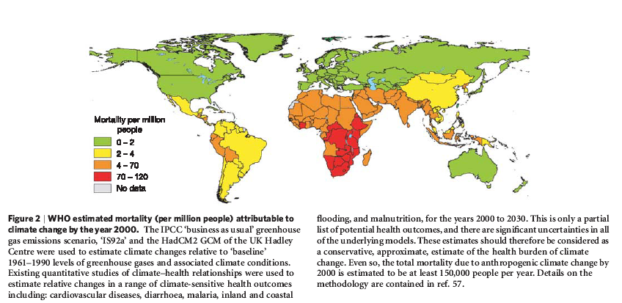
Mortality Related to Climate Change by 2000 (WHO)
Asia Region
Nature (2005; 488:310-317)
Notes:
Key message:
The above figure showed that South Asia region is also an important area that receives much adverse effect of climate change, estimated by WHO for the year 2000.
Reference: Patz, J.A., Campbell-Lendrum, D., Hollowat, T., and Foley, J.A., 2005. Impacts of regional climate change on human health. Nature 488, 310-317.

Slide 12
Health Impacts of Climate Change
McMichael et al. (2003) and WHO (2008)
Notes:
Reference: Climate change and human health - risks and responses. 2003. World Health Organization http://www.who.int/globalchange/publications/climchange.pdf
Key message:
The figure shows the factors that lead to human-induced (anthropogenic) climate change, particularly population dynamics and unsustainable economic development and consumption patterns that lead to burning of fossil fuels and deforestation, both major sources of greenhouse gas emissions. The concentration of future emissions will depend on policy choices made in the short term.
Climate change can affect health directly and indirectly. Directly, changes in temperatures, precipitation, and weather extremes can affect each of us when the weather is too hot or cold, or there is a windstorm, flood, or drought. Indirectly, these same changes in weather patterns can affect various pathways of disease transmission. For example, increasing temperatures may provide opportunities for disease vectors to change their geographic range or to survive for longer periods of time each year, thus setting the stage for increased disease transmission. Increasing temperatures can increase pathogen replication rates and/or survival in the environment, allowing for increased transmission of food- and waterborne diseases. Air quality also can be affected through increased or decreased formation of air pollutants, as well as from a longer or more intense pollen season. Changes in growing conditions for crops are projected to affect food security in many areas around the world. Reduced precipitation in the primarily dry areas of the world are projected to increase water stress in many regions. All of these changes could affect mental health.
The extent to which health impacts occur will depend on a wide range of moderating influences, particularly policy choices to address the health risks of climate change.

Slide 13
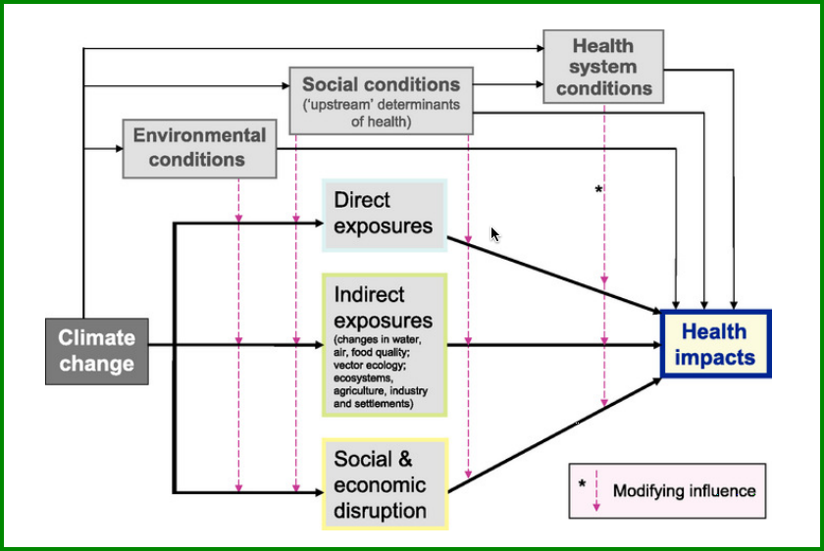
Pathways of influence of climate change on health
Notes:
Reference: IPCC 2007 www.ipcc.ch
Key message:
Schematic diagram of pathways by which climate change affects health, and concurrent direct-acting and modifying (conditioning) influences of environmental, social and health-system factors. (Source: Intergovernmental Panel on Climate Change, 2007)

Slide 14
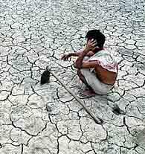
Climate Change Impacts on Health: Increase in Climate Sensitive Health Outcomes
Direct effect:
  Injuries, disability, drowning
  Heat stress
Indirect effect:
  Water and food–borne diseases
  Malnutrition
  Vector–borne diseases
  Air pollution (e.g., particulate
  matter, ozone) and allergy
  (e.g., pollen season)
  Psychological stress
Photo:
http://southasia.oneworld.net/ImageCatalog/ climate-picture.jpg
Notes:
*
Key message:
Many risk factors and illnesses that are currently among the most important contributors to the global burden of disease are sensitive to climate, notably to temperature changes.
These include malnutrition (estimated to kill 3.7 million people per year, globally), diarrhoea (1.9 million), and malaria (0.9 million). Warmer temperatures will have adverse effects on food production, water availability, and the spread of disease vectors.
Photo credit: http://southasia.oneworld.net/ImageCatalog/climate-picture.jpg

Slide 15
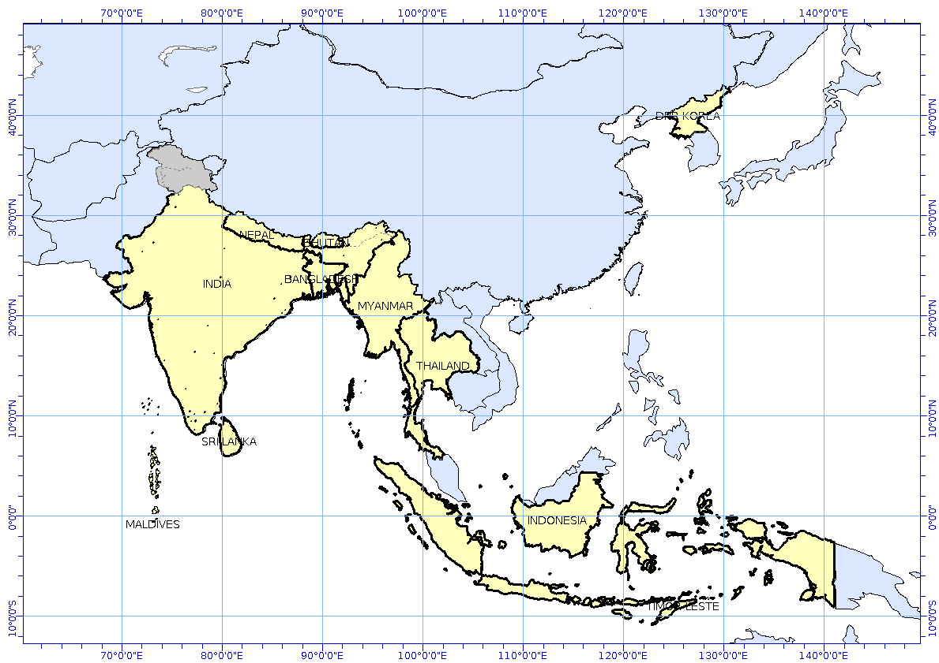
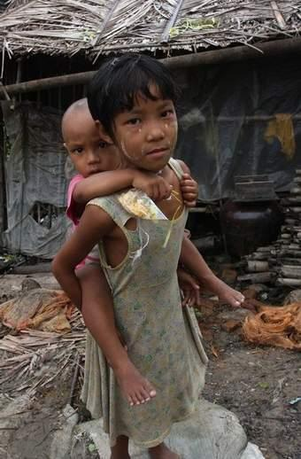
SouthEast Asia Region is Vulnerable to Climate-Sensitive Health Stressors
1996-2005: 57% of people killed globally in natural disasters were from SEAR (South East Asia Region) countries.
Indonesia: 2007, 3 flood events;
4 landslides; 2 tornadoes.
Maldives: May 2007, high tide floods
Bangladesh: November 2007: Super cyclone SIDR: 4,000 dead, millions affected.
Myanmar: May 2008, Cyclone Nargis, 135,000 perish.
Philippines: November 2013, Typhoon Haiyan, >6,000 dead.
Photo: http://cache.daylife.com/imageserve/02fAd1d1tWeAW/340x.jpg
15
Notes:
*
Key message:
The South East Asia (SEA) Region consists of eleven countries: Bangladesh, Bhutan, Democratic People’s Republic of Korea, India, Indonesia, Maldives, Myanmar, Nepal, Sri Lanka, Thailand, and Timor Leste.
More than half of the global number of deaths due to natural disasters occur in this Region. Floods and cyclones kill tens of thousands and affect millions.
In November 2007, tropical cyclone SIDR made landfall in Bangladesh, generating winds of up to 240 km/hr and torrential rains. More than 8.5 million people were affected and over 4,000 died. Nearly 4.7 million people saw their houses damaged or destroyed, most of them belonging to the poorest of the poor (Roy, 2006).
Very severe cyclonic storm Nargis was the worst natural disaster in the recorded history of Myanmar. The cyclone made landfall in the country on May 2, 2008, causing catastrophic destruction and at least 135,000 fatalities and thousands more people missing.
Typhoon Haiyan is a strongest storm recorded at Landfall that passes through the SEA region, particularly Philippines in November 2013 and causing a tremendous loss in lives and land.
Photo: http://cache.daylife.com/imageserve/02fAd1d1tWeAW/340x.jpg

Slide 16
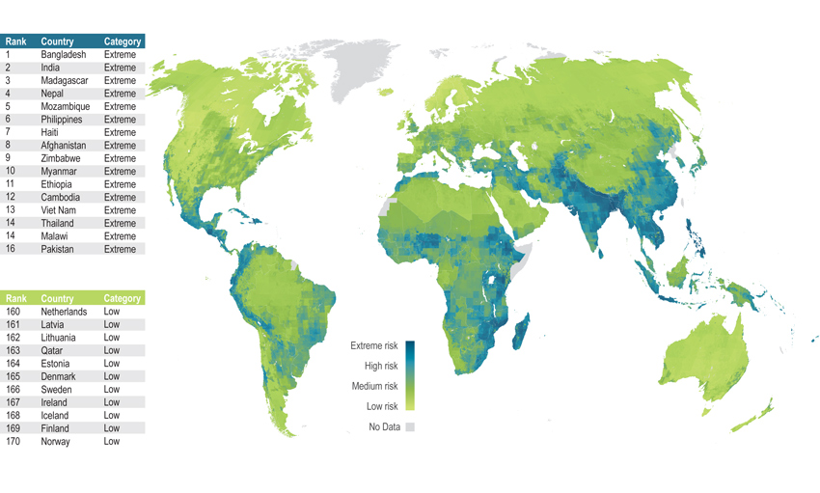
Climate Change Vulnerability Index 2011
Source: http://climatechange.thinkaboutit.eu/think4/post/why_always_the_poorests
Notes:
Ten of the 16 countries most vulnerable to climate change are in Asia; to escape the worst, move to Scandinavia, Ireland or Iceland. Source: http://climatechange.thinkaboutit.eu/think4/post/why_always_the_poorests

Slide 17
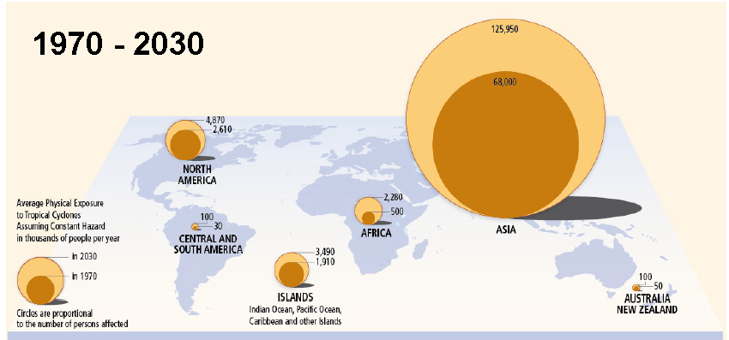
Human Exposure to Tropical Cyclones (1000’s)
Notes:
Message: While the number of people affected as significantly increased over time and is expected to increase, much of this is due to population increases in areas affected by cyclones and not all coming from an increase in the #s and intensity of cyclones alone.
Reference: http://ipcc-wg2.gov/SREX/images/uploads/SREX_Fig4-1.jpg

Slide 18
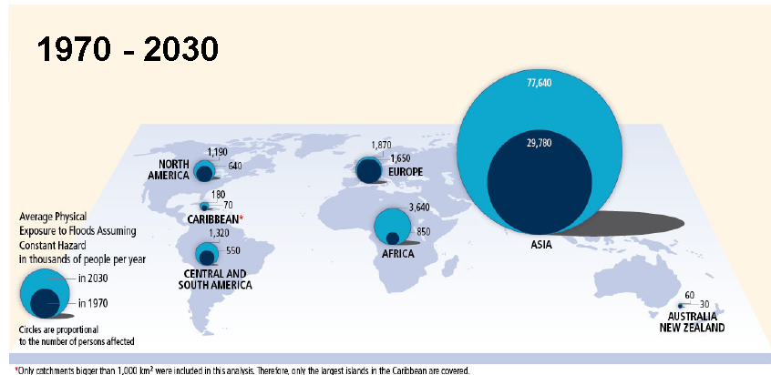
Human Exposure to Floods
Notes:
Reference: http://ipcc-wg2.gov/SREX/images/uploads/SREX_Fig4-2.jpg

Slide 19
Projected Human Impact of Sea-level Rise
2005: 3.9 million people in SEA Region exposed to flooding caused by storm surges and sea-level rise
2070s: Estimated 28 million people to be affected in SEA Region by projected 50 cm sea-level rise
Asset exposure projection: 2,100 – 4,600% increase between 2005-2070, with no adaptation measures
Flooding projections:
Ho Chi Minh City: 60-77% built up area exposed to 100 cm rise
Bangkok: 43-69% flooding in 2025-2100
Manila: 24% damage in 100-year return period flood
Notes:
Reference: World Bank.2013. Turn down the heat: climate extremes, regional impacts, and the case for resilience
Washington DC ; World Bank.

Slide 20
SEA Region is Vulnerable to Climate-Sensitive Health Stressors
Additional reason for SEA Region is population factors.
Population factors affecting the risks/impacts of extreme weather events include population size, age, health status, wealth, and type of settlement.
The most vulnerable are those who have less capacity to cope with climate change effects.
WHO (2008)
Notes:
Reference: WHO (2008)
Key message:
Population factors affecting the risks/impacts of extreme weather events include
Size: how many people does the event affect? The chance for large numbers of adverse health impacts clearly will increase with the size of the exposed population exposed.
Age: the young and old are less able to help themselves in an extreme weather event
Health status: poor health limits individuals’ response ability
Wealth: poverty can limit the types of preparation actions and responses that can be considered, it can also affect exposure (e.g., housing stock)
Wealth is an especially important social factors to address because it can affect exposure conditions and duration during and after the event (e.g., presence of floodwaters with a cyclone). In addition wealth clearly affects individual’s and communities access/ability to redirect resources to address adverse conditions.

Slide 21
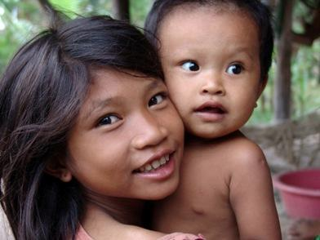
Who is vulnerable to climatic health stressors?
The most vulnerable are:
  children, women, the elderly, pregnant women
  disabled and sick people
  the poor (including slum dwellers, those in informal settlements, the landless and marginalized, and informal open air workers, but also displaced communities and individuals).
Image: http://www.caritas.org.au/images/cambodia/cam_sspr_july04_2.JPG?sfvrsn=7
21
Notes:
*
Key message:
The most vulnerable are those who have less capacity to cope: the poor, children, women, the elderly, disabled and sick people, slum dwellers, the landless and marginalized, informal open air workers, but also the displaced communities and individuals.
Low-income countries and areas where malnutrition is widespread, the level of education is poor and with weak infrastructures will have the most difficulty adapting to climate change and related health hazards. The populations considered to be at greatest risk are those living in small islands, low-lying and coastal areas, mountainous regions, water-stressed areas, in mega-cities − particularly the large urban and peri-urban agglomerations in delta regions in the SEA Region.
The most vulnerable people in the Region will be the poor because they have fewer resources to adapt to the rapid changes of the natural environment whose livelihood is dependent upon. In rural areas, women are increasingly becoming household heads and have the double burden of social reproduction and agricultural work as their husbands leave the rural areas in search of work in urban centres.
Mountain people, communities living in remote areas, slums dwellers in and around mega cities, islanders, and fisher folk will be deeply affected. But it is women, elderly groups, poor communities, children, disabled people, and ethnic minorities who have the least coping and recovering capacity and who, therefore, will be the most physically, socially, and psychologically vulnerable.

Slide 22
Who is vulnerable to climatic health stressors?
The most vulnerable people in Asia Region will be:
  The poor (fewer resources to adapt to the rapid environmental changes)
  In rural areas, women are increasingly becoming household heads and have the double burden of social reproduction and agricultural work
  Pregnant women are especially vulnerable
  People living in substandard housing or water systems will experience greater risks to life and health with severe weather events
    Informal settlements: 79% of population in Cambodia, 44% of population in Philippines and 41% of population in Vietnam
Notes:
Key message:
Here are some generalities about vulnerability that are instructive, but are too generalized to be useful for a vulnerability assessment, except perhaps a very coarse large-scale rapid assessment.
But: Be careful with generalities, as exceptions are always present in our disciplines.

Slide 23
Generalizations about Climate Change Vulnerability of Human Populations
Vulnerability will be greater in highly dense populations
Vulnerability will be greatest in areas of low resources for health care
Vulnerability will be greatest in areas of low resources for disaster and emergency response
Vulnerability will be greatest in areas of over allocated, polluted, and inadequate water supplies
Vulnerability will be greatest in areas of substandard housing and sanitation
Vulnerability will be greatest in areas of low diversity of agricultural cropping systems
Vulnerability will be greatest in areas of high proportion of women and children in the population
Greater vulnerability for populations with serious existing problems
Notes:
Key message:
Here are some generalities about vulnerability that are instructive, but are too generalized to be useful for a vulnerability assessment, except perhaps a very coarse large-scale rapid assessment.
But: Beware of generalities, as exceptions are always present in our disciplines.

Slide 24
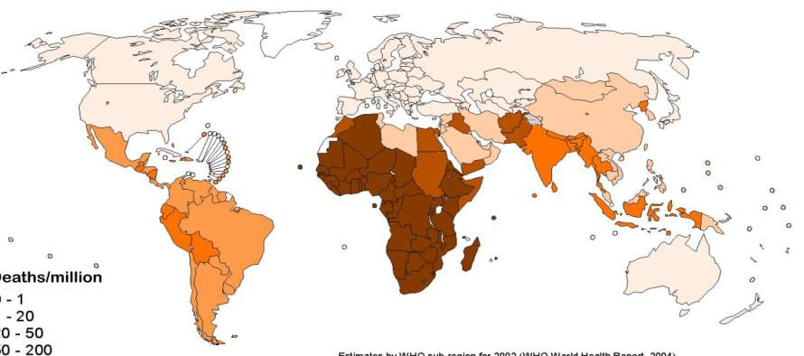
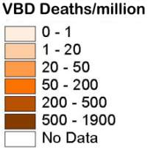
Vector Borne Diseases
Majority of Vector-borne Disease (VBD) burden borne by developing countries (including SEA Region)
WHO (2008)
24
Notes:
*
Key message:
The burden of communicable diseases is still high. Dengue continues to pose a major and increasing public health problem. Chikungunya fever (anthropod-borne virus from mosquitoes) is re-emerging and outbreaks of Nipah virus infections are being reported. Drug-resistant malaria has spreaded.
Reference: WHO 2008 http://www.who.int/heli/risks/vectors/malariacontrol/en/

Slide 25
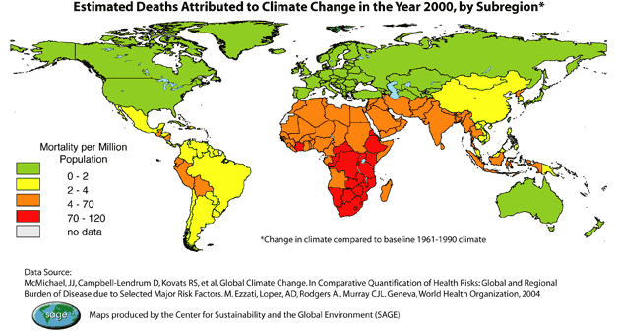
Estimated Deaths Due to Climate Change
Notes:
Reference: http://ecojustice.wordpress.com/2008/04/29/children-poverty-and-climate-change/
Key message:
A recently released UNICEF UK report titled,Our Climate, Our Children, Our Responsibility: The Implications of Climate Change for the World’s Children recognizes the same reality that our two most recent resources have. Reading, “For the vast majority of people the impact of climate change means an increased risk of losing their homes and livelihoods, more disease, less security and sometimes death. Children in the world’s poorest communities are the most vulnerable. They are already seeing the impacts of climate change through malnutrition, disease, poverty, inequality and increasing risk of conflict – and ultimately an increase in child mortality rates”, the report puts into focus the reality that those bearing the least responsibility for the changing climate are those feeling the greatest impact.

Slide 26
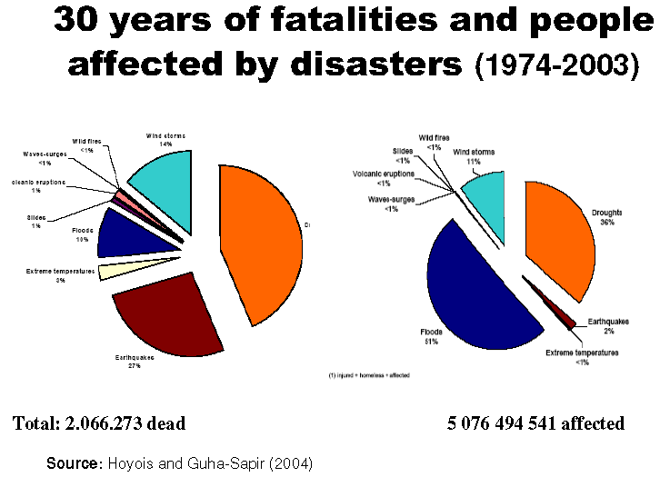
Historical Fatalities Due to Disasters
Notes:
Reference: Guha-Sapir, Debarati, Hargitt, D., & Hoyois, P. (2004). Thirty years of natural disasters 1974-2003 : the numbers. Louvain-la-Neuve: Presses Universitaires de Louvain.

Slide 27
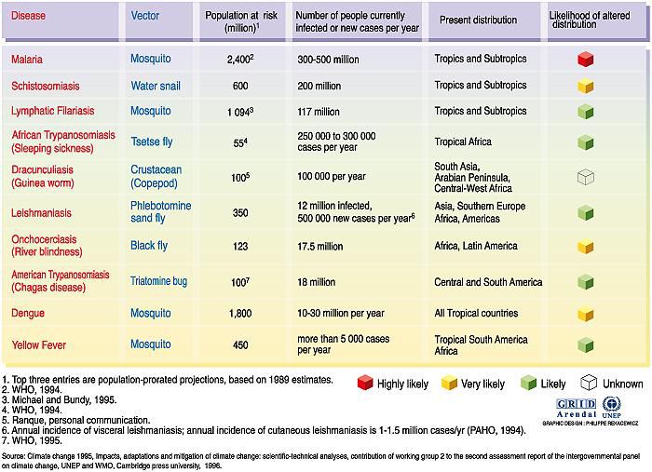
Diseases That Climate Change Might Affect
Notes:
Reference: GRID Arendal. UNEP
Climate Change 1995. Impacts, adaptations and mitigation of climate change: scientific-technical analyses, contribution of working group 2 to the second assessment report of the IPCC. 1996

Slide 28
Direction and Magnitude of Change of Selected Health Impacts of Climate Change
Negative Impact | Positive Impact
Very High Confidence Malaria: Contraction and expansion, changes in transmission season High Confidence Increase in malnutrition Increase in the number of people suffering from deaths, disease and injuries from extreme weather events Increase in the frequency of cardio-respiratory diseases from changes in air quality Change in the range of infectious disease vectors Reduction of cold-related deaths Medium Confidence Increase in the burden of diarrheal diseases
28
Source: WHO (2008)
Notes:
Reference: Change, I. (2013). IPCC Fourth Assessment Report, Working Group II: Chapter 8. Retrieved from http://www.eoearth.org/view/article/153697
Key message:
The figure summarizes the conclusions of the IPCC Human Health chapter (IPCC, 2007a). The arrows are qualitative, not quantitative, and are relative to each other. Note that the confidence bands have to do with the quality and quantity of the literature. There was medium confidence that diarrheal diseases would increase because there are few studies. However, experience on the ground suggests a higher confidence that diarrheal diseases could increase with increased water stress and increased number of flooding events in some areas.
It is a summary, indicative only, not comprehensive and very much semi-quantitative. There are a number of points from this diagram, I would like to highlight:
There will be some positive outcomes (for example, in parts of the world it will become too hot and dry for transmission of malaria to be sustained), but overwhelmingly, the balance of health effects is on the negative side;
The largest effect, globally, is projected to be from malnutrition. There are indications that it will take approximately 35 additional years to reach the World Food Summit 2002 target of reducing world hunger by half by 2015 (Rosegrant and Cline, 2003; UN Millennium Project, 2005). Child malnutrition is projected to persist in regions of low-income countries, although the total global burden is expected to decline without considering the impact of climate change. Attribution of current and future climate-change-related malnutrition burdens is problematic because the determinants of malnutrition are complex. Due to the very large number of people that may be affected, malnutrition linked to extreme climatic events may be one of the most important consequences of climate change.
For example, climate change is projected to increase the percentage of the Malian population at risk of hunger from 34% to between 64% and 72% by the 2050s, although this could be substantially reduced by the effective implementation of a range of adaptive strategies (Butt and McCarl, 2005). Climate-change models project that those likely to be adversely affected are the regions already most vulnerable to food insecurity, notably Africa, which may lose substantial agricultural land. Overall, climate change is projected to increase the number of people at risk of hunger (FAO, 2008a).
Of course, as illustrated in the earlier presentation there will be some winners and losers, in particular in the first half of this century.

Slide 29
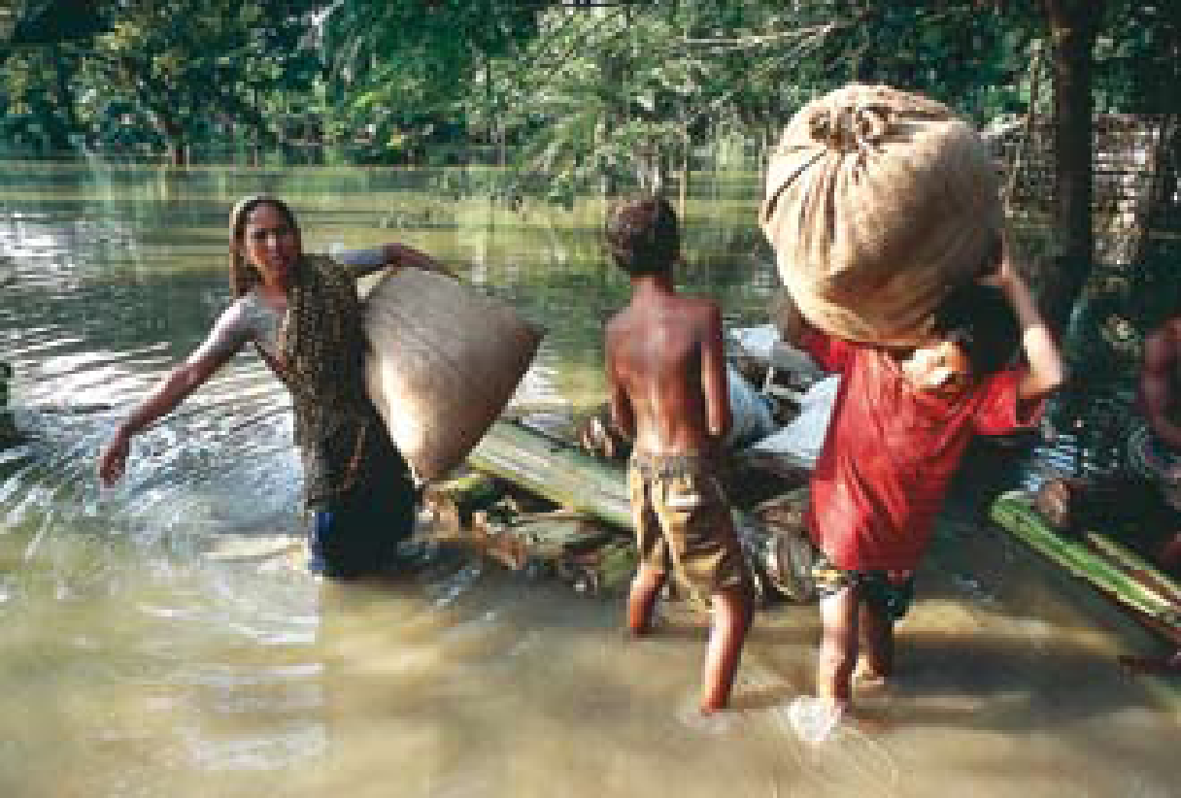
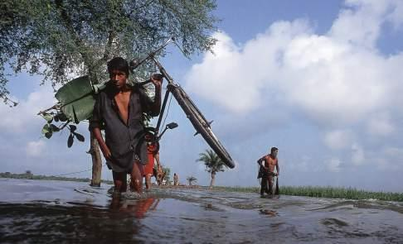
More Injuries, Disabilities, and Drowning from Extreme Weather Events
Photo: ©Abir Abdullah/Still Pictures
Photo: ©Abir Abdullah/Still Pictures
More extreme South East Asian weather
(e.g., Typhoon Haiyan (Philippines), Cyclone Nargis (Myanmar)
29
Notes:
*
“The increase in frequency and intensity of extreme weather events will translate into loss of life, injuries and disability”
(IPCC, 2007a)
Photo credits: ©Abir Abdullah/Still Pictures

Slide 30
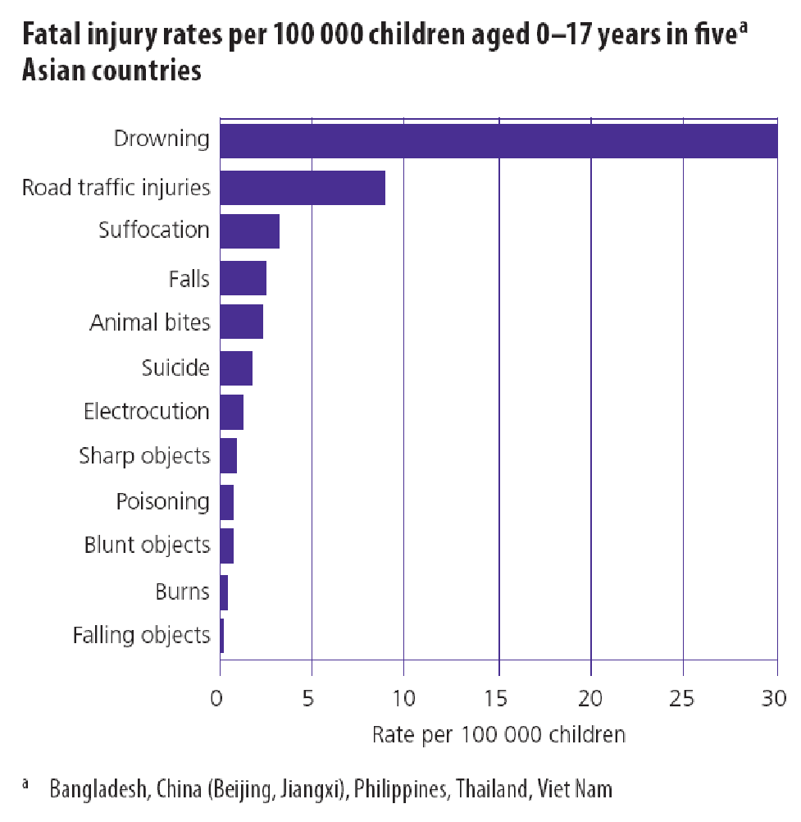
Drowning: Leading Cause of Child Death in Many Asian Countries
More than 175,000 children and teenagers die from drowning each year.
Children under the age of 5 years are most at risk.
Most child drowning events happen in and around the home.
World Health Organization, 2008c
30
Notes:
*
Reference: Peden, M M. World Report on Child Injury Prevention. Geneva, Switzerland: World Health Organization, 2008. Print. Figure 3.2.
Key message:
Changes in the frequency of extreme weather events such as heatwaves, cold spells, hurricanes, cyclones, floods, and storms would result in injuries and deaths. The devastating impact of the 2007 floods in Nepal, Bangladesh, and India and the super-cyclone SIDR in Bangladesh killed over 4,000 people and made millions homeless.
After the 2004 tsunami, relief agencies reported that one-third of the dead appeared to be children. This is the result of the high proportion of children in the populations of many of the affected regions and because children were the least able to resist being overcome by the surging waters.
The data on drowning shown above does not make the distinction between types of causal events. Drowning can also be the result of impacts that are behavioral or cultural in nature. Climate change could increase the number of drowning related to extreme weather.

Slide 31
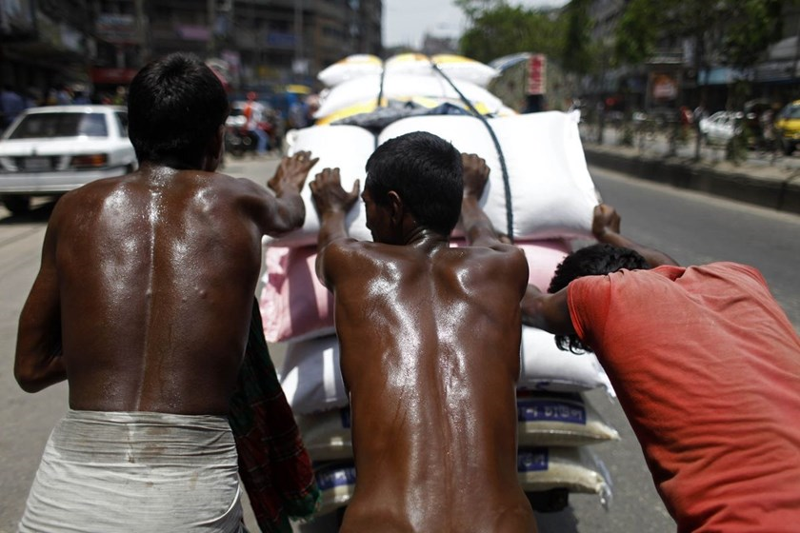
Heat-related Morbidity / Mortality
Heat-related Illnesses
Heat Rash
Heat Cramps
Heat Exhaustion
Heat Stroke
Dehydration and exacerbation
of chronic illness
Photo: ABC News
Notes:
Key message:
A considerable body of work on climate change and human health has focused on direct impacts on heat-related morbidity and mortality. Both increased average temperatures and increasingly frequent and severe extreme heat events produce increased risks of heat-related illness and death. This slide lists health outcomes of prolonged heat exposure, which range from milder issues like heat rash and cramps to severe outcomes like heat stroke, which is a severe form of hyperthermia where the body is unable to regulate its temperature. Essentially, the sweating mechanism fails, and the body is unable to cool down and can ultimately lead to death.
However, we also know that a significant portion of heat-related morbidity and mortality is not officially recognized as being linked to hyperthermia as cause of disease.
Heat Rash = skin irritation caused by excessive sweating during hot, humid weather; most common in young children.
Heat Cramps = affect people who sweat heavily during strenuous activity depleting the body's salt and fluids.
Heat Exhaustion = milder form of heat-related illness that can develop after several days of exposure to high temperatures. Characterized by paleness, fatigue, muscle cramps, dizziness, headache, nausea or vomiting, and fainting. The skin is typically cool and moist.
Heat Stroke = severe form of hyperthermia where the body is unable to regulate its temperature. The sweating mechanism fails, and the body is unable to cool down. Characterized by red, hot, and dry skin (no sweating); rapid, strong pulse; throbbing headache; dizziness; nausea; confusion; and unconsciousness.
CREDIT: Caroline H. Dilworth, Ph.D.
Health Scientist Administrator
National Institute of Environmental Health Sciences
Photo: Than Nian News: https://www.google.com/search?q=extreme+heat+Bangladesh&hl=en&gl=us&authuser=0&tbm=isch&source=lnms&sa=X&ved=0ahUKEwi_sLKticvQAhWFwrwKHfqVBJ4Q_AUICSgC&biw=1821&bih=799&dpr=1#imgrc=IKFMbSD69oS7sM%3A

Slide 32
Extreme Heat Events and Mortality
Risk factors for hyperthermia (over-heating)
  Age
  Underlying medical conditions / mental illness
  Income and poverty status
  Social isolation
  Access to health care and cooling facilities
  Neighborhood characteristics: land use/ land cover, crime rate, housing type, urban heat islands
  Substandard housing and water systems
Average of 688 reported heat-related death per year in US and overall impact likely underestimated
Every death is preventable!
What have been the incidence of hyperthermia in Bangladesh and India?
(Next Slide…)
Notes:
Key message:
In the United States, an average of 688 persons succumb to heat-related death per year. For a significant portion of these deaths, hyperthermia would not be considered the primary underlying cause. Rather, prolonged exposure to heat may also result in additional illness and death by exacerbating preexisting chronic conditions such as various respiratory, cerebral, and cardiovascular diseases as well as increasing risk for patients taking psychotropic drug treatment for mental disorders, due to the body’s impaired ability to regulate temperature. Figures for these illnesses and deaths may be dramatically underestimated as disparities in health care make morbidity measurements difficult and heat is rarely identified as an official cause of death. Also of note, varying age groups have been shown to be sensitive to all-cause mortality under excessive heat stress, including adults over 65, children, and infants under 1 year of age.
While climate change is likely to increase the burden of heat-related illness and death in the United States, many of these outcomes are preventable. With aggressive public health actions and widespread physiologic and behavioral adaptations such as robust heat early warning systems and other health communications, increased air conditioning use, decreased time spent outdoors, and increased wearing of sun-shielding clothing it will be possible to reduce overall rates of illness and death.
CREDIT: Caroline H. Dilworth, Ph.D.
Health Scientist Administrator
National Institute of Environmental Health Sciences

Slide 33
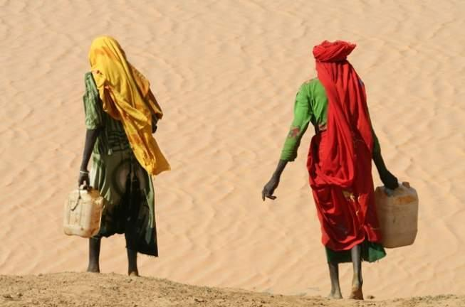
More Heat Waves and Heat Strokes
2003 Andhra Pradesh, India heat wave, with temperatures of up to 54ºC, resulted in death to 3,000 people.
The number of heat strokes was not recorded.
Refugee Study Centre (RSC), http://www.rsc.ox.ac.uk
Photo: © T. Balabaadkan UNEP / Still Pictures
33
Notes:
*
Recent analyses show that human-induced climate change significantly amplified the likelihood of heat waves, increasing the possibility of heat strokes, cardiovascular, and respiratory disorders (McMichael et al., 2004).
Key message:
Eighteen heatwaves were reported in India between 1980 and 1998. A heatwave in 1988 caused 1,300 deaths (De et al., 2004), while another one in 2003 caused more than 3,000 deaths (Government of Andhra Pradesh, 2004).
Higher temperatures are expected to increase the occurrence of heat-related illnesses such as heat exhaustion and heat stroke, and exacerbate existing conditions related to circulatory, respiratory, and nervous-system problems. An increase in heat waves, particularly in urban areas, could significantly increase deaths. Higher overnight temperatures during heat waves are also a concern for human health, as cooler temperatures at night offer much-needed relief from the heat of the day.
Heatwaves in South East Asia cause high mortality in rural populations, and among the elderly and outdoor workers (Chaudhury et al., 2000). Examples are the reported cases of heatstroke in metal workers and in rickshaw pullers in Bangladesh (e.g., Ahasan et al., 1999).
Photo credit: Refugee Study Centre (RSC), http://www.rsc.ox.ac.uk/

Slide 34
Identifying Thermal Extremes with Meteorology and Health Impacts
Scatter plot of daily maximum temperature and total mortality to help identify possible summertime threshold temperatures for extreme heat in Shanghai, China based on the mortality impact.
(L. Kalkstein, personal communication, 2002)
Source: WHO (2008)
Notes:
Reference:
Key message:
This example shows how a scatter plot of total daily deaths versus daily maximum temperature could be used to identify a city-specific threshold summertime temperature that would be used to define extreme heat conditions.
Here the observed sharp increase in daily mortality totals suggests a threshold of roughly 35°C might be an initial value to consider in setting an extreme heat threshold for Shanghai.

Slide 35
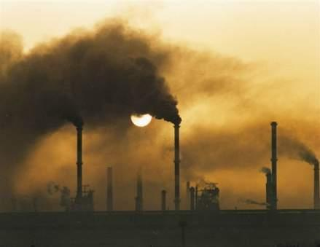
More Respiratory Infections
Air pollution
  Meeting increasing energy demands by greater use of fossil fuels will increase in particulate matter and air pollutants (e.g., ground ozone) => respiratory and cardiovascular diseases
  Increasing allergens (pollen and mold) due to the effect of climate change => allergy
Asian brown cloud (India): Air particulates and pollutants and prolonging period of dry season (late raining)
Photo: © Deb Kushal -UNEP / Still Pictures
35
Notes:
*
Meeting increasing energy demands by greater use of fossil fuels will add to the number of respiratory disorders, such as asthma.
(Cifuentes et al., 2001)
Photo credit: © Deb Kushal -UNEP / Still Pictures
The Asian brown cloud is a layer of air pollution covering parts of South Asia (including India and Pakistan, as a cause of particulate matters and air pollutants from biomass burning and combustion and possible associate with change in rainfall pattern of the region.

Slide 36
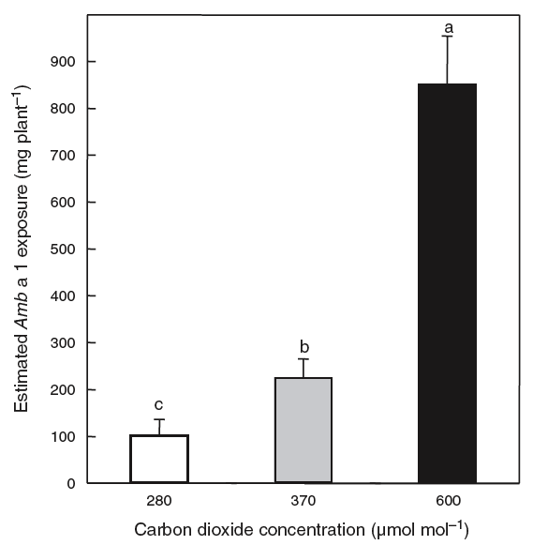
More Respiratory Infections (example)
Ragweed allergen production increases with increasing CO₂ concentration (Ragweed is a common source of respiratory allergies)
Singer et al. (2005)
Notes:
Reference: Singer BD, Ziska LH, Frenz DA, Gebhard DE, Straka JG (2005) Increasing Amb a 1 content in common ragweed (Ambrosia artemisiifolia) pollen as a function of rising atmospheric CO₂ concentration. Functional Plant Biology32, 667–670. Accessible from: http://dx.doi.org/10.1071/FP05039
Example: Common ragweed plants were grown under three different CO2 concentrations, 280 (pre-industrial), 370 (recent), and 600 (possible before 2100). The amount of allergenic protein produced by the plants increased with an increase of CO2 concentration, due to a role of CO2 as a plant fertilizer.
Unit in the figure, Amb a 1 protein is related to the total pollen production.

Slide 37
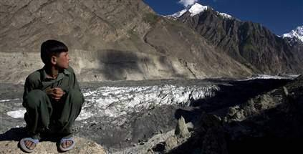
Rapid Glacier Melting = Less Freshwater
http://msnbcmedia3.msn.com
37
Notes:
*
Key message:
The Himalayas have the largest concentration of glaciers outside the polar region.
These glaciers are a freshwater reserve; they provide the headwaters for nine major river systems in Asia – a lifeline for almost one-third of humanity. So rapid glacier melting leads to less freshwater available (both quantity and quality).
Photo credit: http://msnbcmedia3.msn.com

Slide 38
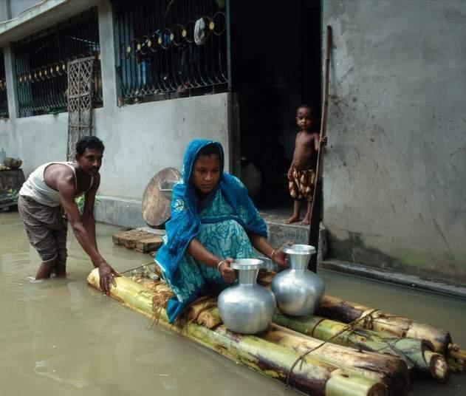
More Water-borne Diseases
In 2005, diarrheal diseases accounted for 20.1% of deaths in children less than five years
Photo credit: © Shehzad Noorani/Still Pictures
38
Notes:
*
Key message:
More variable precipitation patterns, together with warmer temperatures, are likely to compromise the supply of freshwater, increasing the risks of water-borne diseases like cholera and outbreaks of diarrhoeal diseases (Rodó et al., 2002).
Floods cause sewage and drinking water systems to mix. The lack of proper sanitation would make the problem worse.
In 2004, the sanitation coverage in the rural areas of the South East Asia Region was only of 57%, posing this as a major threat to water sources in terms of pollution with human faeces. (Meeting the Millenium Development Goal drinking water and sanitation target: the urban and rural challenge of the decade, WHO and UNICEF, 2006).
Photo credit: © Shehzad Noorani/Still Pictures

Slide 39
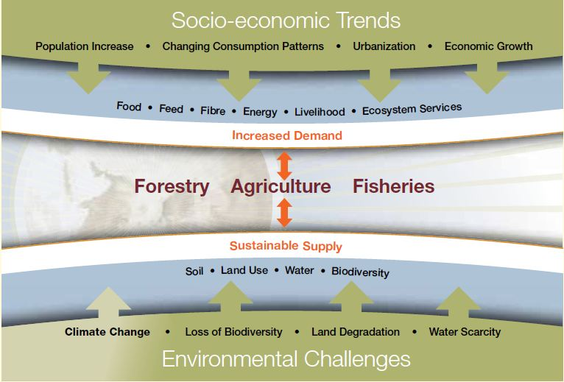
Food Security
Source: FAO
Notes:
Key message:
Climate change may be associated with staple food shortages, malnutrition, and food contamination (of seafood from chemical contaminants, biotoxins, and pathogenic microbes, and of crops by pesticides). Climate change affects all dimensions of food security.
Agriculture production is vulnerable to the effects of climate change. While the magnitude of effects remains uncertain, changes in temperature and water availability, weather extremes and flooding, and changing CO2 levels in the atmosphere all have direct and significant impacts on agricultural productivity and result in shifting crop production patterns across agro-ecological zones. (Source: FAO, Agriculture and Climate Change Mitigation and Adaptation)
The hardest hit will be rain-fed agriculture,­ which covers 96 percent of all cultivated land in sub-Saharan Africa, 87 percent in South America and 61 percent in Asia. Where stability of production cannot be assured, people will be forced to migrate.
CREDIT: Caroline H. Dilworth, Ph.D.
Health Scientist Administrator
National Institute of Environmental Health Sciences

Slide 40
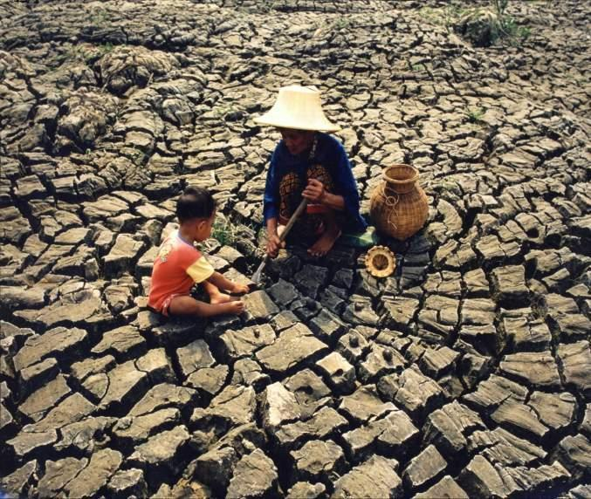
Scarcity of Food = Malnutrition
Crop yields could decrease up to 30% in Central and South Asia by the mid-21st century.
Population growth and urbanization will magnify the malnourished and the risk of hunger.
Photo credit: © Shehzad Noorani / Still Pictures
40
Notes:
*
Key message:
According to IPCC, crop yields could decrease up to 30% in Central and South Asia by the mid-21st century. The rapid population growth and urbanization in the region will magnify the number of malnourished and the risk of hunger for most SEAR countries.
In Bangladesh, production of rice and wheat might drop by 8% and 32%, respectively, by the year 2050 (Faisal and Parveen, 2004).
Recent studies suggest a 2 to 5% decrease in yield potential of wheat and maize for a temperature rise of 0.5 to 1.5°C in India (Aggarwal, 2003).
The net cereal production in South Asian countries is projected to decline at least between 4 to 10% by the end of this century under the most conservative climate change scenario.
Some studies agree that higher temperatures and longer growing seasons could result in increased pest populations in temperate regions of Asia (Roy, 2006).
Given that 60% of the cropped area is still dependent on rainfall (MoEF, 2002), Indian agriculture continues to be fundamentally dependent on rainfall.
Photo credit: © Shehzad Noorani / Still Pictures

Slide 41
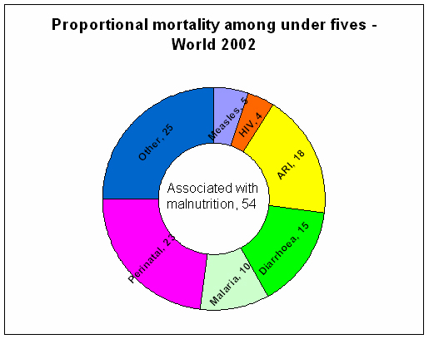
Malnutrition: First Cause of Child Mortality
Proportional mortality among children under five years of age −
World 2002
http://www.goldenrice.org/Content3-Why/why.php
Notes:
*
Reference: http://www.goldenrice.org/Content3-Why/why.php
Key message:
Fifty-four percent of deaths among pre-school children in the developing world are due to the underlying effects of malnutrition on disease (Pelletier et al., 1995).
Rising temperatures and variable precipitation are likely to decrease the production of staple foods in many of the poorest regions, increasing risks of malnutrition (Parry et al., 2004).

Slide 42

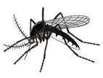




Vector-borne Disease Dynamics
Susceptible Populations
Migration (forced)
Vector environment
Vector
Pathogen
Survival, lifespan
Reproduction/breeding patterns
Biting behavior
Survival
Transmission
Replication in host
WHO (2008)
Notes:
Reference: WHO (2008)
Key message:
There are 3 crucial elements which must co-exist for the occurrence of VBD: the susceptible population, the vector (most often arthropods), and the disease pathogen (e.g., bacteria, virus, parasite). In areas where VBD most frequently occurs, conditions must be suitable for vectors and pathogens, which implies physiologically suitable conditions for vector, host, and pathogen survival and reproduction/replication.
There are a number of areas in the world where conditions may be suitable for all three components; however, other factors have acted to prevent or eradicate disease transmission in these areas, perhaps as a result of improved health care services or vector control measures.
Global climate change is likely to affect all 3 of these components both directly and indirectly. As an example of direct effects: Arthropods are highly sensitive to changes in temperature and precipitation as they cannot regulate their own internal temperatures and are therefore critically dependent on climate for survival and development (Githeko et al., 2000). Changes in climate may accelerate the development time of some arthropod species, for example.
Similarly, many pathogens are climate sensitive as well, and changes in climate could result in increased reproduction rates of some pathogens.
Some example of indirect effects might include: Changes in livelihood conditions due to climate change, which could affect nutritional status of individuals, thereby potentially increasing susceptibility to disease.
The next few slides will cover indirect and direct effects of climate change on human health in more detail.

Slide 43
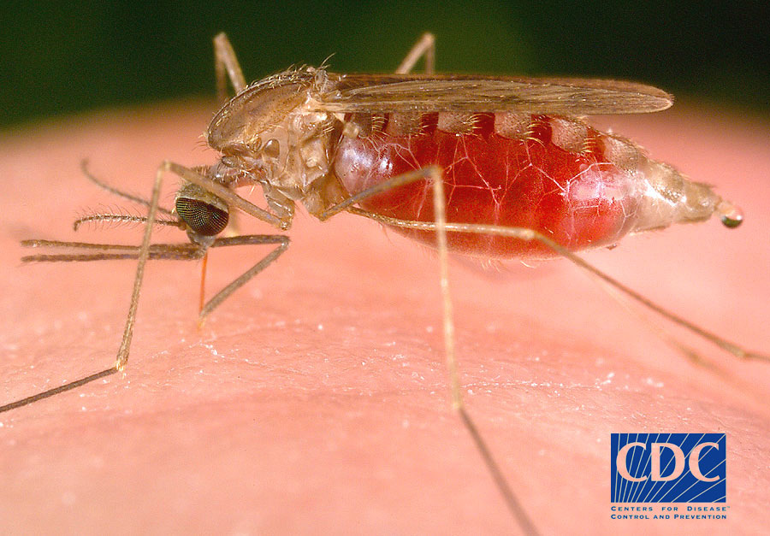
Spread of Vector-borne Diseases
Combined with altered rainfall patterns, hotter conditions may increase the spread of disease, such as malaria, dengue, and chikungunya, to new areas
Warmer temperatures and disturbed rain patterns could alter the distribution of important disease vectors
Aedes aegypti
Notes:
*
Reference: Center for Disease Control
Key message:
Malaria plasmodia are transmitted to humans via the bite of anopheline mosquitoes. In the mosquito, plasmodia go through a complicated life cycle involving a number of differentiation stages. P. vivax and P. malariae require environmental temperatures of at least 15°C for their development within the anopheline mosquito.
P. falciparum requires temperatures of at least 17 or 18°C for its development to take place (Macdonald, 1957).
With gradual increases in global temperatures since the last ice age (+8.0 -9.5°C), transmission has migrated from Africa to southern Europe.
Specific experiments have been conducted on the effect of temperature on the ability of Aedes aegypti to transmit DEN -2 virus. These experiments showed that the DEN-2 virus was transmitted by A. aegypti only if the mosquitoes were kept at 30°C. The required extrinsic incubation period was shortened if the temperature was increased to degrees Celsius and 35°C (Watts et al., 1987). This pattern of temperature and vector efficiency parallels the climatic pattern of DHF outbreaks in Bangkok, Thailand, where case rates rise during the hot season (with daily mean temperatures of 28-30°C) and decrease during the cool season (with daily mean temperatures of 25-28°C).
Reference: Photo source: Mike Nathan, WHO, 2009

Slide 44
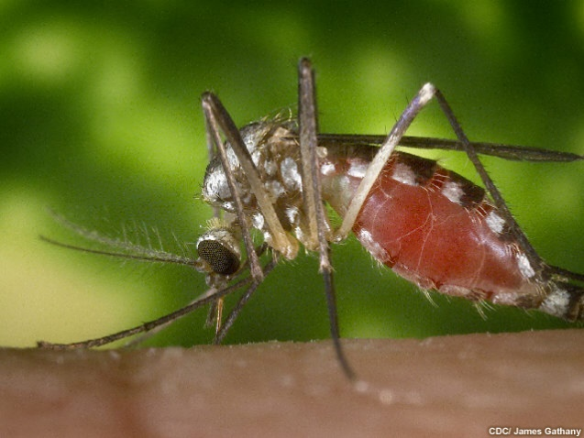
Climate Change and Mosquito-Borne Disease
[Climate change will] “Tend to increase in range and incidence [of mosquito borne diseases]… actual occurrence strongly influenced by local conditions.” (IPCC)
Notes:
Source: IPCC –AR3

Slide 45
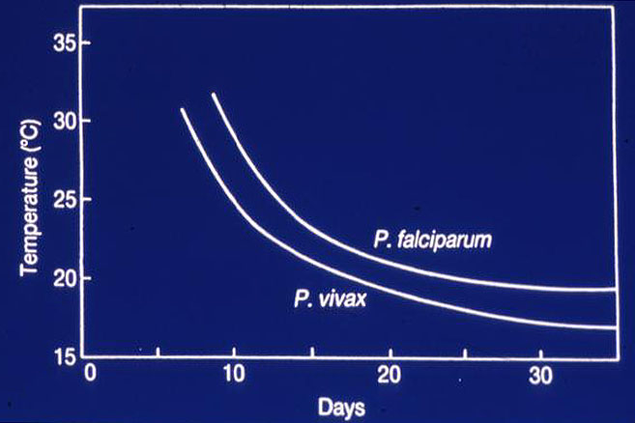
Relationship between temperature and malaria parasite development time inside mosquito (“extrinsic incubation period” or EIP). EIP shortens at higher temps, so mosquitoes are infectious sooner.
Notes:
Reference: http://www.pnas.org/content/103/15/5635/F1.expansion.html
Malaria risk and temperature: Influences from global climate change and local land use practices
relationship between temperature and malaria parasite development time inside the mosquito (“extrinsic incubation period” or EIP). EIP shortens at higher temperatures, so mosquitoes become infectious sooner. Note the nonlinear response to temperature, as well as relative threshold limits for malaria parasite development (≈18°C and 15°C for P. falciparum, and P. vivax, respectively)
Effectively, this means that the lifecycle of the mosquito is shortened with increased temperature resulting in faster growing mosquito populations.

Slide 46
Incubation period
Biting frequency
Survival probability
50
1
40
0.3
0.8
30
0.2
0.6
(days)
(per day)
(per day)
20
0.4
0.1
0.2
10
0
0
0
15
20
25
30
35
40
10
15
20
25
30
35
40
10
15
20
25
30
35
40
Temp (°C)
Temp (°C)
Temp (°C)
TRANSMISSION POTENTIAL
1
P.vivax
0.8
P.falciparum
0.6
0.4
0.2
0
14
17
20
23
26
29
32
35
38
41
Temperature (°C)
Notes:
Reference: IPCC

Slide 47
Example of Adaptation (Intervention) for Malaria
Mode
Mode
of
intervention
intervention
Stage of
Stage of
intervention
intervention
Social
Social
Social
Social
Social
Biological
Social
Biological
Biological
Biological
Behavioral
Behavioral
Behavioral
Behavioral
Surveillance
Surveillance
Adaptive
Surveillance
Adaptive
Adaptive
Adaptive
Use
Use
Use
Use
of
of
of
of
Hlth
Hlth
systems
Health
systems
immunity
bednets
systems
immunity
bednets
bednets
bednets
Other institutions
Primary
Primary
Primary
Primary
Tertiary
Tertiary
Tertiary
Tertiary
Vaccination
Vaccination
Vaccination
Vaccination,
Early
Early
Early
Community
Early
Community
treatment
treatment
treatment
Dams
treatment
Dams
Dams
or group
Global
Dams
or group
Individual
Individual
National
National
National
National
Secondary
Secondary
Secondary
Secondary
Early
Early
Early
Early
warning
warning
warning
warning
Level of
Level of
intervention
WHO (2008)
intervention
Based on McMichael and Kovats, 2000
Notes:
47
Reference: WHO (2008)
Key message:
One categorization of adaptation measures is into the mode of intervention (i.e., biological, behavioral, or social), the level of intervention (i.e., individual, community, national, or global), and the stage of intervention (primary, secondary, or tertiary). There are advantages for all categorization schemes; the one that works best in a particular situation will depend on the needs of the stakeholders.

Slide 48
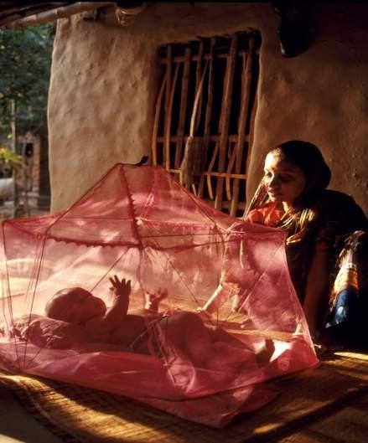
Dengue Fever
In 2005, the estimated population at risk from dengue fever in the South East Asia Region was 1.3 billion.
This is 52% of the global estimated 2.5 billion at risk.
Photo credit: © Shehzad Noorani /Majority World / Still Picture
Notes:
*
Key message:
Changes in climate are likely to lengthen the transmission season of important vector-borne diseases like dengue and malaria and to alter their geographic range, potentially reaching regions that lack either population immunity and/or a strong public health infrastructure (Bhattacharya et al., 2006; Hales et al., 2002).
Photo credit: © Shehzad Noorani /Majority World / Still Picture

Slide 49
Adaptation for Health Sector
Further develop emergency medical services.
Further develop disaster response capacity.
Improve climate-sensitive diseases surveillance and controls.
Improve safe water supply and sanitation.
Improve health services.
Expand and ensure safe water supplies and improved sanitation.
Educate citizens on the risks and responses to climate-related health issues.
Address poverty, education, and gender inequalities.
49
Notes:
*
These are generalized. Specific problems require context-specific measures.

Slide 50
TAKE HOME MESSAGES
The SEA Region has a large population that is currently vulnerable to a number of climate sensitive health stressors.
These stressors are already having a significant adverse health impacts in the Region.
Climate change is likely to increase the risks linked to these stressors, and introduce new sources of risk.
Without adaptation and mitigation, climate change could result in dramatically increased health burdens in the Region.
Much can be done now to adapt and prepare that will improve the health of millions.
50
Notes:
*
Recommended reading: IPCC 2007 report Working Group II, Summary pages 59 to 63

Slide 51
Discussion Questions
Where is the most vulnerable area in your country that affected by climate change/natural disaters?
Who are the most vulnerable in your communities/country?
In your communities, what illnesses/diseases that always occurred/happened caused by climate change (flood, drought, storms, and so on)?
51
Notes:
*

Slide 52
Discussion Questions
Four fundamental questions should be carefully considered in designing adaptation strategies:
What are we adapting to?
Who adapts? / Who is vulnerable?
How do we adapt? and
What do we want to achieve?
52
Notes:
*
WHO (2008)
Some questions need to be considered in designing adaptation plan.
Adaptation to what – is adaptation required to flooding, the spread of vector-borne disease, etc.? The policies and measures implemented must be specific to both the weather/climate hazard, the health outcome of concern, and the local context.
Who will undertake the adaptations – individuals, communities, nations? Will the adaptation be reactive to climate change or proactive? How can the process be facilitated? Using projections of changes in climate and socioeconomic conditions, what are the likely impacts? Which population groups are likely to be at the highest risk? For example, aging of populations in developed countries is likely to increase population vulnerability to heat events.
When should the interventions be implemented? For example, there is concern about malaria spreading to highland areas of Africa. Surveillance systems should be established at the edges of the current distribution where changes in temperature and/or precipitation could provide a suitable climate for malaria vectors. Once surveillance has identified the presence of the vectors, then programs to distribute treated bednets could be implemented.
Beginning the process of adaptation will require an understanding of what is currently being done to reduce the burden of climate-sensitive health outcomes, as well as how effective those activities are in addressing climate variability and other factors. Discussions with experts involved with these activities and/or independent evaluations will provide insights into what else could be done now to reduce current vulnerability and the barriers to implementing these activities. Qualitative or quantitative consideration of likely future climate change can identify additional measures to increase the ability of the institutions, agencies, communities, and individuals to increase the range of possible future interventions, such as increasing the geographic extent of integrated vector management programs in anticipation of disease vectors changing their range.
Finally, the effectiveness of all interventions should be monitored and evaluated to ensure that public health funds are being used effectively and efficiently.

Slide 53
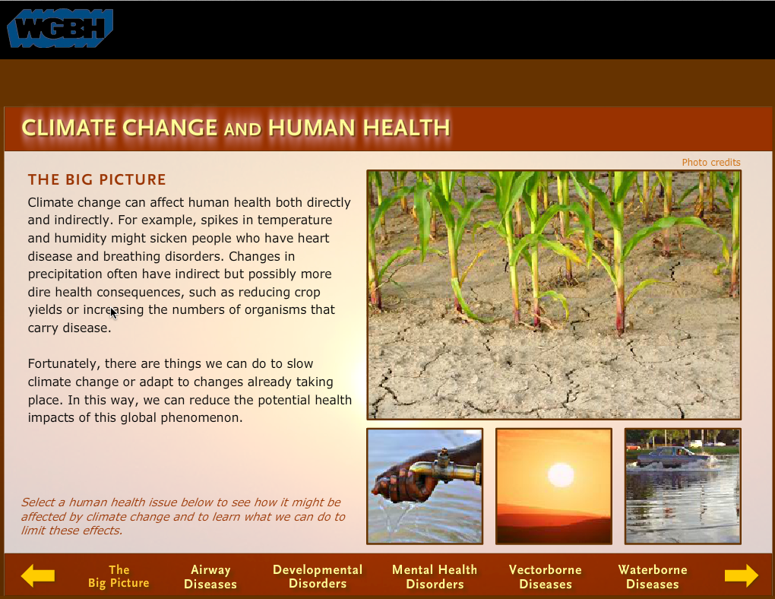
Exercise: Video and Discussion
http://www.pbslearningmedia.org/resource/envh10.sci.life.eco.cchealth/climate-change-and-human-health/
Notes:
Reference: PBS Learning Media pbslearningmedia.org
Discussion Questions
What are some health conditions that are affected by a person's environment?
Describe how climate change might affect one of the health issues featured in the interactive activity.
Can you think of any other health conditions that might be affected by climate change?
What are some ways to reduce health risks for each of these conditions?

Slide 54
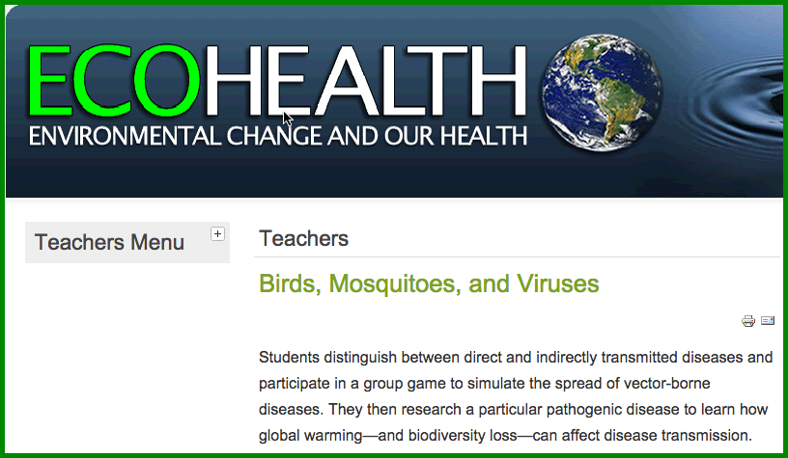
Exercise: Birds, mosquitos, and viruses
http://ecohealth.wisc.edu/index.php?option=com_content&view=article&id=181%3Ateachers-lp-birds-article&catid=130&Itemid=272
Notes:
Reference: http://ecohealth.wisc.edu/
Estimated class time:
Two 50-minute class periods. (One for activity and research, one for poster creation and presentation.)
OBJECTIVES:
Students will:
Distinguish between direct and indirect disease transmission
Identify various vectors associated with disease
Simulate the spread of a vector-borne disease
Research a specific vector-borne disease
Create and present a poster relating global warming to spread of disease
MATERIALS NEEDED:
Ball of yarn or string
Stickers (colored sticky dots will work)
Index cards (or paper scraps): enough for each student, half with the letter M written on them, half with the letter P.
Coin
Internet access
Poster making supplies (paper, markers, etc.)
PROCEDURES:
Teaching Strategy:
Introduce the topic by directing students to "How Diseases Get Spread." As a class, discuss the differences between direct and indirect transmission, and the meaning of the term vector. Tell the class that they will be simulating what might happen in a case of indirect transmission.
Have students choose one of the cards having either an 'M' or a 'P' on it. Students that pick up M's will represent mosquitoes and those that get P's will represent people. Tell them not to reveal what roles they are playing.
Divide the class into 4 groups and have each group represent a city by standing together in a corner of the room.
The ball of yarn represents a bird that is infected with a virus. The teacher calls the name of a student and throws the ball of yarn to that student, while holding on to one end of the yarn.
If the student that catches the ball is a mosquito, then that student chooses another student nearby to tag. If the tagged student is a person, then that student identifies him/herself as being infected by placing a sticker on his/her forehead (or some other conspicuous place). If the tagged student is a mosquito, then nothing happens. Go on to the next turn.
If the student that catches the ball is a person, nothing happens. Go on to next turn.
Now the teacher flips the coin. If the toss is heads, the bird stays in that 'city.' If tails comes up, the bird flies to another city or corner of the room. The student who has the yarn, calls the name of another student - either in the same corner or a different corner, depending on the toss of the coin - and throws the ball of yarn to him/her, while holding on to a piece of it.
Repeat procedures 4 and 5, ten to fifteen times, being sure that those who catch the ball continue to hold on to a piece of the yarn.
At the close of the activity, have students note the tangled web of disease transmission. Discuss the following:
How many people got infected with the virus?
What were the vectors in this disease?
Did the virus stay in one city or did it travel to others?
Did the 'people' that came in contact with the 'bird' always get infected? Why or why not?
How difficult would it be to trace the path of this disease without the yarn to illustrate it?
What was realistic about this simulation?
What was not realistic?
Now direct students to "Hitching a Ride to Find the Host With the Most," pointing out the three key things that influence the spread of disease. Have students study the case study links about malaria, dengue fever and Hantavirus.
Divide the students into groups of 2-3 and assign, or allow them to pick, one of the diseases in the box at the bottom of the page. Add West Nile virus as a choice, even though it's not included on the chart. Students should research their disease choice and then create a poster mimicking the style and types of information contained in the case studies from the site. Be sure to emphasize possible effects that global warming may have on the spread of that disease. Have each group present their poster to the class.
ASSESSMENT:
Participation in discussion
Role-playing participation
Poster and presentation
EXTENSION ACTIVITIES:
Repeat the activity using different beginning ratios between mosquitoes and people.
Add a second 'bird' to the activity.
Research the steps that the CDC takes when tracking the spread of disease.
Research and present information about recent epidemics in your city or state.

Slide 55
References
McMichael, Anthony J., Rosalie E. Woodruff, and Simon Hales. "Climate change and human health: present and future risks." The Lancet 367.9513 (2006): 859-869. http://laes.hcwh3.seguetech.com/sites/default/files/documents-files/151/Climate_Chg_Human_Health.pdf
Climate change and human health - risks and responses. 2003. World Health Organization
http://www.who.int/entity/globalchange/publications/climchange.pdf?ua=1
Summary of above document (Also available in Spanish, French, and Russian)
http://www.who.int/globalchange/publications/cchhsummary/en/
McCarthy, James J., ed. Climate change 2001: impacts, adaptation, and vulnerability: contribution of Working Group II to the third assessment report of the Intergovernmental Panel on Climate Change. Cambridge University Press, 2001.
https://ipcc.ch/ipccreports/tar/wg2/pdf/wg2TARfrontmatter.pdf

Slide 56
Instructor Review of Materials
What was useful?
What is missing?
How did you, or would you, modify the materials to make them better fit your instructional context?
Please share your experience and modifications here: climatecurriculum@googlegroups.com

Slide 57
References and Resources
The curriculum of USAID’s Climate-Resilient Ecosystems and Livelihoods (CREL) in Bangladesh is a free resource of teaching materials for university professors, teachers and climate change training experts.
Reproduction of CREL’s curriculum materials for educational or other non-commercial purposes is authorized without prior written permission from the copyright holder, provided the source is fully acknowledged.
Suggested citation: USAID. 2016. Bangladesh Climate-Resilient Ecosystem Curriculum (BACUM). USAID‘s Climate-Resilient Ecosystems and Livelihoods (CREL) Project. Winrock International. Dhaka, Bangladesh.
Disclaimer: The CREL’s curriculum is made possible by the support of the American People through the United States Agency for International Development (USAID). The contents of the curriculum do not necessarily reflect the views of USAID or the US Government.

Slide 58
USAID's Climate-Resilient Ecosystems and Livelihoods (CREL) Project
Winrock International
House 13/B, Road 54, Gulshan 2, Dhaka 1212
Bangladesh
Tel: +880-2-9848401 www.winrock.org

