Slide 1
Bangladesh Climate-Resilient Ecosystem Curriculum (BACUM)
Module 3: Forest Carbon Measurement and Monitoring

Slide 2
Module 3: Forest Carbon Measurement and Monitoring
SECTION II: FOREST CARBON STOCKS AND IPCC GUIDELINES
2.3. IPCC Guidelines for Forest Carbon Measurement and Monitoring

Slide 3
Forest Carbon Measurement and Monitoring (FCMM)
FUNDAMENTALS OF FOREST CARBON IN REDD+ CONTEXT
  1.1. Forests, the Global Carbon Cycle and Climate Change
  1.2. The Roles of Forests and Forest Carbon in Global Climate Negotiations
  1.3. Challenges for Forest-based Climate Change Mitigation
FOREST CARBON STOCKS AND IPCC GUIDELINES
  2.1. Overview of Forest Carbon Pools (Stocks)
  2.2. Land Use, Land Use Change, and Forestry (LULUCF)
  2.3. IPCC Guidelines for Forest Carbon Measurement and Monitoring
  2.4. Reference Levels – Monitoring against a Baseline
FOREST CARBON MEASUREMENT AND MONITORING METHODS
  3.1. Overview of Forest Carbon Measurement and Monitoring
  3.2. Quality Assurance and Quality Control (QA/QC)
  3.3. Field Sampling Design Methods
  3.4. Forest Carbon Field Measurement Methods
  3.5. Carbon Stock Calculation and Available Tools
  3.6. Creating Activity Data and Emissions Factors
  3.7. Considerations in Developing a Monitoring System

Slide 4
Acknowledgements
EXPERT CONTRIBUTORS | SPECIFIC INPUTS
Prof. (Dr.) Manzoor Rashid | Curriculum Development for all topics
Prof. (Dr.) Md. Danesh Miah | REDD+, Forest Carbon
Prof. (Dr.) Md. Jakariya | Community NR Management, Climate Change, Natural Resources Management
UNIVERSITIES
Bangladesh Agricultural University
University of Chittagong
Dhaka University
Independent University, Bangladesh
Khulna University
Noakhali University of Science and Technology
Shahjalal University of Science and Technology
Sher-e-Bangla Agriculture University
North South University
CREL STAFF | CREL STAFF
John A Dorr | Utpal Dutta
Abu Mostafa Kamal Uddin | Ruhul Mohaiman Chowdhury
Kevin T. Kamp | Rahima Khatun
Paul Thompson | Sultana Razia Zummi
Abdul Wahab | Shams Uddin
Shahzia Mohsin Khan
DESIGN, LAYOUT AND CONTENT DEVELOPMENT: Ms. Chi Pham, Curriculum Development Expert, Bangkok, Thailand

Slide 5
Learning objectives
At the end of this session, students will be able to:
Explain the importance of IPCC and UNFCCC to forest carbon accounting
Describe the characteristics of good practices for carbon measurement and monitoring
Identify the IPCC approaches and tier system of carbon accounting
Relate to the current situation of the national greenhouse gas inventory in Bangladesh

Slide 6
Key Players
What is the UNFCCC
What is the IPCC?
What do they have to do with climate change and forest carbon inventories?
Notes:
KEY MESSAGES:
UNFCCC and IPCC are key elements of the international efforts to understand and respond to climate change.
The IPCC and the UNFCCC have different roles and legal structures.
It is helpful to have the students volunteer what they know about each organization before you start the lecture so you have a better sense of their familiarity with the concepts. You may adjust the lecture to include more or less introductory information as needed based on their responses.

Slide 7
Class Exercise.
Pre-class Reading Assignment and Group Discussion
Objective: To determine the IPCC’s role on GHG inventory
Activity:
Assign learners to explore the UNFCCC (http://unfccc.int/2860.php) and IPCC (http://www.ipcc.ch/) websites or hard copies provided in the previous class
Separate students into groups and have each group of students discuss issues related to UNFCCC and the IPCC given in the previous slide. Share the questions from each group with the whole class and use them to guide the lecture.
Time: 25 minutes
Notes:
KEY MESSAGES:
The exercise should help students better understand respective roles of IPCC and UNFCCC.
Suggestions:
Teacher to provide some introduction to the websites.
Let students discuss given issues and share them with one another. Use their discussion and the following slides to guide discussion during the lecture
The slides 8-16 will help summarizing the discussion.

Slide 8

What is the UNFCCC?
United Nations Framework Convention on Climate Change
Adopted in 1992, entered into force in 1994. As of 2014 there are 196 signatory countries
Provides a framework for negotiating specific international treaties (called "protocols") that may set binding limits on greenhouse gases.
One of the first tasks set by the UNFCCC was for signatory nations to establish national greenhouse gas (GHG) inventories which include both emissions and removals
Notes:
KEY MESSAGES:
The UNFCCC has 196 signatory or participating countries.
This is the framework for any international agreements or treaties (called protocols such as the Kyoto Protocol) on climate change.

Slide 9
Goal and Objectives of the UNFCCC
What is the overall goal?
  “ to protect the climate system for the benefit of present and future generations of mankind. ”
What are the further objectives?
  “ to achieve stabilization of greenhouse gas concentrations in the atmosphere at a level that would prevent dangerous anthropogenic interference with the climate system. ”
Notes:
KEY MESSAGES:
The UNFCCC has a very specific overall goal as well as additional objectives
Notes: The second objective here “ to achieve stabilisation of greenhouse gas concentrations in the atmosphere at a level that would prevent dangerous anthropogenic interference with the climate system” has been criticized as being too vague, as the meaning of “dangerous anthropogenic interference” can be interpreted in many different ways.

Slide 10
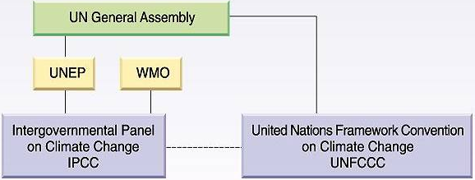
IPCC vs UNFCCC
Notes:
KEY MESSAGES:
The UNFCCC and the IPCC are connected
IPCC as an institutional body to the UNFCCC
IPCC was established by the United Nations Environment Programme (UNEP) and the World Meteorological Organization (WMO) in 1988, before UNFCCC was adopted, to provide the world with a clear scientific view on the current state of knowledge in climate change.
The IPCC is recognized as the most authoritative scientific and technical voice on climate change, and its assessments had a profound influence on the negotiators of the United Nations Framework Convention on Climate Change (UNFCCC) and its Kyoto Protocol.
Image Source:
http://www.grida.no/publications/vg/climate/page/3069.aspx

Slide 11


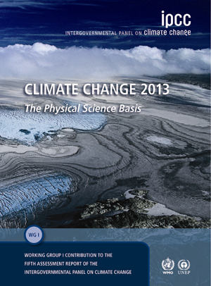
The Role of IPCC
  To assess on a comprehensive, objective and transparent basis the scientific, technical and socio-economic information relevant to understanding the scientific basis of climate change, its potential impacts and options for adaptation and mitigation
Notes:
KEY MESSAGES:
The IPCC is the scientific and technical advisor to the UNFCCC
The work of the IPCC is guided by the mandate given to it by its parent organizations the World Meteorological Organisation (WMO) and the United Nations Environment Programme (UNEP). At its 14th Session the Panel approved principles governing its work.
Image Source:
www.ipcc.ch

Slide 12
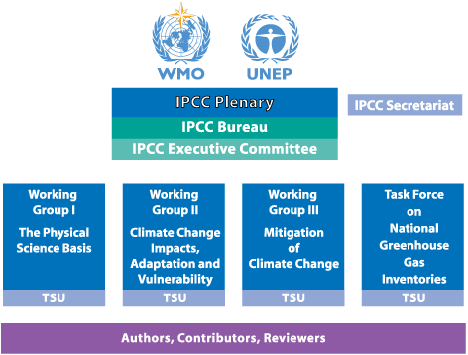
IPCC Organization
Notes:
KEY MESSAGES:
The IPCC is divided into three working groups and a task force
The IPCC is organized into three working groups plus a task force on national greenhouse gas (GHG) inventories.
Working Group I assesses the scientific aspects of the climate system and climate change
Working Group II addresses the vulnerability of human and natural systems to climate change, the negative and positive consequences of climate change, and options for adapting to them
Working Group III assesses options for limiting greenhouse gas emissions and otherwise mitigating climate change, as well as economic issues.
Task Force on National Greenhouse Gas Inventories (TFI) was established by the IPCC to oversee the IPCC National Greenhouse Gas Inventories Programme (IPCC-NGGIP)
Image Source:
http://www.ipcc.ch/organization/organization_structure.shtml

Slide 13
Task Force on National Greenhouse Gas Inventories (TFI)
Task Force on National Greenhouse Gas Inventories (TFI) was established by the IPCC to oversee the IPCC National Greenhouse Gas Inventories Programme (IPCC-NGGIP).
The core activity is to
  develop and refine an internationally-agreed methodology and software for the calculation and reporting of national GHG emissions and removals
  encourage its use by countries participating in the IPCC and by parties of UNFCCC.
The NGGIP also established and maintains an Emission Factor Database.
Guidelines for national greenhouse gas inventories
Notes:
KEY MESSAGES:
The IPCC Task Force on National Greenhouse Gas Inventories (TFI) plays an important role in developing methodologies and databases required to produce GHG inventories as is now required of all UNFCCC signatory countries.
References:
This IPCC presentation provides background on the evolution of the good practice guidelines: http://223.27.200.5/www.ipcc-nggip.iges.or.jp/presentation/LULUCF-AFOLU.pdf
This IPCC web page has details on the NGGIP Task Force and links to download the guidelines: http://www.ipcc-nggip.iges.or.jp/public/2006gl/

Slide 14
Good Practices for Carbon Inventories
Overall good practice requirement
The UNFCCC defines a list of national greenhouse gas inventories including carbon inventories
Good practices lead to
A quality inventory of anthropogenic
emissions and removals of greenhouse
gases that is credible and
convincing
Good Practice?
Notes:
KEY MESSAGES:
There are a number of practices or quality principle of a carbon monitoring system that are required to produce an inventory that is considered credible and trustworthy. These are fundamentally important which is why the UNFCCC has issued guidelines.

Slide 15
Class Exercise. Group Brainstorming
Objective: To identify good practices for a measurement and monitoring system
Activity:
Divide the students into small groups
Have each group come up with a list of 5 good practices or characteristics of a measurement and monitoring system
Have each group match their lists with good practices for measurement and monitoring of forest carbon defined by UNFCCC in the following slides
Time: 25 minutes
Notes:
KEY MESSAGES:
The exercise encourages students to share their knowledge and thinking about characteristics of good practice.
Notes:
Have the students brainstorm about good practices for a monitoring system. They could use carbon as an example or perhaps one they are more familiar with (medical, accounting, censuses even class grading are all examples). Have them list what characteristics or practices they think are most important. Teacher might have to give an example or definition of practices to get things started.

Slide 16
TACCC
Quality principles are defined in the UNFCCC Reporting Guidelines TACCC
Transparency
Accuracy
Completeness
Consistency
Comparability
Notes:
KEY MESSAGES:
The IPCC task force has a list of 5 quality principles that underlie their guidelines on reporting. Note these practices could be used for any measurement/monitoring system
Have each group match their lists with good practices for measurement and monitoring of forest carbon defined by UNFCCC in the following slides
Reference:
UNFCCC. Link: http://unfccc.int/resource/docs/cop8/08.pdf

Slide 17
Transparency
There is sufficient and clear documentation such that individuals or groups other than the inventory compilers can understand how the inventory was compiled and can assure themselves it meets the good practice requirements for national greenhouse gas emissions inventories
  System must have clear assumptions and methodologies
Notes:
KEY MESSAGES:
Systems must have clear and accepted assumptions and methodologies. If outside parties cannot understand how you estimate or monitor fluxes than how can they trust the values?
Reference:
UNFCCC. Link: http://unfccc.int/resource/docs/cop8/08.pdf

Slide 18
Accuracy
The national greenhouse gas inventory contains neither over- nor under-estimates so far as can be judged.
Accuracy requires making all endeavors to remove bias from the inventory estimates
  Unbiased estimates reflect true emissions (no systematic error) and reduce uncertainty (improve precision)
Notes:
KEY MESSAGES:
Once it is clear how the numbers are determined it is also important that the inventories be unbiased.
Notes: There will be errors associated with measurements and calculations but it is essential that those errors do not consistently cause under or over estimations. Check here to make sure the students can distinguish between accuracy of a number and precision of the same. Also make sure they understand the concept of bias.
Reference:
UNFCCC. Link: http://unfccc.int/resource/docs/cop8/08.pdf

Slide 19
Accuracy vs Precision
Accuracy: how closely the reported value matches the actual or true value of the thing measured
Precision: how similar repeated measurements of a object are to one another when made under similar conditions
Notes:
KEY MESSAGES:
Both concepts are important to all measurement systems. An ideal system is both accurate and precise. The more accurate a measurement is the closer it is to the “true” value. Precision is more a measure of the measurement itself- how close to one another are repeated measurements.
Reference:
UNFCCC. Link: http://unfccc.int/resource/docs/cop8/08.pdf

Slide 20
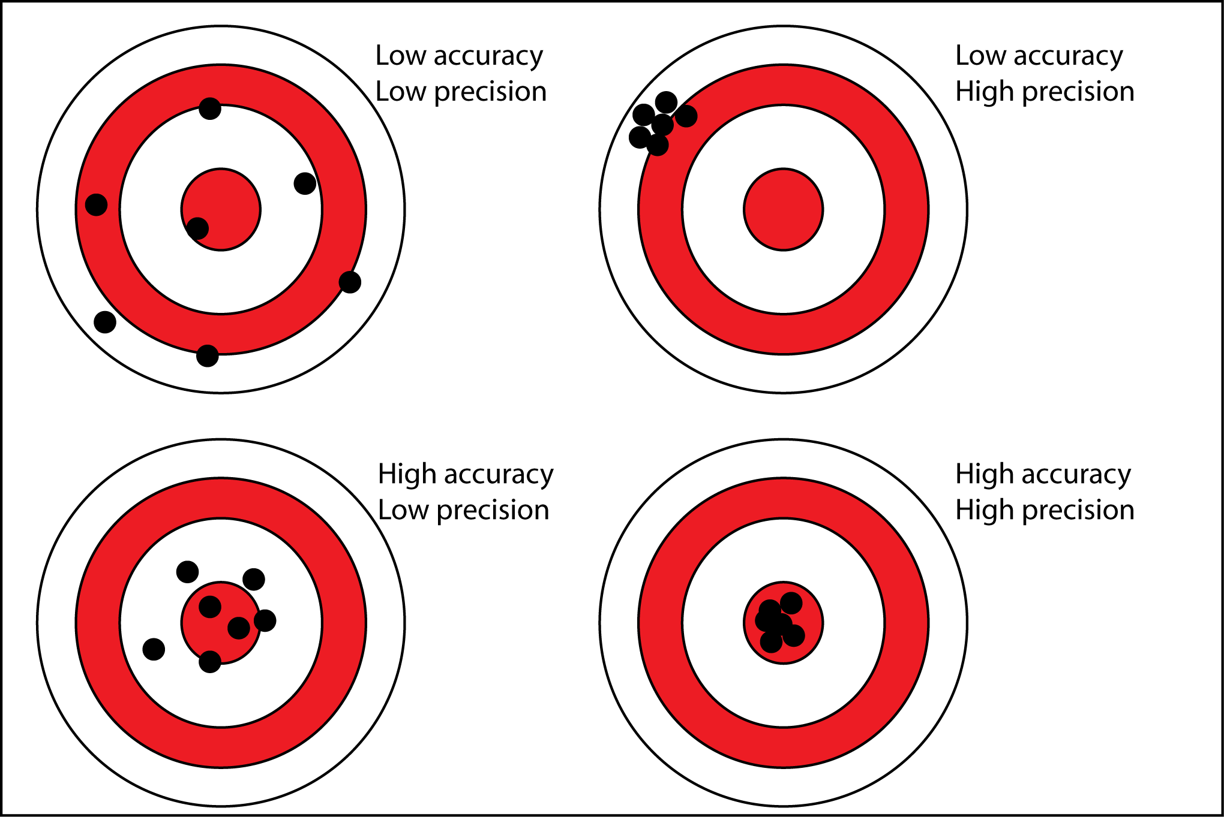
Accuracy vs Precision
Notes:
KEY MESSAGES:
Accurate measurements fall in the bulls eye. Precise measurements are tightly clustered. Accurate and precise measurements are tightly clustered in the bulls eye!
Image source:
http://www.antarcticglaciers.org/glacial-geology/dating-glacial-sediments-2/precision-and-accuracy-glacial-geology/

Slide 21
Completeness
Estimates are reported for all relevant categories of sources and sinks, and gases.
Geographic areas within the scope of the national greenhouse gas inventory are recommended in the IPCC guidelines.
Notes:
KEY MESSAGES:
No inventory is complete if it is missing important pools: either geographic areas of sources/sinks of carbon. Where elements are missing, their absence should be clearly documented together with a justification for exclusion.
Reference:
UNFCCC. Link: http://unfccc.int/resource/docs/cop8/08.pdf

Slide 22
Review of Carbon Pools and Fluxes
Atmospheric Carbon (CO2)
Photosynthesis
Respiration
Mortality
Decomposition
Exudation
Notes:
KEY MESSAGES:
When discussing the completeness it is important to review the forest carbon pools
Notes:
This is just a brief review as students have seen this in previous lectures but when discussing completeness the first idea is which pools and fluxes should be included. Have the students discuss or vote on which carbon pools are most important to include and why? ( are they the biggest? The most likely to change with land use change?).
The second part of the completeness concept is geographic extent
Reference:
Image from http://www.waterfriendlygarden.com/CleanAir.html [Note: I’ve kept this reference although its immediate relevance to what is in the slide is unclear]
Image source:
Vickers, B. et al. 2012. Community guidelines for accessing forestry voluntary carbon markets Chapter 1 Forests and Climate Change FAO Regional Office for Asia and the Pacific. http://www.fao.org/docrep/016/i3033e/i3033e01.pdf

Slide 23
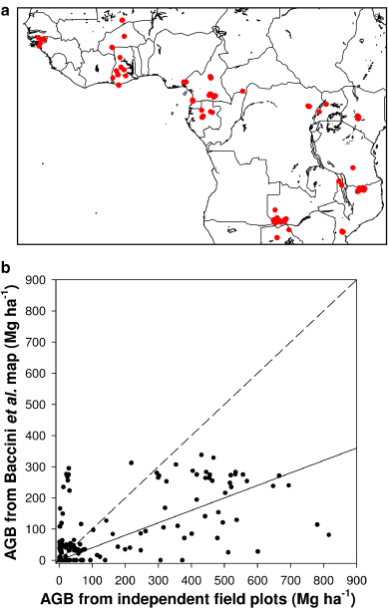
Consistency
Estimates for different inventory years, gases and categories are made in such a way that differences in the results between years and categories reflect real differences in emissions.
  Inventory should be calculated using the same method and data sources in all years
Notes:
KEY MESSAGES:
Monitoring involves repeated measures –from year to year or over a period of several years and depends on the ability to compare measurements from one year to the next.
Inventory annual trends, as far as possible, should be calculated using the same method and data sources in all years and should aim to reflect the real annual fluctuations in emissions or removals and not be subject to changes resulting from methodological differences.
Notes:
If a new instrument or method is introduced there should be a period where both old and new approaches are done simultaneously to allow for comparison and confidence in comparing values across methods. The image shows a comparison between field inventory values and satellite image derived values for above ground biomass in tropical Africa. The dashed line is the one to one line- where the points would fall if the two methods had consistent results. Clearly in this case there is a need for more field inventory plots and better calibration of the imagery interpretation. It would be impossible to detect effects of LUC if an inventory changed from field to satellite data over the course of time in this case.
Reference:
UNFCCC. Link: http://unfccc.int/resource/docs/cop8/08.pdf
Image Source:
Mitchard et al 2011 doi:10.1088/1748-9326/6/4/049001 (better link is http://223.27.200.5/iopscience.iop.org/1748-9326/6/4/049001/pdf/1748-9326_6_4_049001.pdf). See Figure 1.

Slide 24
Comparability
The national greenhouse gas inventory is reported in a way that allows it to be compared with national greenhouse gas inventories for other countries.
This comparability should be reflected
  in appropriate choice of key categories
  use of the reporting guidance and tables
  use of the classification and definition of categories of emissions and removals.
Notes:
KEY MESSAGES:
As with the case for consistency- the need to compare measurements over time – there is also a need to be able to compare across space- projects within a country or across countries.
Notes:
While not all projects/ countries will use the exact same categories and methods as long as inventories follow the TACCC principals and accepted measurement methods, and use the same unites to report their data, cross-project comparability should be easy to achieve.
Reference:
UNFCCC. Link: http://unfccc.int/resource/docs/cop8/08.pdf

Slide 25
Any Other Good Practices or Quality Principles?
Notes:
KEY MESSAGES:
Have students share any other principles they came up with in the class activity that were not covered in the 5 principles just discussed.

Slide 26
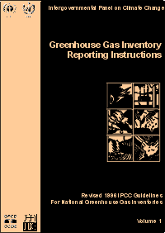
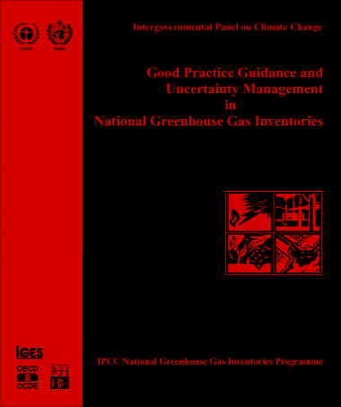


IPCC Guidelines for National GHG Inventories
1996 IPCC Revised Guidelines for National Greenhouse Gas Inventory
2000 IPCC Good Practice Guidance (GPG) and Uncertainty Management in National Greenhouse Gas Inventories
2003 Good Practice Guidance (GPG) for Land Use, Land-Use Change and Forestry
2006 IPCC Guidelines for National Greenhouse Gas Inventory
Notes:
KEY MESSAGES:
The IPCC has developed and updated good practice guidelines for various aspects of carbon monitoring
Notes: Let learners explore information on the website related to guidelines for GHG inventory in forest sector
Highlight the difference between 1996 IPCC Revised Guidelines for National Greenhouse Gas Inventory and 2006 IPCC Revised Guidelines for National Greenhouse Gas Inventory
See summary in slides 28-29.

Slide 27
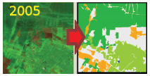
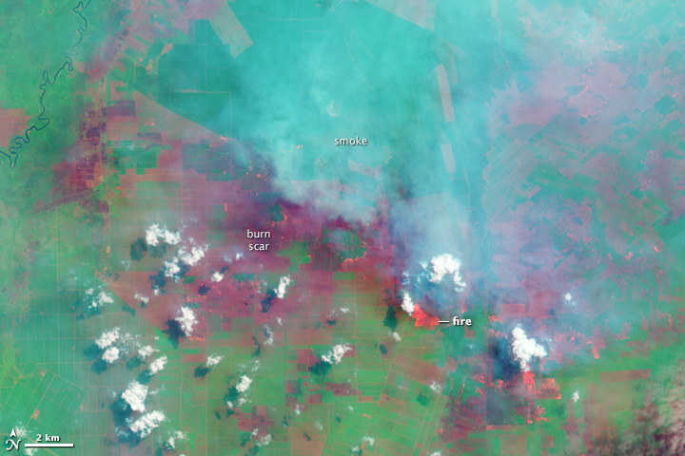
Carbon Accounting for Land Use, Land Use Change and Forestry (LULUCF)
Estimates of carbon emissions and removals involve two factors:
1. The amount of area undergoing a specific transition- this is called the Activity Data
2. The change in carbon pools association with that transition- this is called the Emissions Factor
Notes:
KEY MESSAGES:
Estimates of carbon emissions and removals for Land Use, Land Use Change and Forestry (LULUCF) involve two factors: Activity data and Emissions factor
Image source:
http://www.fire.uni-freiburg.de/GFMCnew/2013/07/25/20130725_SEA.htm

Slide 28
Default LULUCF Categories in IPCC 1996 Guidelines
A. Changes in forest and other woody biomass stocks due to
  commercial management
  harvest of industrial roundwood (logs) and fuelwood
  establishment and operation of forest plantations
  planting of trees in urban, village and non-forest locations
B. Forest and grassland conversion
  the conversion of forests and grassland to pasture, cropland etc. can significantly change C-stocks in vegetation and soil
C. Abandonment of cropland, pasture, plantation forests, or other managed lands
D. CO₂ emissions and removals from soils
  cultivation of mineral soils
  cultivation of organic soils
  liming of agricultural soils
Notes:
KEY MESSAGES:
In 1996 the IPCC considered three land use transitions (forest harvesting or plantation establishment, conversion of forest or natural grasslands to crops or pasture and abandonment of cropland/pasture or other managed lands with the assumption it would move back into forest

Slide 29
Land Use Transitions in IPCC 2006 Guidelines
Forest Land
  Forest Land Remaining Forest Land (FF)
  Land Converted to Forest Land (LF)
Cropland
  Cropland Remaining Cropland Land (CC)
  Land Converted to Cropland (LC)
Grassland
  Grassland Remaining Grassland Land (GG)
  Land Converted to Grassland (LG)
Wetlands
  Peatland Remaining Peatland
  Land Being Converted for Peat Extraction
  Flooded Land Remaining Flooded Land
  Land Converted to Flooded Land
Settlements
  Settlements Remaining Settlements (SS)
  Land Converted to Settlements (LS)
Other Land
  Land Converted to Other land
AFOLU: Agriculture, Forestry and Other Land Uses
Notes:
KEY MESSAGES:
In the 2006 Emissions Factor Database the IPCC has a much more complete list of land use transitions considered- have the students discuss why the number of categories increased
The IPCC (2006) considers the transitions listed when developing their Emissions Factor database. These land uses/ management are often referred to as AFOLU (Agriculture, Forestry and other land uses). For each transition the emissions factor is calculated as the change in carbon density. If carbon density increases (in tons of C per hectare) the transition results in a net sequestration of carbon and if the reverse is true and carbon density decreases the emissions factor is positive indicating a net emission or source of CO2 to the atmosphere
Data source:
2006 IPCC Revised Guidelines for National Greenhouse Gas Inventory: http://www.ipcc-nggip.iges.or.jp/public/2006gl/

Slide 30
Approaches to Determine Activity Data
Approach 1: Areas of different land use at different times  basic land use data but no tracking of land use conversions
Approach 2: A land conversion matrix by area but not spatially explicit  survey of land use and land-use change
Approach 3: Spatially explicit monitoring of land use change  geographically explicit land use data
Notes:
KEY MESSAGES:
There is a hierarchy of approaches for activity data
In this case the certainty in the estimate of the activity data increases as you move from Approach 1 to Approach 3. In Approach 1 you measure the amount of land in each land use at each time point but have no spatial information and also have no information on which specific transitions took place. In Approach 2, there is more information on specific transitions (ie how many hectares of forest were converted to pasture or to agriculture as well as how many hectares of pasture were abandoned and now have regenerating forest) but still no spatial associations. Finally in Approach 3 data on which transitions have occurred as well as where each has occurred is collected. Increasing the amount of information requires higher investments in both data acquisition and technical capacity.
30

Slide 31
IPCC Reporting Tiers
The IPCC has set up a Carbon Accounting system of three tiers based on available data and capacity
  Tier 1: No new data collected. Default emissions factor values from the IPCC database used. Activity data usually a coarse estimate. “Global defaults”
  Tier 2: No new data collected. Country defined emission factors used. Higher resolution activity data used: specific regions and land use categories “Local defaults”
Notes:
KEY MESSAGES:
The IPCC Carbon Accounting system is set up on a hierarchy of tiers.
As the availability of national and sub-national data increases especially repeated measures over time project or national inventories can move from Tier one to Tier three. Note inventory systems are likely to measure different pools or fluxes at levels of accuracy (tiers) depending on costs and available data. Ideally the most important pools and fluxes are measured at higher tiers.

Slide 32
IPCC Reporting Tiers
  Tier 3: Uses models, inventory monitoring systems and high resolution data tailored to reflect national characteristics. Requires national and sub-national carbon inventories and repeated measurements in areas where land use is changing. Models are validated and calibrated with field measurements. Certainty is much higher, but so are costs and it requires a high level of technical expertise.
Notes:
KEY MESSAGES:
Tier three is the highest level of certainty in the IPCC hierarchy. It requires multiple years of inventory data at the national and sub-national level as well as the ability to calibrate and validate models to local conditions. It may be easier to reach Tier 3 for some carbon pools than others. Remind the students of the carbon pools w

Slide 33
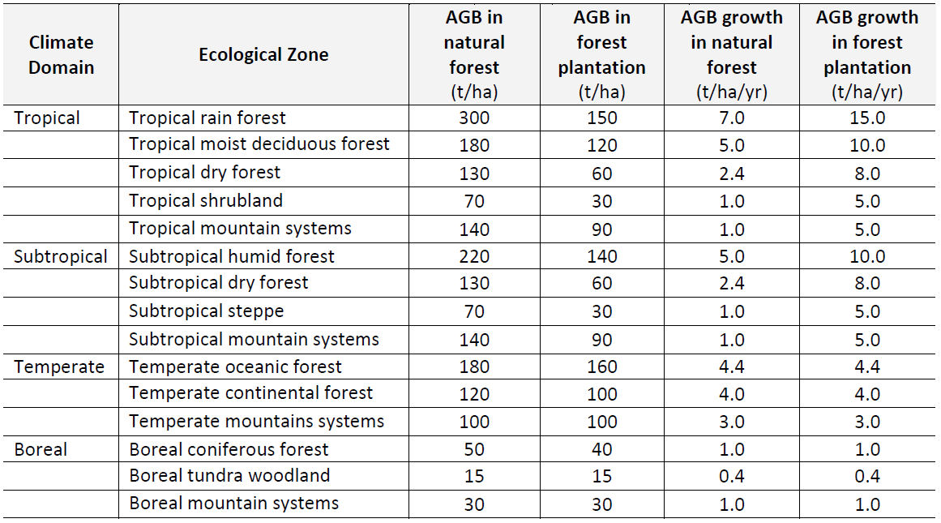
IPCC Tier 1 Biomass Values
The default carbon fraction = 0.47 Source: IPCC (2006)
Notes:
KEY MESSAGES:
Here is an example of Tier one data from the IPCC- in this case estimated AboveGround Biomass for various broad forest classes. Emissions factors from deforestation would be calculated based on above ground biomass and an estimate of carbon density of 47%
Above ground biomass mass increment (growth) for the various forest classes could be used to estimate the impact of afforestation on national emissions.
Chart source: 2006 IPCC Revised Guidelines for National Greenhouse Gas Inventory: http://www.ipcc-nggip.iges.or.jp/public/2006gl/

Slide 34
IPCC Tier 2 Biomass Values of Thailand
Forest type | AGB biomass (t/ha) | Carbon fraction | Carbon stock
 |  |  | (tC/ha) | (tCO₂/ha)
Evergreen | 238.23 | 0.48 | 114.35 | 419.28
Pine | 135.60 | 0.48 | 65.09 | 238.66
Mangrove | 173.70 | 0.47 | 81.64 | 299.34
Inundated | 34.88 | 0.47 | 16.39 | 60.11
Mixed deciduous | 197.60 | 0.49 | 96.82 | 355.02
Dry dipterocarp | 106.41 | 0.51 | 54.27 | 198.99
Bamboo | 34.88 | 0.48 | 16.74 | 61.39
overall | 131.61 | 0.48 | 63.17 | 231.63
Source: Kasetsart University Faculty of Forestry [KUFF] (2010)
Notes:
KEY MESSAGES:
Here is an example of Tier 2 data from Thailand- here the data are specific to national forest definitions and conditions.
Notes: The Tier 1 values for Tropical rain, moist and dry forest ranged from 130 to 300 t AGB Biomass per hectare where here we have 7 forest types with values that range from 34.9 to 238.2 t AGB Biomass. You can see how moving from one tier to the next will affect carbon accounting. Key to note here: we compared biomass but the true issue is carbon. The IPCC default is trees are 47% carbon ( carbon fraction of 0.47) and as you can see here that is also variable and measurements in Thailand vary from 0.47 to 0.51
Chart Source:
Kasetsart University Faculty of Forestry [KUFF] (2010) – [NEED more detailed source information]

Slide 35
Class Exercise. Group Homework
Objective: To compare effects of using Tier 1 and Tier 2 data for carbon inventories
Activity:
  Find data on the amount of area in each forest class in Thailand.
  Using the aboveground biomass and carbon fraction values presented in this lecture calculate forest aboveground carbon stocks using the “local defaults” as well as the IPCC “global defaults”
  Report both the size of the difference and the major sources (which forest types)
Notes:
Homework report
Data here are from Thailand but it might be more interesting for the students to use local data if available. If you have inventory data for a region or specific forest type you could also use those values and compare them to carbon stocks calculated using Tier 1 and Tier 2 values for above ground biomass- if necessary you may provide the forest class area for the students

Slide 36
Class Exercise. Group Homework
Forest area in Thailand in 2008
Forest type | Area | ABG biomass | carbon fraction | carbon stock
 | (10³ ha) | (t/ha) |  | (10³tC)
Evergreen | 5,371.75
Mangrove | 323.59
Mixed Deciduous | 9,420.51
Dry dipterocarp | 2,093.72
Total | 17,209.58
Notes:
Homework report
Data here are from Thailand but it might be more interesting for the students to use local data if available. If you have inventory data for a region or specific forest type you could also use those values and compare them to carbon stocks calculated using Tier 1 and Tier 2 values for above ground biomass- if necessary you may provide the forest class area for the students

Slide 37
Class Exercise. Group Homework
Carbon stock in aboveground biomass of forest in Thailand
in 2008 (Tier 1)
Forest type | Area | ABG biomass | carbon fraction | carbon stock
 | (10³ ha) | (t/ha) |  | (10³tC)
Evergreen | 5,371.75 | 300 | 0.47 | 757,416.05
Mangrove | 323.59 | 300 | 0.47 | 45,626.75
Mixed Deciduous | 9,420.51 | 180 | 0.47 | 796,975.48
Dry dipterocarp | 2,093.72 | 130 | 0.47 | 127,926.48
Total | 17,209.58 |  |  | 1,727,944.76
Notes:
Homework report
Data here are from Thailand but it might be more interesting for the students to use local data if available. If you have inventory data for a region or specific forest type you could also use those values and compare them to carbon stocks calculated using Tier 1 and Tier 2 values for above ground biomass- if necessary you may provide the forest class area for the students

Slide 38
Class Exercise. Group Homework
Carbon stock in aboveground biomass of forest in Thailand
in 2008 (Tier 2)
Forest type | Area | ABG biomass | carbon fraction | carbon stock
 | (10³ ha) | (t/ha) |  | (10³tC)
Evergreen | 5,371.75 | 238.23 | 0.48 | 614,261.19
Mangrove | 323.59 | 173.7 | 0.47 | 26,417.89
Mixed Deciduous | 9,420.51 | 197.6 | 0.49 | 912,131.85
Dry dipterocarp | 2,093.72 | 106.41 | 0.51 | 113,624.46
Total | 17,209.58 |  |  | 1,666,435.39
Notes:
Homework report
Data here are from Thailand but it might be more interesting for the students to use local data if available. If you have inventory data for a region or specific forest type you could also use those values and compare them to carbon stocks calculated using Tier 1 and Tier 2 values for above ground biomass- if necessary you may provide the forest class area for the students

Slide 39
Take Home Message
The IPCC, an advisory body to UNFCCC, plays an important role providing scientific and technical guidance on all aspects of climate change including national greenhouse gases inventories
Good practice guidelines, such as TACCC for carbon accounting are essential to developing a credible and verifiable monitoring system
The IPCC approaches and tier system of carbon accounting is based on available data and capacity. Values used in carbon calculations range from global defaults (Tier 1) to local defaults (Tier 2) and to repeated inventories and calibrated models (Tier 3)

Slide 40
References and Resources
USAID. 2015. USAID LEAF‘s Climate Change Curriculum. USAID Lowering Emissions in Asia Forests Program (USAID LEAF). Winrock International and US Forest Service. Bangkok, Thailand.
Watson, C. 2009. Forest carbon accounting: overview & principles. UNDP: CDM Capacity Development in Eastern and Southern Africa. Available Source: http://www.undp.org/climatechange/carbon-finance/Docs/Forest%20Carbon%20Accounting%20-%20Overview%20&%20Principles.pdf
IPCC website: http://www.ipcc.ch
1996 IPCC Revised Guidelines for National Greenhouse Gas Inventory: http://www.ipcc-nggip.iges.or.jp/public/gl/invs1.html
2000 IPCC Good Practice Guidance (GPG) and Uncertainty Management in National Greenhouse Gas Inventories: http://www.ipcc-nggip.iges.or.jp/public/gp/english/index.html
2003 Good Practice Guidance (GPG) for Land Use, Land-Use Change and Forestry: http://www.ipcc-nggip.iges.or.jp/public/gpglulucf/gpglulucf.html
2006 IPCC Revised Guidelines for National Greenhouse Gas Inventory: http://www.ipcc-nggip.iges.or.jp/public/2006gl/

Slide 41
References and Resources
The curriculum of USAID’s Climate-Resilient Ecosystems and Livelihoods (CREL) in Bangladesh is a free resource of teaching materials for university professors, teachers and climate change training experts.
Reproduction of CREL’s curriculum materials for educational or other non-commercial purposes is authorized without prior written permission from the copyright holder, provided the source is fully acknowledged.
Suggested citation: Winrock International. 2016. USAID‘s Climate-Resilient Ecosystems and Livelihoods (CREL). Winrock International. Dhaka, Bangladesh.
Disclaimer: The CREL’s curriculum is made possible by the support of the American People through the United States Agency for International Development (USAID). The contents of the curriculum do not necessarily reflect the views of USAID or the US Government.

Slide 42
USAID's Climate-Resilient Ecosystems and Livelihoods (CREL) Project
Winrock International Headquarters
2101 Riverfront Drive, Little Rock
Arkansas 72202-1748 USA
Tel: 1-501-280-3000
Web: www.winrock.org

