Slide 1
Bangladesh Climate-Resilient Ecosystem Curriculum (BACUM)
Module 1: Introduction to Climate Change

Slide 2
Module 1: Introduction to Climate Change
SECTION II: IMPACTS OF CLIMATE CHANGE ON PEOPLE AND THE ENVIRONMENT
2.6. Climate Change and Terrestrial Ecosystems

Slide 3
Introduction to Climate Change (ICC)
HOW AND WHY THE CLIMATE IS CHANGING
1.1. Introduction to Climate Science and Climate Change
1.2. Causes of Climate Change
1.3. Climate Intensification: Floods, Droughts and Cyclone
IMPACTS OF CLIMATE CHANGE ON PEOPLE AND THE ENVIRONMENT
2.1. Introduction to Climate Change Impacts
2.2. Sea Level Rise
2.3. Climate Change and Water Resources
2.4. Climate Change and Food Security
2.5. Climate Change and Human Health
2.6. Climate Change and Terrestrial Ecosystems
RESPONSES TO CLIMATE CHANGE – MITIGATION AND ADAPTATION
3.1. Climate Change and Forest Management
3.2. Climate Change and Water Resources: Responses and Adaptation
3.3. Principles and Practices of Climate Change Vulnerability Assessment
3.4. Uncertainties in Climate Change
3.5. Climate Change and Ecosystem Services
3.6. Effective Communications in Climate Change

Slide 4
Acknowledgements
EXPERT CONTRIBUTORS | SPECIFIC INPUTS
Prof. (Dr.) Manzoor Rashid | Curriculum Development for all topics
Prof. (Dr.) Md. Danesh Miah | REDD+, Forest Carbon
Prof. (Dr.) Md. Jakariya | Community NR Management, Climate Change, Natural Resources Management
UNIVERSITIES
Bangladesh Agricultural University
University of Chittagong
Dhaka University
Independent University, Bangladesh
Khulna University
Noakhali University of Science and Technology
Shahjalal University of Science and Technology
Sher-e-Bangla Agriculture University
North South University
CREL STAFF | CREL STAFF
John A Dorr | Utpal Dutta
Abu Mostafa Kamal Uddin | Ruhul Mohaiman Chowdhury
Kevin T. Kamp | Rahima Khatun
Paul Thompson | Sultana Razia Zummi
Abdul Wahab | Shams Uddin
Shahzia Mohsin Khan
DESIGN, LAYOUT AND CONTENT DEVELOPMENT: Ms. Chi Pham, Curriculum Development Expert, Bangkok, Thailand

Slide 5
Learning Objectives
At the end of this session, learners will be able to:
Describe how climate influences the distribution of plants around the world and ways of classifying plant communities
Describe the impacts of climate change on vegetation and wildlife, from the level of the individual to the biome level
Notes:
Notes:
References:

Slide 6
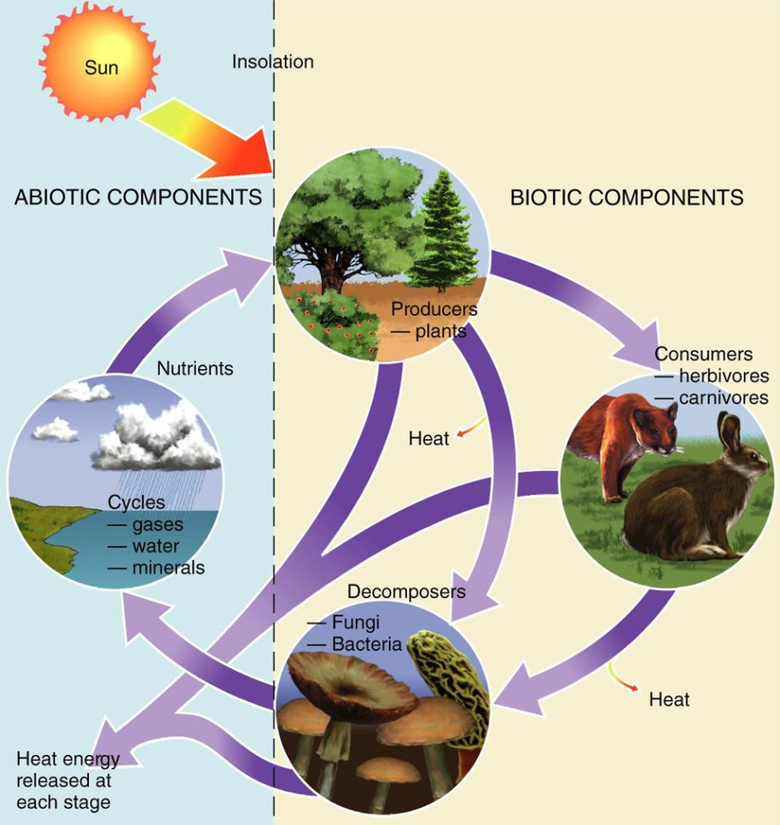
What is an ecosystem?
Ecosystem:
An interdependent association of living plants and animals and their physical environment
Notes:
Ask audience for definitions of the term ecosystem and briefly discuss the graphic above describing the different components of an ecosystem
Notes:
Plants and animals work to fit specific niches…Are there going to be more large predators in an ecosystem or plants?
References:
http://www2.pvc.maricopa.edu/~douglass/gph_111/ppoints/bio.ppt

Slide 7
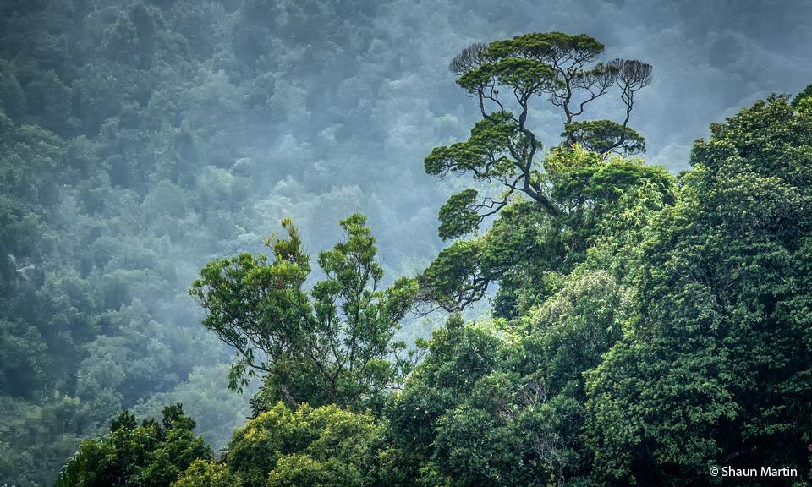
Climate and vegetation
Notes:
This portion of the lecture will deal with the relationship between climate and vegetation
Photo credit: Shaun Martin

Slide 8
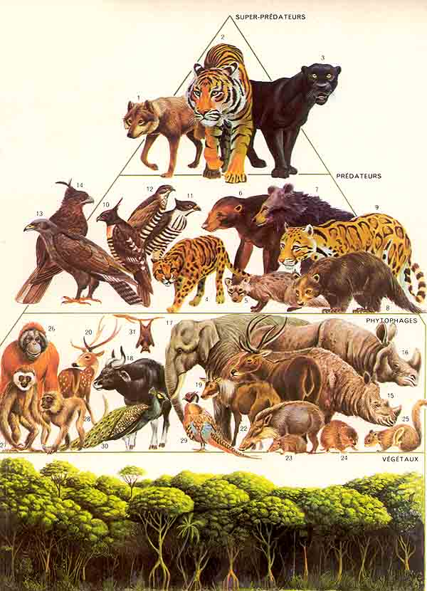
Climate and vegetation
Why is it important to study the relationship between climate and vegetation?
Notes:
Key Message: Ask the audience why it is important to focus on vegetation to understand ecosystem change. There are many reasons!
References: http://ekosistem-ekologi.blogspot.com/2013_02_01_archive.html

Slide 9
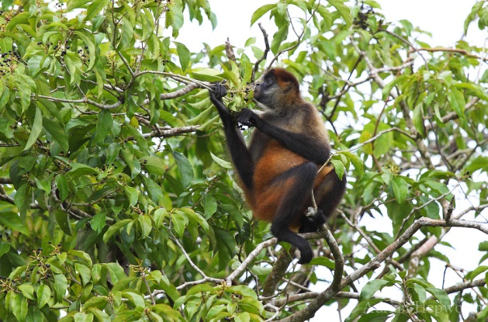
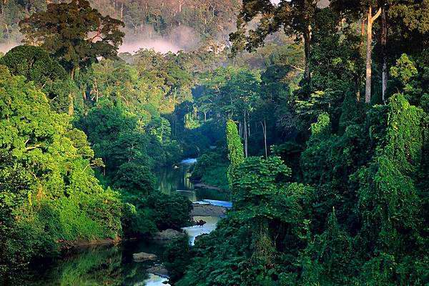
Why focus on vegetation?
Plants are closely tied to climate & other abiotic drivers
Plants form the base of the food chain and thus have a strong impact on animals
People rely on ecosystem services provided by forests, farms, and fisheries
Plants alter their environment in ways that influence weathering, erosion rates, soil development, and climate
Notes:
Read the four points above to explain the focus on vegetation.
Key message:
Plant form and function is closely tied to climate
Chlorophyll is the engine behind the world’s major biomes! Plants form the base of the food chain and also provide habitat for other species.
& 4. Plant communities provide a host of ecosystem services (often as a result of ways in which they alter their environment) that humans rely on such as water regulation, wood and non-wood products, erosion control and soil formation (they influence weathering rates), nutrient cycling, pollution control, climate regulation, disturbance regulation (e.g. shoreline protection by mangroves), , etc
References:
photo 1: http://southernboating.com/blog/2010/04/30/bahamas-special-photo-essay/
photo 2: http://cdn.c.photoshelter.com/img-get2/I0000Noi8bJEVDf8/fit=1000x750/Monkey-Spider-M0380.jpg
Photo 3: http://www.aid-n.com/southeast-asia-tropical-rain-forest-is-protected-by-the-government/

Slide 10
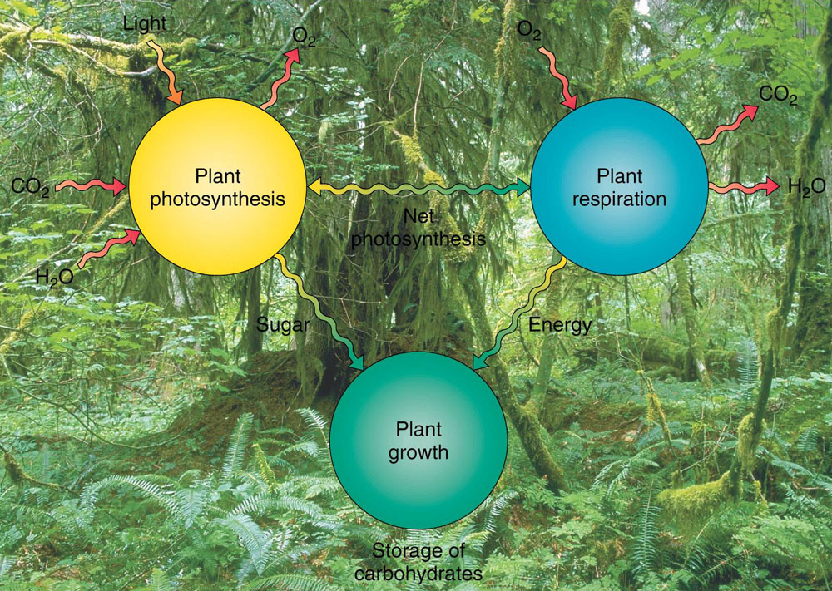
Chlorophyll is the engine behind the world’s major biomes
Photosynthesis = Carbon Dioxide + Water + Light Glucose + Oxygen
Respiration = Glucose + Oxygen Carbon Dioxide + Water + Heat Energy
Notes:
Walk through the basic equations for photosynthesis and respiration
Key message:
During the process of photosynthesis CO2 and water are used by plant chlorophyll to convert the suns energy into plant material. This plant growth provides food for higher trophic levels (levels higher in the food chain). During respiration plants (and animals) absorb O2 from the atmosphere to metabolize sugars and provide energy for growth (and other metabolic processes). They give off CO2, water, and heat energy in the process.
References:
Graphic: www2.pvc.maricopa.edu/~douglass/.../bio.ppt‎

Slide 11
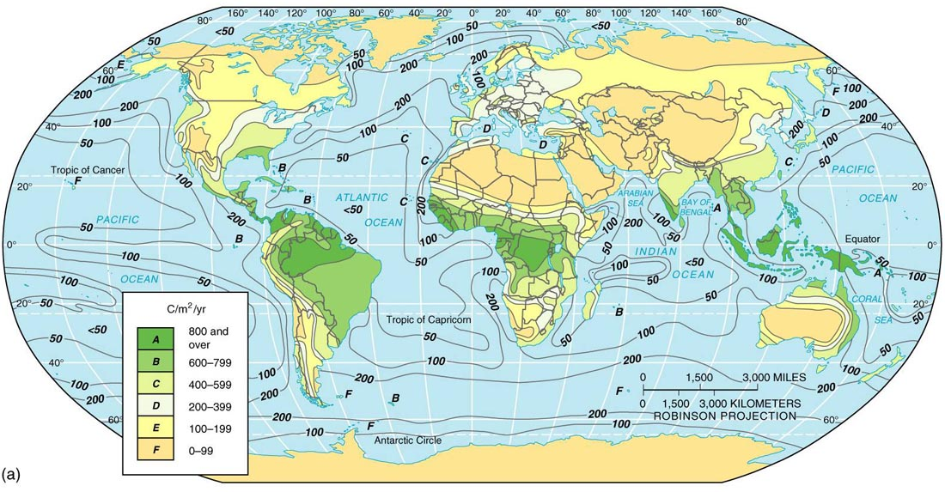
Net Primary Productivity (NPP)
The net photosynthesis for an entire plant community is its NPP
Notes:
The net photosynthesis (after the costs of respiration are accounted for) for an entire plant community is its net primary productivity.
Key message:
Gross patterns of productivity and climate resemble each other. In the warm and wet environments of the tropics NPP is very high. There is a relationship between Carbon and NPP, as expressed in this figure.
References:
http://www2.pvc.maricopa.edu/~douglass/gph_111/ppoints/bio.ppt.

Slide 12
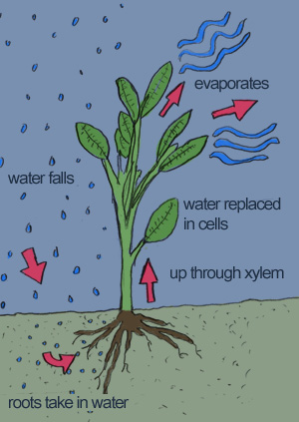
Plant-environment interaction
www.blogdivvy.com
Notes:
CO2 enters and water and oxygen exit a plant through leaf stomata. Plants regulate the trade off between CO2 uptake and water loss by adjusting stomatal aperture.
Key message:
-Plants absorb CO2 for photosynthesis, while losing water thru evapotranspiration driven by evaporative demand associated with air temperature.
-Leaf stomata regulate a trade off between CO2 uptake and water loss through stomatal closure.
-Plants tend to increase stomatal closure in response to an increase in evaporative demand to prevent excessive water loss and to maintain their safety limits—a trade off between growth and safety.
-Stomatal sensitivity, a magnitude of an increase in stomatal closure with increasing evaporative demand, varies across species.
-Soil moisture gradient also constrains stomatal sensitivity—decrease in soil moisture increases stomatal sensitivity.
CC will substantially increase evaporative demand (due to warmer temperatures and potentially shifts in seasonal rainfall regimes, both of which will affect soil moisture as well as vapor pressure deficits)
References:
http://evolution.berkeley.edu/

Slide 13
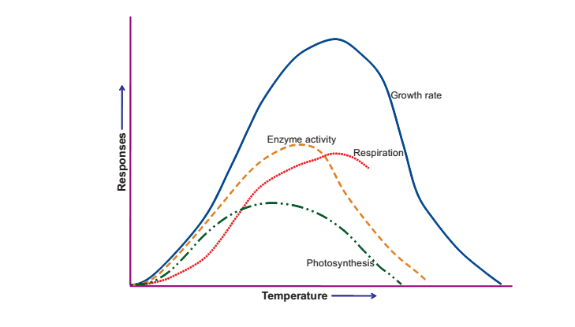
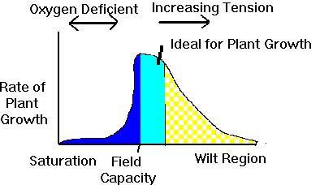
Ecological tolerance
The processes of plant growth, metabolism, and germination have optimum temperature and soil moisture ranges
Temperature
Soil moisture
Notes:
The processes of plant growth, metabolism, and germination have optimum ranges of temperature and soil moisture. There is some variation in optimum conditions among species.
Key message:
Temperature: Most organisms are adapted to live within a relatively narrow range of temperatures and will not thrive if temperatures are colder or warmer. The growing season of plants, for example, is strongly influenced by temperature.
Water: Plants and all other organisms require water. On land, water is often scarce, so patterns of rainfall have a major influence on life.
References:
Graphic 1: http://www.intechopen.com/books/abiotic-stress-plant-responses-and-applications-in-agriculture/extreme-temperature-responses-oxidative-stress-and-antioxidant-defense-in-plants
Graphic 2: http://www.swac.umn.edu/classes/soil2125/doc/s7chp3.htm

Slide 14
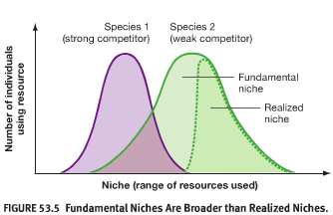
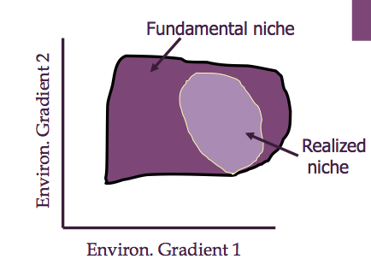
Ecological tolerance
Fundamental niche = the environmental conditions within which a species can survive and grow (Hutchinson 1957)
Realized niche = a subset of a species’ fundamental niche where a species is actually found due to competition and other biotic interactions.
Notes:
A species fundamental niche is the environmental conditions within which that species can survive and grow. The realized niche is the portion of the fundamental niche within which the species exists due to competition with other species.
Key message:
The fundamental niche is always broader than the realized niche.
Niches both fundamental and realized are likely to change for many organisms as they struggle to adapt to changing climate. For species with very rigid fundamental niches, prospects for adaptation and survival are probably poor without focused management.
Graph 1 axis labels environmental gradient 1 and 2 could refer to temperature, rainfall, soil conditions, etc.
References:
Graphic 1: http://www.studyblue.com/notes/note/n/bio-117-final/deck/4657639
Graphic 2:http://dc311.4shared.com/doc/tZLkALEo/preview.html

Slide 15
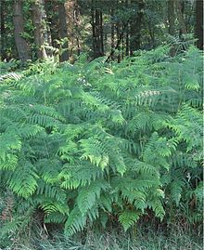
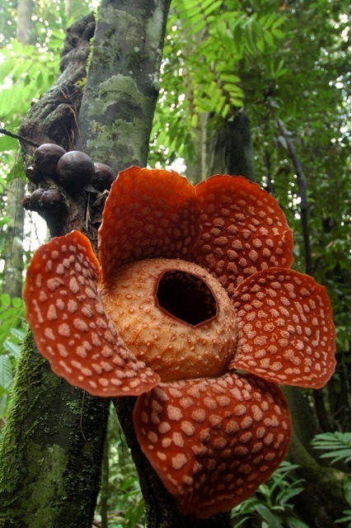
Plant distribution
Plants cover most of the earth’s surface
Individual species, however, have a smaller and unique
distribution based on their own history and tolerance of environmental conditions
Plants (and animals) fall somewhere on a continuum
from generalist species that can thrive in a variety of
environmental conditions to specialist species that can only
thrive in a narrow range of environmental conditions
Bracken fern, a generalist, is one of the world's most common plants
Rafflesia, a specialist, is a parasitic flowering plant endemic to South East Asia that produces an odor like carrion that attracts flies to pollinate it.
Notes:
Although plants cover the earth, each species has its own unique distribution based on its ecological tolerance and history.
Key message:
Plants and animals fall somewhere on a continuum from generalist species that can thrive in a variety of environmental conditions to specialist species that can only thrive in a narrow range of environmental conditions. The rafflesia is an example of a specialist plant species. The koala bear that only eats Eucalyptus leaves is an example of a specialist animal species. Also the panda bear that eats only bamboo.
References:
Photo: http://blogs.scientificamerican.com/science-sushi/files/2012/06/Rafflesia_cantleyi_flower.jpeg

Slide 16
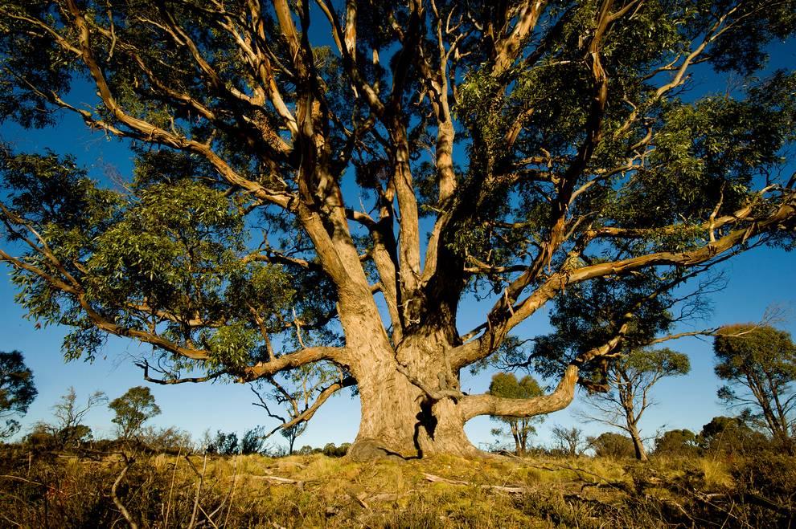
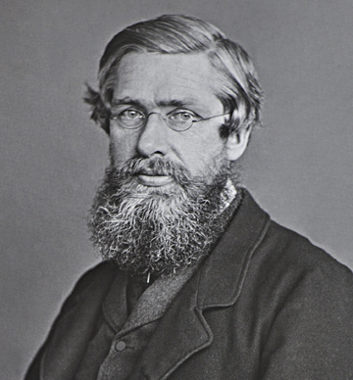
Biogeographic Hypotheses
Adaptation: Plants are adapted to their environment (i.e. plants that evolve in response to the same environmental conditions will be similar).
Eucalyptus found only in Australia
History: The partial isolation of continents has led to the evolution of different lineages in different places (i.e. ecosystems of historically unique places will be different due to having historically unique species).
Alfred Russell Wallace
Notes:
Biogeography is the study of the distribution of species and ecosystems in geographic space and through geological time. It can be studied with a focus on ecological factors (adaptation) that shape the distribution of organisms, or with a focus on the historical factors that have shaped the current distributions.
Key message:
Alfred Russell Wallace ”the father of Biogeography” noticed that different regions of the world had congruent patterns of endemic species and he drew up six biogeographic realms (nearctic, neotropical, holarctic, ethiopian, oriental and australian). Wallace worked primarily in the Malaysian region and had noticed a clear break between Australian fauna and the fauna on the islands to the northwest. This break has come to be known as Wallace's line (also a line between the Australian and the Asian biogeographic zones).
References:
Photo: http://news.nationalgeographic.com/news/2013/10/131022-gold-eucalyptus-leaves-mining-geology-science/

Slide 17
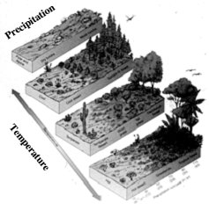
Adaptation
Species with similar ecological tolerances develop into a plant community that has similar structural characteristics but distinctive species composition in different regions
At the broadest scale these plant communities are the major biomes of the world.
The regional extent of each biome is primarily determined by climate, thus climate is the basis for most biome classification systems
Walter, Holdridge, Whittaker
Tropical rain forest
Notes:
Key message: Biomes are major ecological communities that have a characteristic appearance, such as tropical rain forest or tundra, and that are distributed over a wide land area and defined largely by regional variations in climate. There are a number of different biome classification systems a few of which we will discuss in this lecture.
Biomes are ecosystems that extend over large geographical areas and take their name from the dominant vegetation type within (for example, coniferous forest). A biome may cover a large area of a continent or may straddle several (the tropical rainforest is found in three). Each has its own characteristic soil, flora and fauna. Climate determines the distribution pattern of the different biomes. If climate is changing, then it stands to reason that the map of world biomes will also need to be modified.
The diagram illustrates where different biomes fall on a continuum of temperature and precipitation. For example, tropical rain forests at the equator are wet and hot.
References: www.botany.wisc.edu-courses-botany 422-Lecture-pdf-Climate

Slide 18
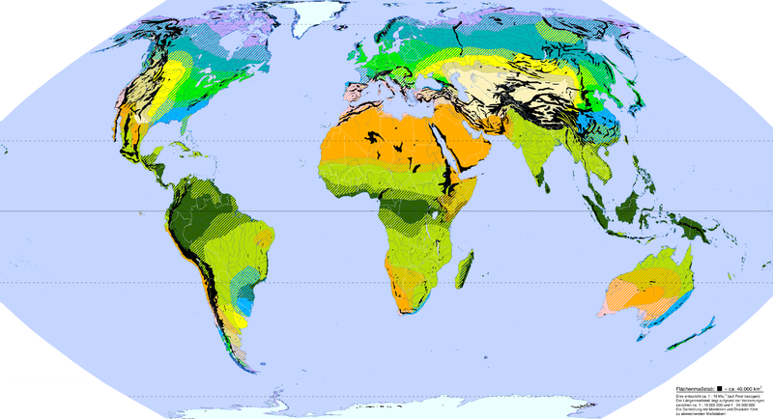
Walter’s “Climate Zone System”
German ecologist Heinrich Walter classified regions on the basis of seasonal patterns of temperature and precipitation
Predicts similar ecosystems in places with similar climates (focuses on adaptation rather than history)
I: Equatorial
II: Tropical
III: Subtropical
IV: Mediterranean
V: Warm temperate
VI: Nemoral
VII: Continental
VIII: Boreal
IX: Polar
Notes:
Heinrich Walter, a German ecologist, came up with one of the most widely adopted classification schemes based on seasonal patterns of temperature and precipitation.
Key message:
This classification ignores species composition. It focuses on the ecological similarities produced by adaptive convergences in similar environments.
References:
http://commons.wikimedia.org/wiki/File:Zonobiome.png

Slide 19
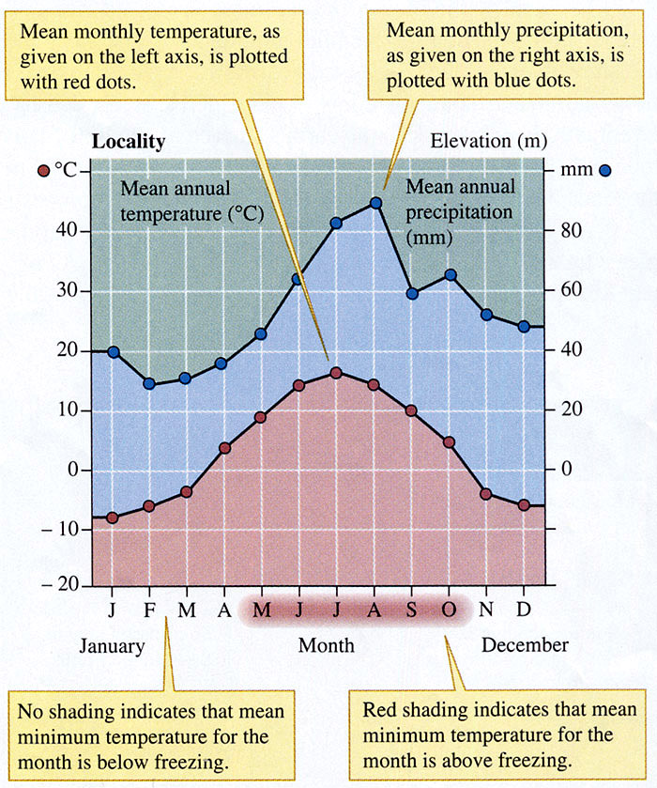
Walter’s climate diagrams
Useful for comparing climates between localities
Temperature and rainfall lines depict the seasonal availability of water
Walter’s biome scheme predicts similar ecosystems in places with “homoclimates”
Notes:
Climate diagrams are useful for summarizing major climate features for each biome and make it possible to compare climates between localities.
Key message:
Climate diagrams depict moisture and temperature curves by month to convey the seasonal availability of water, both relative moisture deficits or surplus’. Note that the temperature and rainfall scales are adjusted to roughly show when rainfall is likely to be insufficient to support full plant production. As a rule of thumb, about 20 mm of monthly precipitation for each 10°C in temperature provides sufficient moisture for plant growth. This occurs when the precipitation line (blue) is above the temperature line (red). The bars at the bottom indicate freezing weather.
Again, this classification system focuses on the ecological similarities produced by adaptation in similar environments.
References:
Graphic: http://sky.scnu.edu.cn/life/class/ecology/chapter/Chapter2.htm

Slide 20
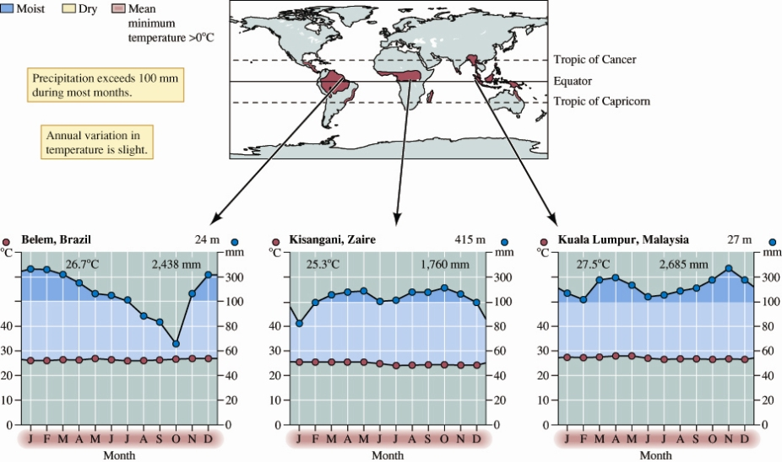
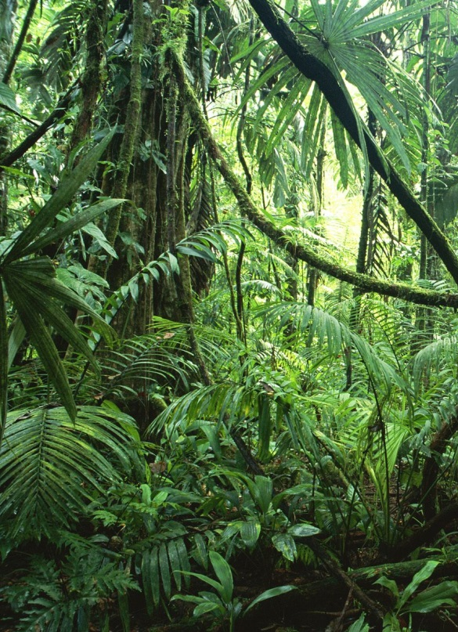
Tropical rain forest
Notes:
The next few slides depict climates of some of the major biomes
Key message:
Tropical rain forests are found near the equator between the Tropic of Cancer and the Tropic of Capricorn where precipitation generally exceeds 100mm/month (as indicated by the dark blue shading) and there is only slight variation in annual temperatures. Here you can see climate diagrams for tropical rain forest locations in Brazil, the Congo, and Malaysia.
Reference:
http://sky.scnu.edu.cn/life/class/ecology/chapter/Chapter2.htms
http://tourists360.com/tropical-rainforest/

Slide 21
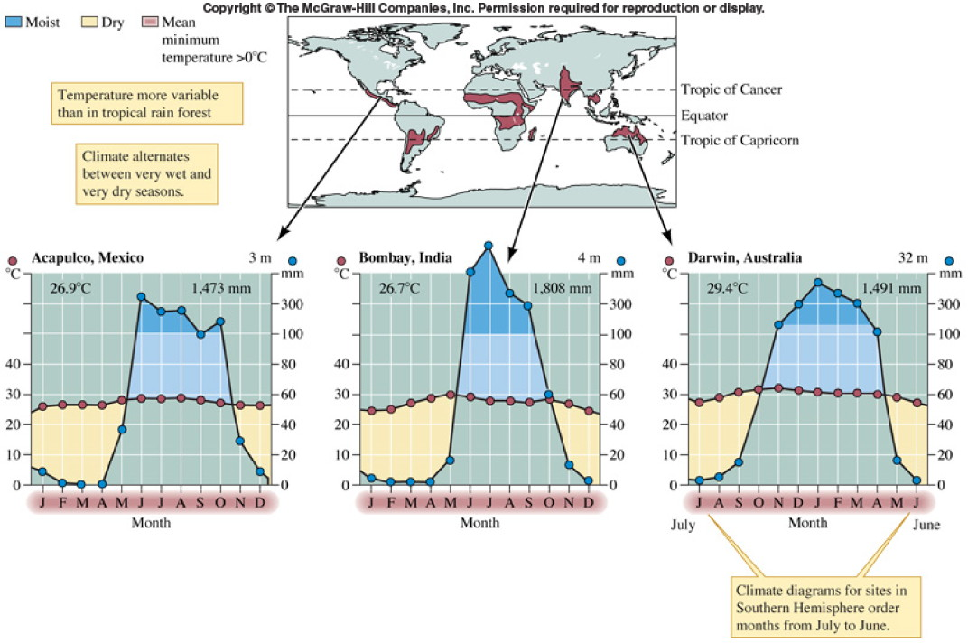
Tropical dry forest
Notes:
Tropical dry forest, unlike tropical rain forest experience distinct wet and dry seasons (indicating by the blue and tan shading) and temperatures are more variable
Key message:
Here you can see climate diagrams for dry tropical forest locations in Mexico, India, and Australia
References:
http://sky.scnu.edu.cn/life/class/ecology/chapter/Chapter2.htms:
http://archive.sciencewatch.com/inter/aut/images-aut/2009/09maySCIAzof3XL.jpeg

Slide 22
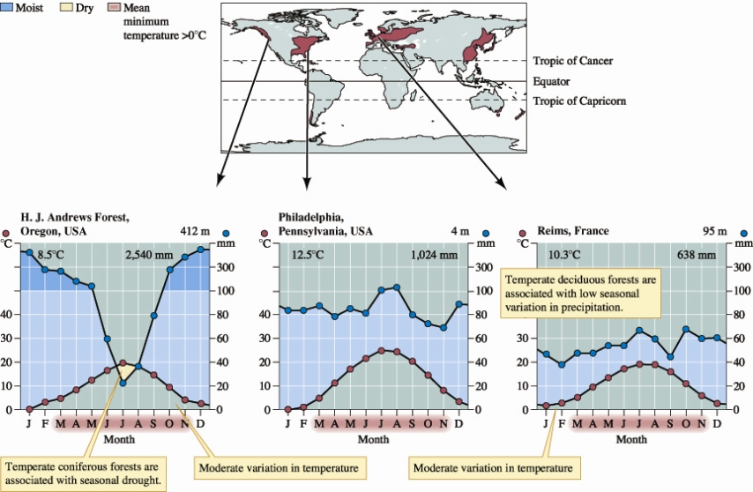
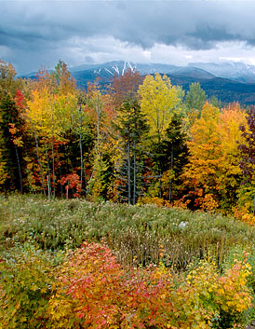
Temperate Forest
Notes:
Temperate forests experience moderate variation in temperature and low seasonal variation in precipitation for deciduous temperate forests while temperate coniferous forests are associated with seasonal drought.
Key message:
Here you see climate diagrams for temperate forest locations in the states of Oregon and Pennsylvania in the US and in France
References:
http://wildtracks.files.wordpress.com/2012/01/autumn-foliage.jpg
http://sky.scnu.edu.cn/life/class/ecology/chapter/Chapter2.htms:

Slide 23
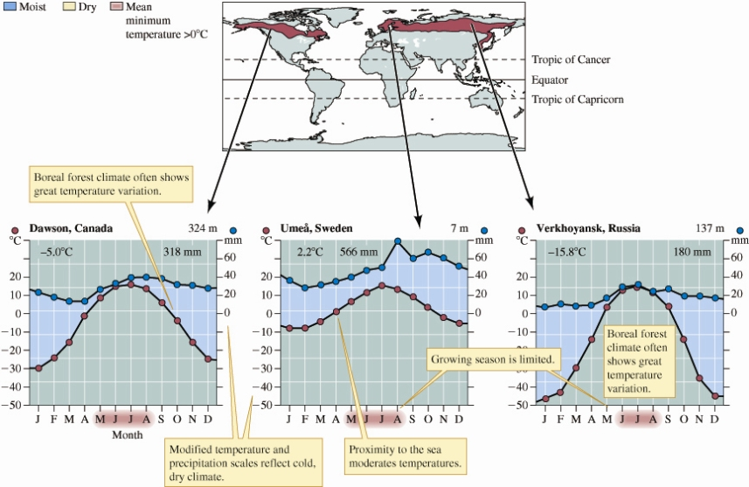
Boreal forest
Notes:
Boreal forests often experience great temperature variation and precipitation is fairly low throughout the year.
Key message:
Here you see climate diagrams for boreal forest locations in Canada, Sweden, and Russia.
References:
http://sky.scnu.edu.cn/life/class/ecology/chapter/Chapter2.htms
http://upload.wikimedia.org/wikipedia/commons/2/2d/Picea_glauca_taiga.jpg

Slide 24
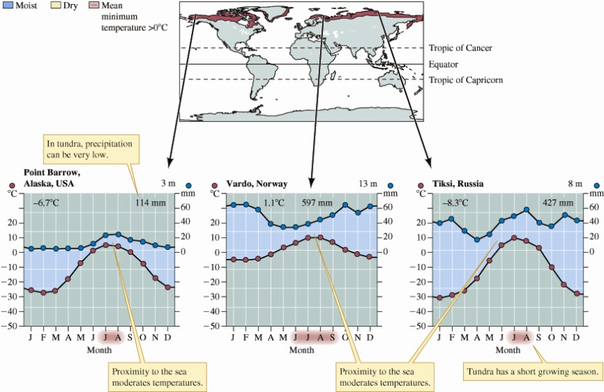
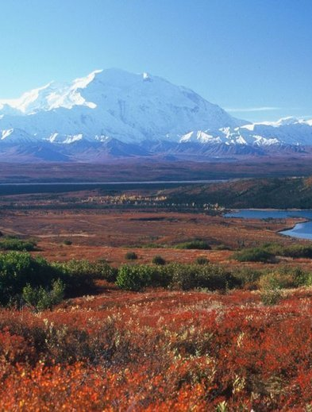
Tundra
Notes:
Tundra experiences consistently cold temperatures and precipitation can be quite low
Key message:
Here you see climate diagrams for tundra locations in Alaska, Norway, and Russia
References:
http://sky.scnu.edu.cn/life/class/ecology/chapter/Chapter2.htms
http://dev.epubbud.com/uploads/1/2/5/1255998/images/tundra.jpg

Slide 25
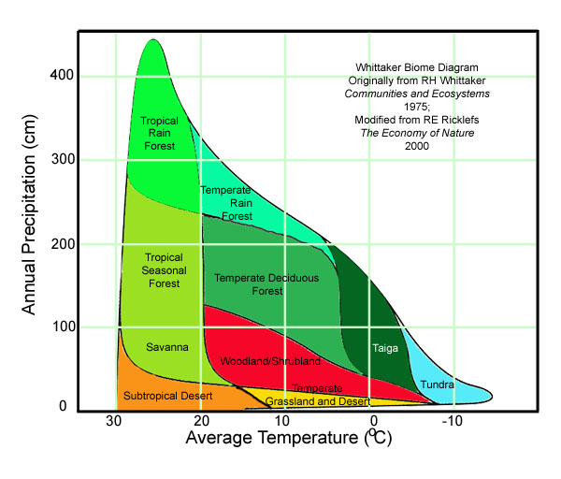
Whittaker’s biome scheme
American plant ecologist Robert Whittaker classified regions according to their dominant vegetation which generally reflects local climate
Simplification of the Holdridge biome scheme
Notes:
Robert Whittaker, an American ecologist, came up with another simple, widely used biome classification scheme that is based on temperature and precipitation.
Key message:
Robert Whittaker plotted rainfall vs. temperature for points all over the globe on a single graph (one version shown here). He then looked at what biomes had developed at those sites, and was able to group the different biomes according to mean annual temperature and precipitation, as the shaded areas in the graph indicate. This scheme is considered a simplification of the Holdridge biome classification which had three axes: temperature, precipitation, and potential evapotranspiration. Unlike the Walter classification system the Whittaker and Holdridge schemes do not take into account the seasonality of temperature and precipitation.
References:
http://www.marietta.edu/~biol/biomes/biome_main.htm

Slide 26
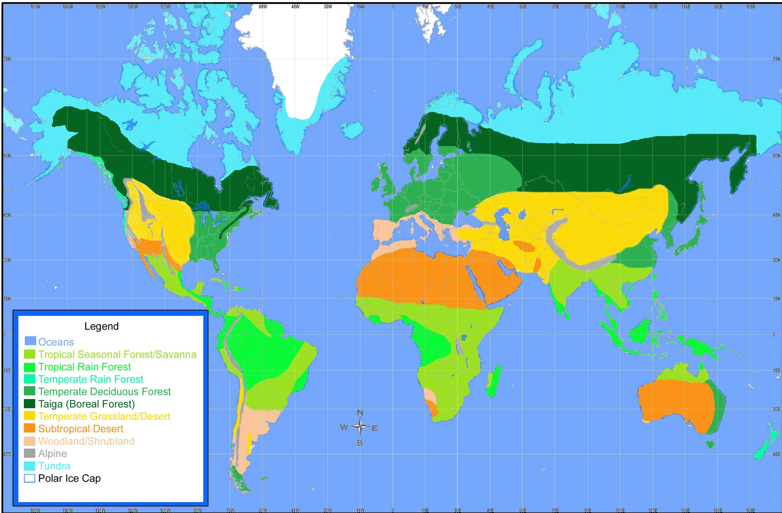
Biomes of the world
Notes:
Biomes are major types of ecological communities, recognizable on a regional scale, although many other communities may exist there as well. For instance, here in ______, our biome is the _______.
Key message:
Biome classification is a useful tool to understand structure and functioning of large ecological systems. Different systems of classification make coarser or finer distinctions among biomes and characteristics of one biome often intergrade gradually into the next.
While climate is largely determined by location with regard to the equator, it is also determined by distance from the ocean and topography.
Average, minimum, and maximum temperatures and rainfall influence the distribution of species. While potential vegetation is largely determined by climate, the actual distribution of vegetation is influenced by additional factors and has been modified by humans.
References:
http://www.marietta.edu/~biol/biomes/biome_main.htm

Slide 27
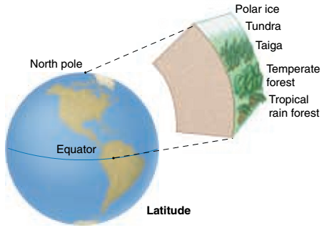
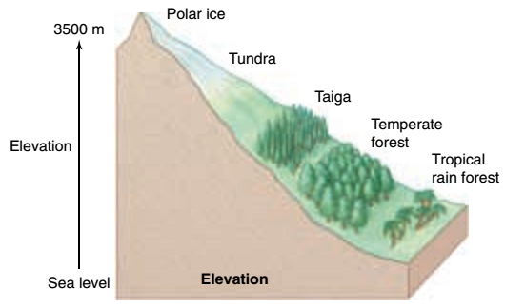
Factors that influence landscape/local scale plant distribution :
Topography
Geology/soil characteristics
Chance and history
Species interactions
Fire
Herbivory (plant consumption)
Notes:
Key message:
Although the two key parameters that determine biome distribution are available moisture and temperature, many different environmental factors play a role. Different places with the same annual precipitation and temperature sometimes support different biomes, so other factors must also be important. These factors include…(read list). Discuss topography
Notes:
Scale determines the relative importance of various controls
Topography causes local variation in climate that influences local species distribution. Elevation affects temperature such that every 1000 ft of altitude = 100 miles of latitude = -3.5 °F. Mountain ranges tend to intercept rain, creating deserts in their shadow. Human activity is also an important determinant of plant distribution that is not listed here.
References:
http://www.bio.utexas.edu/faculty/sjasper/Bio301M/aquahab.html

Slide 28
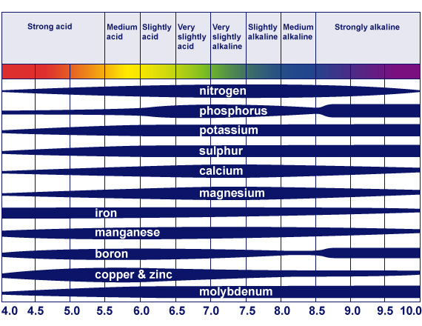
Soil Factors that influence landscape/local scale plant distribution :
Notes:
Soils are the second most important influence on plant distribution after climate.
Key message:
Soils develop over time as a function of:
Parent material (geology)
Temperature and rainfall (climate)
Organisms (ecology)
Soil types are a product of the dominant soil-forming processes operating in a given environment. Climate is the key control over soil type at a global scale. Temperature and rainfall: Chemical weathering occurs quickly under hot wet conditions and slowly under cold and dry conditions. For example, humid climates generally produce acid soils as basic minerals are leached away over time. Geology can cause variation in soil characteristics/edaphic conditions that influence plant distribution at finer scales. Organisms: Plants and animals deposit organic matter. Soil organisms influence soil structure. People also influence soil characteristics.
How do soils influence plant distribution? The physical consistency, pH, and mineral composition of soil often severely limit plant growth, particularly the availability of nitrogen and phosphorus. Discuss graphics: Soil texture influences water availability and soil pH influences nutrient availability.
References:
Graphic 1: http://www.nature.com/scitable/knowledge/library/soil-water-dynamics-59718900
Graphic 2: http://www.vernier.com/innovate/measuring-the-ph-of-soil-with-the-new-tris-compatible-flat-ph-sensor/

Slide 29
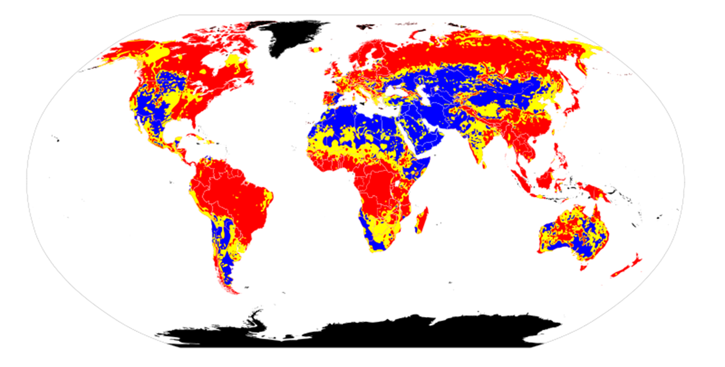
Humid climates tend to produce more acidic soils
Acidic pH Neutral pH Basic pH No data
Source: http://commons.wikimedia.org/wiki/File:World_Soil_pH.svg
Notes:
Humid climates generally produce acid soils as basic minerals are leached away over time.
Key message:
Gross patterns of soils, climates and biomes resemble each other.
References:
FROM UC Davis lecture: [http://www.des.ucdavis.edu/faculty/Richerson/ESP30/0-2%20Vegetation%20Patterns.pdf].
Source: http://commons.wikimedia.org/wiki/File:World_Soil_pH.svg – need to add legend: [red = acidic; yellow = neutral; blue = basic; black = no data]

Slide 30
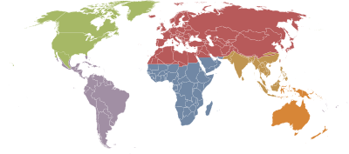
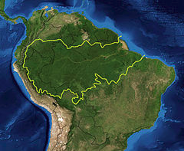
History: Ecozones
Ecozones
Ecozones delineate large areas of the Earth's surface within which organisms have been evolving in relative isolation over long periods of time
Biogeographic approach to classifying organisms based on their history rather than adaptation
Ecoregion
Notes:
There is another biogeographic approach to classifying organisms that focuses on their history rather than adaptation (as opposed to the classification schemes we discussed earlier). This approach is used by WWF who have divided the earth up into 8 ecozones. Read definition.
Key message:
Ecozone: broadest biogeographic division of the Earth's land surface, based on distributional patterns of terrestrial organisms. Ecozones delineate large areas of the Earth's surface within which organisms have been evolving in relative isolation over long periods of time, separated from one another by geographic features. As such, ecozone designations are used to indicate general groupings of organisms based on their shared biogeography. WWF has identified 8 ecozones. Ecozones correspond to the floristic kingdoms of botany or zoogeographic regions of zoology.
Ecoregion: relatively large unit of land or water containing a characteristic set of natural communities that share a large majority of their species, dynamics, and environmental conditions. WWF has identified 867 terrestrial ecoregions, and approximately 450 freshwater ecoregions across the Earth.
References:
Graphic 1: http://en.wikipedia.org/wiki/Ecozone
Graphic 2: http://simple.wikipedia.org/wiki/Ecoregion

Slide 31
WWF Ecozones
Ecozone (WWF definition) | Area |  | Notes
 | million km2 | million km2
Palearctic | 54.1 | 20.9 | including the bulk of Eurasia and North Africa
Nearctic | 22.9 | 8.8 | including most of North America
Afrotropic | 22.1 | 8.5 | including Sub-Saharan Africa
Neotropic | 19.0 | 7.3 | including South America, Central America, and the Caribbean
Australasia | 7.6 | 2.9 | including Australia, New Guinea, New Zealand, and neighbouring islands. The northern boundary of this zone is known as the Wallace line.
Indo-Malaya | 7.5 | 2.9 | including the Indian subcontinent, Southeast Asia, and southern China
Oceania | 1.0 | 0.39 | including Polynesia (except New Zealand), Micronesia, and the Fijian Islands
Antarctic | 0.3 | 0.12 | including Antarctica.
Notes:
Slide is provided as a reference but is currently hidden
Notes:
References: http://en.wikipedia.org/wiki/Ecozone

Slide 32
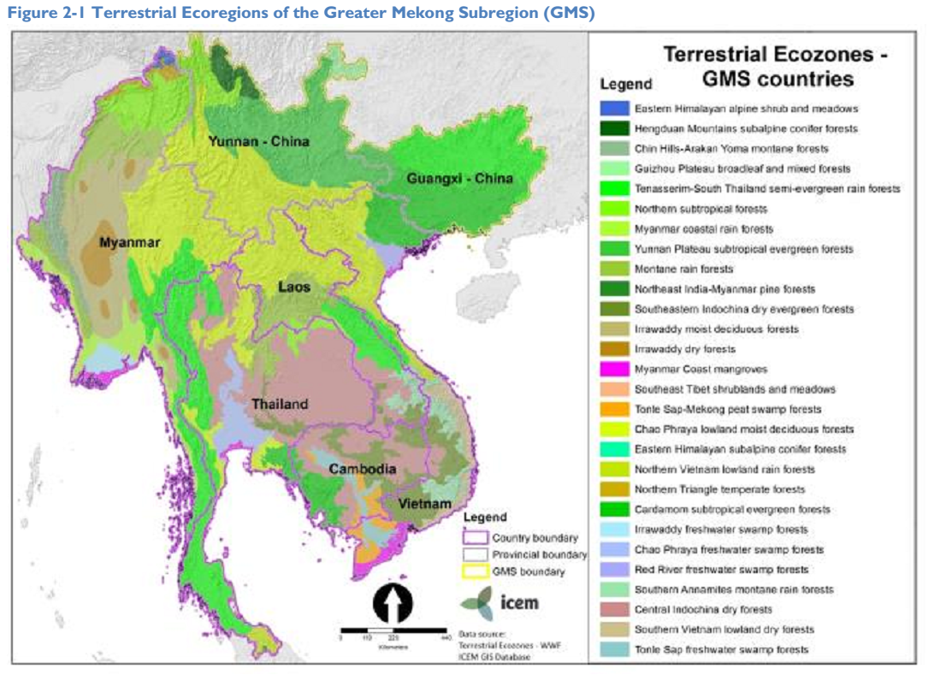
South East Asian terrestrial ecozones
Notes:
Terrestrial ecoregions of the Greater Mekong Subregion from USAID Mekong ARCC Climate Study for the Lower Mekong Basin
Key message:
Ecoregion: relatively large unit of land or water containing a characteristic set of natural communities that share a large majority of their species, dynamics, and environmental conditions. WWF has identified 867 terrestrial ecoregions, and approximately 450 freshwater ecoregions across the Earth. The Mekong ARCC Climate Study divided the basin into ecozones – areas of similar climate, ecosystems, and agricultural characteristics and potential.
The Lower Mekong Basin is a region of rich diversity – of landscapes, biodiversity, and ethnic and cultural diversity. It lies in the Indo-Burma Biodiversity Hotspot with 12 of the World Wide Fund for Nature
(WWF) Global 200 ecoregions, which are critical landscapes of international biological importance including: the Northern Indochina sub-Tropical Moist Forests, Annamite Range Moist Forests, the
Indochina Dry Forests, the Eastern Himalayan Alpine and Meadows, the Eastern Himalayan Broadleaf and Conifer Forests, the Salween River, the Peninsular Malaysian Lowland and Montane Forests, the
Cardamom Mountains Moist Forests, the Mekong River, and the Andaman Sea (Figure 2-1).
References:
http://www.mekongarcc.net/resource/usaid-mekong-arcc-lower-mekong-climate-study-released-download

Slide 33
Class exercises
Option 1: Outline the factors influencing the distribution of a specific biome.
Option 2: Create a Walter climate diagram of current temperature and precipitation conditions for Bangladesh. Redraw your climate diagram based on what you know about climate change projections for 2100. Discuss what the new graph suggests about water availability throughout the year and how likely ecosystem shifts are in the next century.
Notes:
Option 1 is brief and can be a class discussion. Option 2 could be done in groups or individually.
Notes:
References:

Slide 34
Terrestrial ecosystems and changing climate
Notes:
Notes:
References:

Slide 35
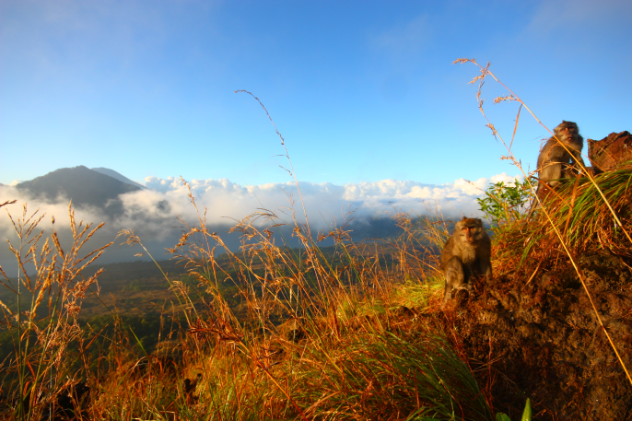
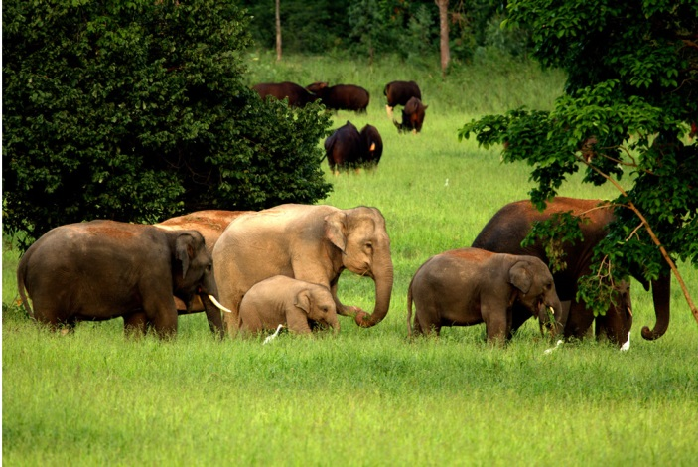
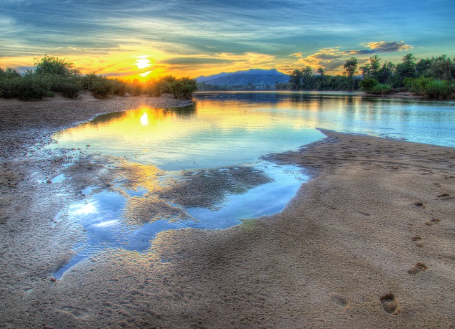
Ecological Impacts
Living things are intimately connected to their physical environment.
Ecosystems are affected by changes in:
Temperature
rainfall/moisture
pH
Salinity
activities & distribution of other species
…many other factors
Notes:
Review the ways in which ecosystems are impacted by changing climate
Key message:
Wildlife is impacted directly by changes in temperature and precipitation and indirectly through effects of climate on habitat suitability (e.g. vegetation) and the frequency and intensity of disturbances (e.g. severe storms, wildfires)
Ask audience to consider a particular local species
What are the conditions in its environment that affect this species?
Which of these factors may be changing and in what ways?
In addition to being affected by their physical environment, living things are also intimately connected to each other. For example, honey is produced in a beehive, but the bees depend on pollen and nectar from the plants they pollinate. These plants, in turn, depend on the bees that pollinate them, the worms that aerate the soil, the microbes that release nutrients, and many other organisms. This diverse array of creatures is key to the functioning of the entire system.
References:
From presentation by the National Acadamies: annefjohnson.com/docs/ei_presentation.ppt‎
based on its report Ecological Impacts of Climate Change (2009): www.nas.edu/climatechange

Slide 36
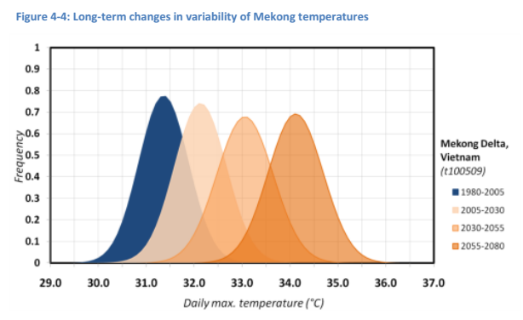
CC Impacts for Asia
What are some of the climate change projections for Asia? How will they impact Asian ecosystems?
Notes:
Key message:
Ask the audience for examples of some climate change impacts projected for South East Asia. The first graphic that appears shows projected temperature shifts in the Lower Mekong Basin and the second graphic shows the long-term changes in variability of Mekong temperatures from the Mekong ARCC Climate Study. Summary of IPCC climate change impacts listed on the next slide.
Notes:
The first graph is figure 4.3 from the Mekong ARCC Climate Study and shows the long term warming signal in daily maximum temperatures at five stations based on the average change from 6 GCMs and IPCC SRES A1b. The second graph is figure 4.4 from the Mekong ARCC Climate Study and shows that in the medium and long term, temperature regimes are also becoming more variable than under baseline conditions.
References:
http://www.mekongarcc.net/resource/usaid-mekong-arcc-lower-mekong-climate-study-released-download

Slide 37
IPCC summary of CC Impacts in SE Asia
Warming similar to global mean
More rain, more intense rainfall Warming similar to global mean
Reduced snow / ice in Himalayas
More extreme storms -> More floods and landslides
More and longer droughts
Water stress & decreased water availability
More glacial melt floods; slope destabilization & decreased river flows as glaciers recede
Lower crop yields
Reduced soil moisture / evapotranspiration → degradation / desertification
Diarrhea risk, heat stress, changing disease vector patterns
Extinction risk from habitat fragmentation / CC interactions
Coastal zones – inundation, storms
Aquaculture / infrastructure will be affected
Wetlands, mangroves, reefs threatened
Notes:
Summary of CC impacts in SE Asia from the IPCC. In the next section of the lecture we will focus on the impacts of climate change on terrestrial ecosystems.
Key message:
References:
http://www.mekongarcc.net/resource/usaid-mekong-arcc-lower-mekong-climate-study-released-download

Slide 38
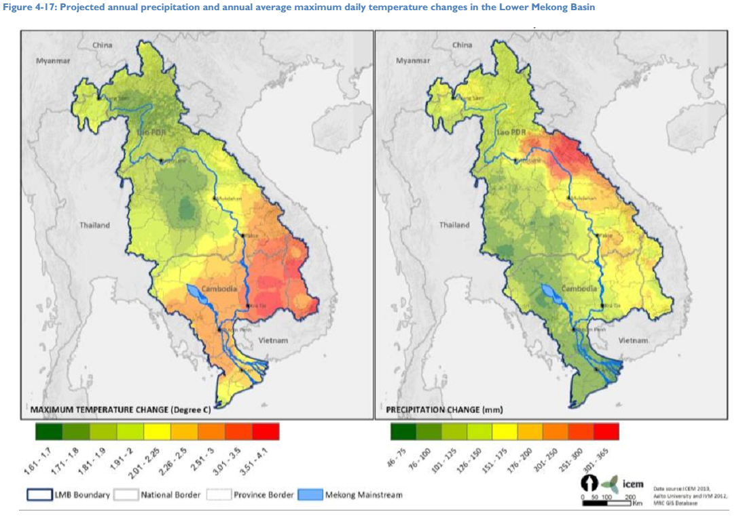
Projected temperature and precipitation changes for the lower Mekong River basin
Notes:
Another figure from the Mekong ARCC Climate Study showing projected annual average maximum daily temperature and annual precipitation changes for the LMB (unfortunately this analysis was not conducted for the entire Mekong region).
Key message:
References:
http://www.mekongarcc.net/resource/usaid-mekong-arcc-lower-mekong-climate-study-released-download

Slide 39
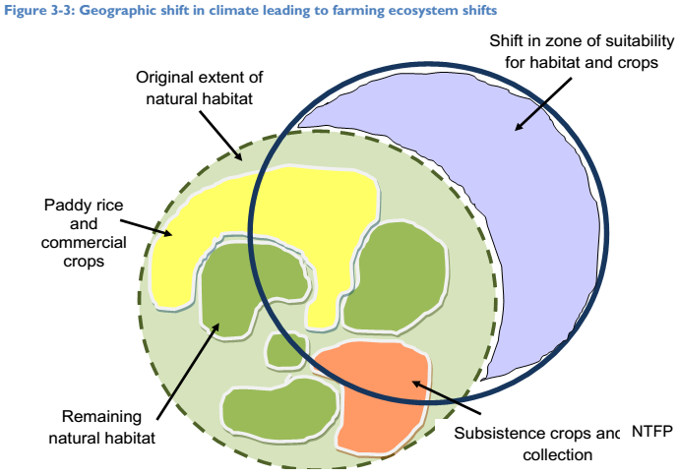
Climate change shifts
Climate change shifts are spatial or temporal changes in regular or extreme climate.
They include geographic shifts, elevation shifts, and seasonal shifts
These shifts can prompt changes in areas of suitability for specific habitats and lead to changes in species composition
Notes:
Climate change shifts are spatial or temporal changes in regular or extreme climate that will impact habitat suitability and lead to changes in species composition
Key message:
Climate change shifts are spatial or temporal changes in regular or extreme climate. They include geographic shifts – which prompt changes in areas of suitability for specific habitats and/or crops; elevation shifts – affecting highly restricted habitats and species; and seasonal shifts – inducing a change in yields and cropping patterns. A good example of a temporal shift occurs in Chiang Saen, where under climate change the onset of wet season flow is projected to shift 15 days later. Shifts in regular climate may shift the zone of suitability for natural habitats and crops leading to changes in species composition in certain areas (Figure 3-3). Climate change shifts will involve species and spatial shifts in farming ecosystems.
The projected rate of ecosystem change is large in many cases compared to the ability of species and systems to migrate (Loarie et al. 2009). One measure of this, which has been termed the “velocity of climate change,” represents the local horizontal velocity of an ecosystem across the Earth´s surface needed to maintain constant conditions suitable for that ecosystem. under approximately 3.6°C warming by 2100 the global mean velocity of all ecosystems is about 0.4 km per year.
References:
http://www.mekongarcc.net/resource/usaid-mekong-arcc-lower-mekong-climate-study-released-download

Slide 40
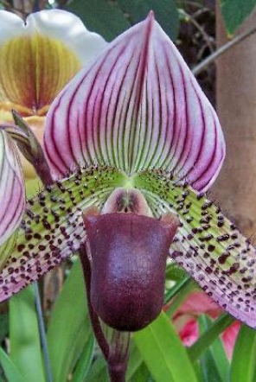
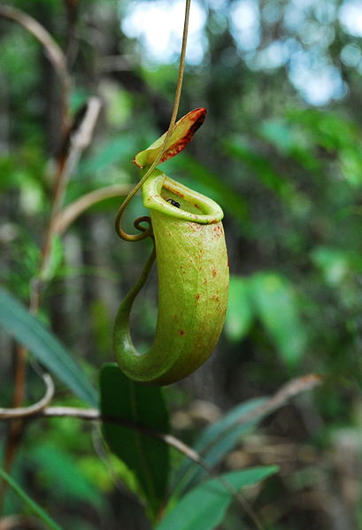
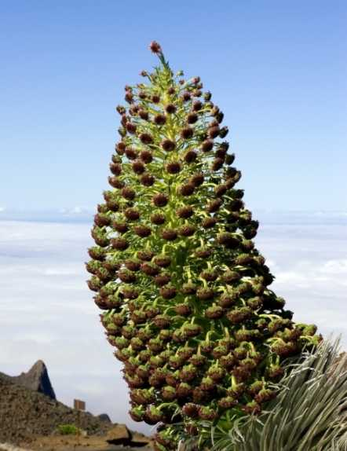
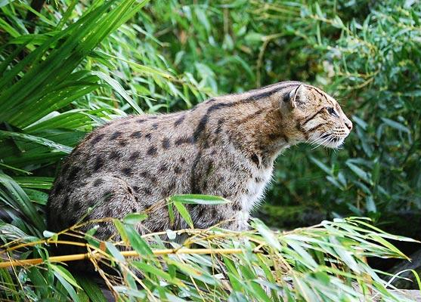
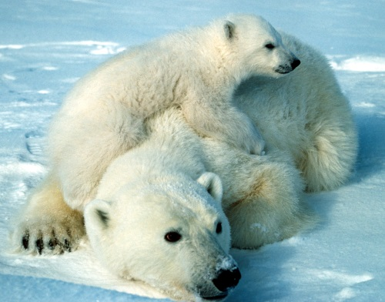
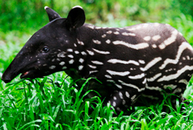
Species vulnerability
Species at greatest risk for CC:
Rare, threatened, endangered
Restricted ranges
Poor dispersers
Mountain-top and low-lying island endemics
Extreme niche specialists
Narrow physiological tolerances
Notes:
Discuss the list of characteristics which describe species at greatest risk for CC.
Key message:
The ecosystems that are at their ecological or geographic limit (formations with zero water balance, ecosystems dominated by relic species from past climates, high-mountain ecosystems, certain formations in arid regions) are the ones that will be most affected by climatic change.
References:
Graphic 1: http://richardbrown81.hubpages.com/hub/Solutions-from-the-Endangered-Species-Trade
Graphic 2: http://www.telegraph.co.uk/news/picturegalleries/earth/3145140/The-IUCN-Red-List-of-endangered-species.html?image=3
Graphic 3: http://lawprofessors.typepad.com/environmental_law/2013/01/the-polar-bear-critical-habitat-decision.html
Graphic 4: http://www.allaboutwildlife.com/ten-most-endangered-animals
Graphic 5: http://www.earthtimes.org/nature/endemism-island-mainland-species/2120/ (Rare and endangered Silversword plant that grows on the summit of Haleakala Maui)
Graphic 6: http://en.wikipedia.org/wiki/List_of_threatened_species_of_the_Philippines

Slide 41
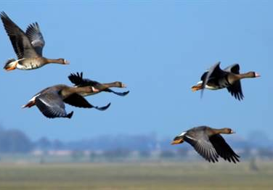
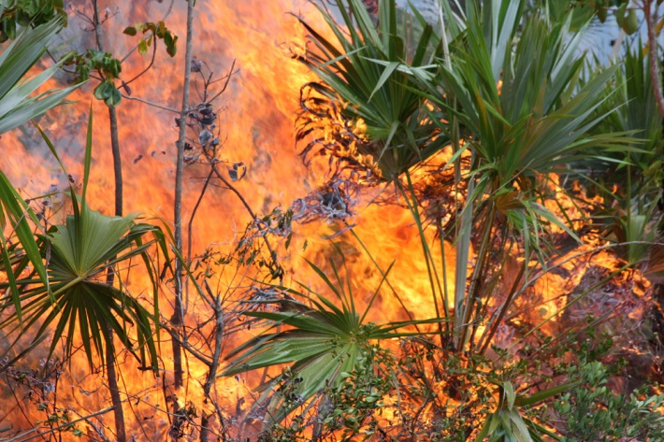
Ecological impacts
As a result of climate change species and ecosystems are experiencing changes in:
Range and distribution
Physiology
Phenology
Risk of disturbance
Notes:
Read the list of four ways in which plants and animals are impacted by climate change. The next section of the lecture will describe each in more detail beginning with physiology.
Key message:
Physiology: the ways that living things or any of their parts function (for example growth rate)
References:
Graphic1: http://www.travelwithus.co.za/viewblog.aspx?id=34
Graphic 2: http://trongraulamvuon.com/ky-thuat-trong-cay/10-loai-hoa-dai-dien-cho-cac-nuoc-dong-nam-a/
Graphic 3: http://www.fws.gov/ph26.html

Slide 42
Range and distribution
Species can adapt or relocate to areas with more tolerable climate conditions (or face extinction).
Range and distribution are influenced by:
Niche
Dispersal capacity
Species interactions
Notes:
Species can adapt or relocate to areas with more tolerable climate conditions. Their ability to do so depend on their niche, dispersal capacity, and species interactions.
Key message:
Well-documented biological impacts from climate change include shifts in population range and distributions, which reflect the product of several interacting processes. First, the dispersal capacity of species from a regional species pool determines whether they will have the opportunity to invade or inhabit a site.
Second, the range of abiotic environmental conditions that are physiologically tolerable to a species defines its fundamental niche, and thus niche boundaries can change as climate changes. Third, biological interactions (predation, competition, and others) may constrain, or in some cases expand (Bruno et al. 2003), the habitable range of conditions or the realized niche of a species. A set of species with overlapping realized niches constitutes a community, and by affecting all of these processes, climate change can alter the composition and function of communities.
Large shifts in vegetation distributions are expected this century with the most rapid & extreme shifts at ecotones – the region of transition between two biological communities. About 40 percent of wild plants and animals that have been studied over decades are relocating to stay within their tolerable climate ranges.
Some organisms—those that cannot move fast enough or those whose ranges are actually shrinking—are being left with no place to go. For example, as arctic sea ice shrinks, so too shrink the habitats of animals that call this ice home, such as polar bears and seals.
Range shifts particularly threaten species that:
cannot move fast enough
depend on conditions that are becoming more rare (like sea ice)
Need some specific examples of range shifts for SE Asian wildlife or plants
As climate or other conditions shift, organisms initially respond based on physiological and behavioral adaptations molded through their evolutionary history (Somero 2012). New conditions may be physiologically tolerable, allowing acclimatization (an adjustment of physiology within individuals) or adaptation (increased abundance and reproduction of tolerant genotypes over generations), or may be intolerable, promoting migration (by individuals or populations), change in phenology (timing of annual events), or death and local extinction if adaptation is not possible (Parmesan 2006).
Climate-driven range shifts also may be accompanied by changes in demographics and organism abundance and size, as suggested by coupled climate-population models (Hare et al. 2010).
References:
Graphic 1: http://www.redorbit.com/news/science/1211671/potential_impacts_of_climate_change_on_the_distribution_of_north/
Graphic 2: http://russolab.unl.edu/research_seed.html
Graphic 3: http://insidescoopsf.sfgate.com/blog/2011/10/26/october-26th-one-year-later/aptopix-germany-bird-migration/
Presentation by the National Acadamies: annefjohnson.com/docs/ei_presentation.ppt‎
based on its report Ecological Impacts of Climate Change (2009): www.nas.edu/climatechange

Slide 43
Past shifts in terrestrial habitat
18,000 years ago Spruce trees and oak trees filled small pockets of habitat – as climates warmed Spruce trees expanded northward and the Oak trees expanded into Southeastern U.S., Western Europe and Southern Europe
Shifts in vegetation occur slowly, tree species were able to successfully expand into favorable regions
18Kya
ice sheet
ice
spruce
oak
9Kya
spruce
ice
ice
spruce
oak
Present
spruce
ice
spruce
oak
oak
Distribution of spruce and oak forests in Northern Hemisphere since the Last glacial period 18,000 kya
Notes:
Find example for SE Asia
Key message:
The projected rate of ecosystem change in the next century is large in many cases compared to the ability of species and systems to migrate
(Loarie et al. 2009).
References: http://slideplayer.us/slide/767225/

Slide 44
Physiology (plants)
All plants face a trade off between growth (productivity) and safety (survival) that is influenced by a number of changing environmental factors:
Increasing chronic and acute temperatures
Changes in water availability
Increasing CO₂ (CO₂ fertilization effect?)
Notes:
Key Message:
All plants face a trade off between growth and safety that is influenced by a number of changing environmental factors:
Increasing chronic and acute temperatures
Changes in water availability
Increasing CO2
Notes:
Limits of the Tolerance Concept: Both too little and too much could be a limiting factor. The success of an organism, population, or community depends on a complex of conditions; any condition that approaches or exceeds the limit of tolerance may be said to be a limiting factor.
--Organisms may have a wide range of tolerance for one factor and a narrow range for another.
--Organisms with wide ranges of tolerance for all factors are likely to be most widely distributed.
--When conditions are not optimum for a species with respect to one ecological factor, the limits of tolerance may be reduced for other ecological factors due to interactions among factors.
Two additional factors that influence the growth-safety trade off:
(a) temperature and vapor pressure deficit, which together affect water loss (evapotranspiration rates), and
(b) plant structure and anatomy (e.g., vessel types) and how these relate to a plant's hydraulic resistance.
References:
http://www.ic.ucsc.edu/~wxcheng/envs23/lecture8/ecosystem.htm

Slide 45
Increasing temperatures and changes in water availability affect:
Productivity
Survival
Notes:
The productivity and survival (growth and safety) of any plant species will depend on the combined influence of increasing temperatures and changing water availability, as well as many other environmental variables (e.g. atmospheric CO2, soil nutrient availability).
Key message:
A warmer climate leads to a longer growing season and increased plant productivity at high latitudes. This aerial view of Earth reveals the change in plant growth in the boreal and arctic regions over the past 30 years. At low latitudes warmer temperatures and heat extremes may exceed the limit of tolerance for many plants and decrease productivity. Changing patterns of precipitation and water availability will interact with changes in temperature to further influence plant productivity. Temperature and vapor pressure deficit, which together affect water loss (evapotranspiration rates) influence the plant trade-off between growth and safety.
References:
http://moonandback.com/2013/03/11/amplified-greenhouse-effect-shifts-norths-growing-seasons/

Slide 46
Increasing atmospheric CO₂ affects:
Productivity (CO₂ fertilization effect)
Water-use efficiency
Courtesy of David F. Karnosky.
Notes:
Increasing atmospheric CO2 influences plant productivity and water use efficiency. However, the long term and ecosystem effects of CO2 fertilization are uncertain.
Key message:
CO2 fertilization effect: “Greening” response of plants to increased atm CO2 due to increased water use efficiency (remember trade off between CO2 uptake and water loss by plants that we discussed at the beginning of the lecture)
– CO2 fertilization effect may counter drying effect of increasing temperatures, but there is a lot of uncertainty about the strength of the CO2 fertilization effect
The impacts of climate change for any particular plant species will depend on a combination of factors. Greater CO2 concentrations will not necessarily result in a fertilization effect, especially in the tropics where nutrients are very often limiting and in seasonal areas where life history traits which have evolved to deal with drought stress are more important than the photosynthetic pathway and efficiency of CO2 use.
Free-air carbon dioxide enrichment (FACE) allows experiments with controlled atmospheric concentrations of carbon dioxide to be conducted in the field and avoids potential experimental artifacts from growing plants in enclosed chambers.
FACE experiments indicate that elevated CO₂ levels lead plants to:
Increase photosynthetic C-fixation rates
Decrease stomatal conductance, water use & evapotranspiration
Decrease uptake of some nutrients from the soil (such as N) which can limit productivity enhancement
Long-term and ecosystem CO2 effects smaller than estimated from greenhouse and plot experiments
→Physiological acclimation
→Ecosystem compensating feedbacks
References:
http://www.brightstarstemeculavalley.org/science/risingCo2nPlants.html

Slide 47
Physiology (animals)
Temperature and precipitation affect:
Growth rate
Metabolism
Sex ratios & recruitment
Survival
Temperature dependent sex determination, higher metabolic rates, and less biologically available water in a warmer, drier climate are threatening amphibian & reptile populations in South East Asia (Bickford et al. 2010)
Notes:
Animated slide.
Changing temperature and precipitation regimes are already impacting the survival of some species (ex: amphibian and reptile populations, see notes).
Key message:
Climate warming is a major driver of the processes of speciation and extinction. If climate factors change beyond the tolerance of a species they must adapt or alter their distribution.
This is a problem for South East Asian species because most of South East Asia is an archipelago with isolated island-specific amphibian and reptile populations, assemblages, and communities. These populations do not have the ability to migrate to cooler latitudes. Isolation and habitat loss, increasing temperatures, and decreasing precipitation could drive populations and species extinct.
-Other confounding factors to species migration: physical barriers that limit dispersal, species interactions, habitat degradation, invasive species
Of the 57 species of freshwater turtles currently known in SE Asia, 43 species are already threatened.
References:
Bickford et al. 2010
http://annamiticus.com/2013/02/21/cites-cop16-record-number-of-tortoises-and-freshwater-turtles-on-the-agenda/
http://australianmuseum.net.au/amphibian-research-and-conservation-in-southeast-asia
http://ecofrenhealth.blog.com/files/2013/09/Tokay_geckoB.jpg

Slide 48
Phenology
Timing of many events is linked to temperature and precipitation regimes:
Flowering
Leaf turnover
Migration
Reproduction
Notes:
The timing of biological events for both plants and animals is changing as a result of changes in temperature and precipitation regimes.
Key message:
Some seasonal biological activities are happening 15-20 days earlier than several decades ago:
Trees blooming earlier
Migrating birds arriving earlier
Butterflies emerging earlier
References:
Penuelas J and Filella I 2001. Response to a warming world. Science 294: 793 – 795

Slide 49
Key questions
Why do changes in phenology cause problems for some species?
How might earlier blooming of plants affect other species?
What about the species that pollinate them?
“The bee-keepers feed the bees with sugar because of the lack of nectar”
Notes:
Ask the audience to think about how changes in the timing of biological events might impact various species.
Key message:
Changes in timing differ from species to species, so ecological interactions are disrupted.
If all of the species in an ecosystem shifted their seasonal behavior in exactly the same way, shifts in the timing of biological activity might not create problems. But when a species depends upon another for survival and only one changes its timing, these shifts can disrupt important ecological interactions, such as that between predators and their prey.
For example, the European pied flycatcher has not changed the time it arrives on its breeding grounds even though the caterpillars it feeds its young are emerging earlier. Missing the peak of food availability means fewer chicks are surviving, in turn causing the flycatcher’s population to decline.
How might earlier blooming of trees and flowers affect other species?
What about the species that pollinate them?
References:
Oxfam International
wildlifephotographyuk.co.uk

Slide 50
Timing matters!
Notes:
Ask the audience to think about how changes in the timing of biological events might impact various species.
Key message:
Changes in timing differ from species to species, so ecological interactions are disrupted.
If all of the species in an ecosystem shifted their seasonal behavior in exactly the same way, shifts in the timing of biological activity might not create problems. But when a species depends upon another for survival and only one changes its timing, these shifts can disrupt important ecological interactions, such as that between predators and their prey.
For example, the European pied flycatcher has not changed the time it arrives on its breeding grounds even though the caterpillars it feeds its young are emerging earlier. Missing the peak of food availability means fewer chicks are surviving, in turn causing the flycatcher’s population to decline.
How might earlier blooming of trees and flowers affect other species?
What about the species that pollinate them?
References:
Oxfam International
wildlifephotographyuk.co.uk

Slide 51
Risk of disturbance
Temperature and precipitation affect:
Diseases and pests
Droughts and floods
Fire regime
Notes:
Key message:
Climate changes directly and indirectly affect the growth and productivity of forests: directly due to changes in atmospheric carbon dioxide and climate and indirectly through complex interactions in forest ecosystems. Climate also affects the frequency and severity of many interconnected forest disturbances including diseases and pests, droughts and floods, and fire regime.
Droughts cause tree mortality when plant thresholds for water stress are exceeded. Insect populations can rapidly build up in response to increased food supply from drought-weakened host trees. Wildfire comes in to complete the cycle.
More frequent disturbances will lead to the spread of invasive species, slow regeneration for some species, and altered species assemblages.
References: http://www.cbc.ca/natureofthings/features/beetle-destruction-in-bc
http://geospatialworld.net/Magazine/MArticleView.aspx?aid=30949
http://www.dailymail.co.uk/sciencetech/article-2240253/Fresh-hope-Amazon-figures-rainforest-destruction-slowed-lowest-level-monitoring-began.html

Slide 52
Diseases and pests: bark beetle in North America
Many pathogens and insect pests are temperature sensitive
Some grow well at or beyond temperatures that cause stress in their hosts
Timing matters!
British Columbia Ministry of Forests and Range/L. Maclaughlan
Source:
http://www.fao.org/docrep/011/i0670e/i0670e02.htm
Notes:
As with any organism, pathogens have preferred temperatures, and will expand or contract ranges depending on their tolerances. Range changes may aﬀect biodiversity either by introducing a new pathogen or parasite to a population, or by releasing hosts from a major source of population regulation
Key message:
Climate change affects diseases and pests by:
directly impacting their development, survival, reproduction, distribution & spread
impacting the relationships between pests, their environment and other species such as natural enemies, competitors and mutualists.
altering host defenses and physiology
Warmer temperatures have predisposed coniferous forest in western Canada to a severe outbreak of mountain pine beetle (Dendroctonus ponderosae) extending over more than 13 million hectares. In the US, management policy over the last 100 years has led to large expanses of even-aged pine stands which has contributed to the mountain pine beetle problem there.
Insects and disease are a normal, even critical, part of the forest life cycle because they help break down plants and put nutrients back into the soil. Drought-stressed trees can’t fend off pests and pathogens like healthy trees can. Persistent changes in tree mortality rates can alter forest structure, composition, and ecosystem services such as carbon sequestration.
References:
http://www.fao.org/docrep/011/i0670e/i0670e02.htm
Harvell et al., 2002

Slide 53
Fire regimes
In Southeast Asia fire risk is exacerbated by ENSO-related droughts. Droughts occur during El Niño conditions, and flooding during La Niña conditions Given that ENSO events may increase with climate change the region may become more fire prone.
Notes:
In Southeast Asia fire risk is exacerbated by ENSO droughts. Given that ENSO events may increase with climate change this could lead to increased fire frequency in the region.
Key message:
Figure caption: Figure 9. Relationship between ENSO and fire activities by comparing anomalies of seal level pressure in Indonesia and active fires detected by NOAA AAVHRR and MODIS on Sumatra between 1997 and 2007. Source: South Sumatra Forest Fire Management Project (SSFMP).
During the past ENSO episodes the increasing fire activities in Asia have been widely attributed to the ENSO droughts. A comparison of ENSO severity and fire activities, notably land-use fires, seem to confirm this at first glance as can be seen in Figure 4 – an example of Sumatra / Indonesia. It has also been thoroughly investigated that ENSO-triggered droughts are resulting to increased flammability and vulnerability of tropical equatorial forests in SE Asia(Goldammer and Seibert, 1990). However, the causes of wildfires and the underlying causes of land-use fires
and smoke pollution are exclusively of human-made origin and increasingly originating from the application of fire to convert native vegetation, including peat swamp ecosystems. These burning activities are favored but not caused by drought. Since there is some evidence that global warming could increase the frequency and duration of ENSO events, resulting longer and more severe periods of drought
(Trenberth and Hoar, 1996) it may be expected that the overall future burning regimes in insular SE Asia will aggravate in the future.
Fire is an important tool for converting forests to agricultural land and for land management in Asia. Low and moderate intensity fires are common in the seasonally dry deciduous or savannah forests of SE Asia which contain fire adapted species. Fires in the moister evergreen forests are less common and are often associated with unusual events like droughts caused by dry phases of ENSO. Fires are influenced by ecosystem conditions and climate but also by land management practices. During 1997-1998, for example, large-scale wildfires occurred throughout Asia; these were linked to rapid land use changes, further exacerbated an extended ENSO-related drought
References:
http://www.fire.uni-freiburg.de/GlobalNetworks/Northeast-Asia/Pan%20Asia%20proceeding_Climate%20Change(final).pdf

Slide 54
Ecological consequences of repeated fires
Notes:
Key message:
Increasing fire frequency can drive changes in species composition that lead to ecosystem shifts. Figure caption: Figure 7.2. Relationship between single and multiple fires and phases of vegetation succession against time in peat swamp forest. With repeated fires, progressive succession towards forest is replaced by a retrogressive succession to ‘savannah’ type vegetation dominated by ferns, sedges and grasses and with few or no trees (adapted from Page et al. [2008b]).
Notes:
Repeated fires over successive or every few years lead to a progressive decline in the number of primary forest species. Studies of lowland forests have shown that fire causes increased tree mortality, with highest losses in the understorey (trees with dbh <10 cm) (Slik et al., 2002) even at low fire intensity and flame length (Baker et al., 2008), and converts forest stands with a high diversity of primary species into ones dominated by a few fire-adapted or pioneer species (Toma et al. 2005). Several studies have highlighted invasion of ferns and grasses as a particular feature of
repeatedly burned forest in Southeast Asia (Cleary and Priadjati, 2005; Slik et al., 2008; Van
Nieuwstadt, 2002; Woods, 1989).
References:
http://climate.ncas.ac.uk/people/allan/Global-White-Paper-Chapters-01-Dec-2013/Global-Vegetation-Fire-White-Paper-2013-Chapter-07-Page-89-99.pdf

Slide 55
Droughts and floods
Why do the frequency and severity of droughts and floods increase with climate warming?
What is the significance of this for ecosystems?
Notes:
Ask the audience why droughts and floods might increase with climate warming
Key message:
A warmer atmosphere can hold more moisture. The intensity of rain events (and the risk of floods) depends in part on the amount of moisture in the air.
Evapotranspiration is declining and the water holding capacity of the atmosphere is increasing so it takes longer for water to recharge in the air after a rain event, and there is little to no rain between events potentially causing droughts.
References:
http://www.rimes.int/cc/climate-change-analysis

Slide 56
Droughts and floods
The primary immediate response of trees to drought is to reduce NPP and water use, which are both driven by reduced soil moisture and stomatal conductance. Extended severe drought conditions lead to tree mortality.
Prolonged flooding leads to plant death even for species adapted to inundation. Mangroves and tidal wetlands are threatened by sea level rise and increased flooding and landward migration is constrained by human infrastructure and activities.
Notes:
Key message:
South East Asia is annually affected by climate extremes, particularly floods, droughts and tropical cyclones, while large areas of the region are highly prone to flooding and influenced by monsoons.
Floods - More infrequent and intense storms increase base flows in streams (particularly intermittent streams), increase flood risk, accelerate erosion, and increase the potential for both landslides. Land-use change and degradation, overexploitation of water resources and biodiversity, and contamination of inland and coastal water already threaten many species. Landward migration of mangroves and tidal wetlands is expected to be constrained by human infrastructure and human activities. In particular, mangrove communities are affected by sea-level rise, by rainfall patterns and runoff that change the flow of freshwater to the coastal zone and, consequently, the distribution of proper saline habitat for mangroves. In particular, projected increases in evapotranspiration and rainfall variability are likely to have a negative impact on the viability of freshwater wetlands, resulting in shrinkage and dessication.
Droughts - Increases in the frequency, duration, and/or severity of drought and heat stress associated with climate change could fundamentally alter the composition, structure, and biogeography of forests in many regions. Droughts occur in nearly all forest ecosystems. Drought is a critical predisposing factor that leads to both wildfires and major insect outbreaks. Drought effects are influenced by soil texture and depth, exposure, species present, life stage, and the frequency, duration, and severity of drought. The primary immediate response of trees to drought is to reduce net primary production (NPP) and water use, which are both driven by reduced soil moisture and stomatal conductance. Under extended severe drought conditions, plants die. Seedlings and saplings usually die first and can succumb under moderate drought conditions. Deep rooting, stored carbohydrates, and nutrients in large trees make them susceptible only to longer, more severe droughts. Allen et al. (2010) provides examples of recent drought and heat induced tree mortality.
References:
http://www.ifad.org/events/apr09/impact/se_asia.pdf
http://www.nwf.org/~/media/PDFs/Global-Warming/2014/Terrestrial-Report/CC-and-Terrestrial-Systems_Final-Report_NPLCC-NWF_ChIV-Impacts.pdf

Slide 57
Droughts and floods
Infrequent and intense precipitation
Frequent and light precipitation
leads to upper soil saturation which favors runoff over infiltration
leads to greater overland flow and runoff to rivers which can cause flooding.
lower canopy interception
greater soil erosion and nutrient loss
favors infiltration over runoff
leads to greater infiltration decreasing the risk of flooding
higher canopy interception
less soil erosion and nutrient loss
Notes:
Changes in the frequency and intensity of rainfall throughout the year are just as important as changes in annual means.
Key message:
Infrequent and intense rain events have different consequences for vegetation than frequent and light precipitation events. Go over

Slide 58
Non-climate pressures amplified by climate change:
Habitat fragmentation / loss
Unsustainable extraction
Loss of key wildlife species
Invasive species
Air and water pollution
Notes:
Go through the list of non-climate pressures.
Key message:
Human activities have many other effects on ecosystems. These effects compound the effects of climate change, making it more difficult for ecosystems to adapt. You might ask the audience how these pressures might interact with climate changes to impact wildlife. For example, habitat fragmentation may make it impossible for some species to migrate to suitable habitat as the climate changes.
Climate and non-climate disturbances act in concert. Ex. 1992 – 1993 – logging degraded primary foresting making it vulnerable to fires. A drought brought on by El Nino created devastating fires destroying 27,000 km² of acreage. In 1998 the same type of thing happened again when El Nino created a weak monsoon season – destroying many plant and animal species.

Slide 59
Species respond individually to climate change
Notes:
Key message:
Differing responses lead to changes in species interactions and composition.
References: http://www.fws.gov/pacific/climatechange/meetings/coastal/pdf/sessiona/Halofsky%20Coastal%20CC%20SF%201-29-09.pdf

Slide 60
Community-level impacts
Species react in different ways and at different rates to changing conditions
This results in changes in community structure
Shifts in mast flowering & fruiting events, and increased growth and abundance of lianas are causing community scale shifts in forest composition
Notes:
Differing responses lead to changes in species interactions and composition.
Key message:
Altered forest composition due to shifts in mast flowering / fruiting events (Whitmore 1998, Curran) and increased growth and abundance of lianas (Wright et al. 2004, Phillips et al. 2007)
References:
Photo: courtesy of Dr. Geoffrey Blate, US Forest Service

Slide 61
Mekong Region: Shift Toward Deciduous Forest Ecosystems
Reduction of forested areas and displacement of evergreen by deciduous forest types
Subtropical moist forests projected decline from 48% of total forest area to 12% (2100)
Semi-deciduous broad leaf forest is projected to decrease by 41% in 2020, and by 69% in 2100
Effects of invasive species & pests.
Notes:
References: See presentation “Climate change adaptation for forest ecosystems, Cambodia” by Geoff Blate
Key message:
Over the past 20 years, the intensity and geographic spread of forest fires has increased, causing significant economic damage.
Endemic flora and fauna have been disappearing in Southeast Asia due to shifting rainfall patterns and climate-related pest infestation and disease.
Climate change could trigger the replacement of subtropical moist forests by tropical dry forests in some parts of Southeast Asia.
If asked why deciduous trees will replace evergreen, you could just say that they’re typically more drought tolerant.
References:

Slide 62
Community-level impacts
Faster drying of seasonal wetlands may impact entire food webs
Notes:
Faster drying of seasonal wetlands may impact entire food webs
Key message:
The increased occurrence of drought events leaves the cloud forests periodically extremely vulnerable to fire. Forest fires occur typically due to intentional (arson) or unintentional (agricultural burning) sources and are on the rise due to increasing land use pressure at lower elevations.
With this increased frequency we speculate that the system will have less and less capacity to recuperate after a disturbance event.
Along with changing average climate conditions this may result in the passing of critical tipping points and lead to swift changes in vegetation complexes and fire ecology. E.g. switch from Montane Cloud Forest to Pine
Additional stresses could result from regional climate change related to large scale deforestation and land use change at lower elevations.
Fire is not entirely uncommon in most cloud forests
The revisit times we are witnessing now due to encroachment are several orders of magnitude higher than historically witnessed
Regeneration requires decades to centuries
El Niños increasing in frequency and intensity
References:
http://www.globalwildlife.org/images/uploads/projects/Melaleuca_blackwater.jpg
http://wwf.panda.org/who_we_are/wwf_offices/laos/solutions/
http://www.davidlongstreath.com/users/DavidLongstreath15077/images/DavidLongstreath150771791541.jpg
http://mongabay-images.s3.amazonaws.com/13/0318wetlands.jpg
http://www.voanews.com/content/at-india-tiger-reserves-tournism-help-conservation-effort/1598900.html
http://upload.wikimedia.org/wikipedia/commons/b/b7/White-tailed_deer.jpg
http://travelinglight.travellerspoint.com/s21/

Slide 63
Landscape- to biome-level impacts
Severe, repeated droughts threatening Amazon forest
Notes:
Drought and heat stress brought on by climate change are threatening the health on Amazon rain forests. There is some evidence of increasing tree mortality due to drought and heat stress globally (Allen et al. 2010).
Key message:
At left, the extent of the 2005 mega-drought in the western Amazon rainforests during the summer months of June, July and August as measured by NASA satellites. The most impacted areas are shown in shades of red and yellow. The circled area in the right panel shows the extent of the forests that experienced slow recovery from the 2005 drought, with areas in red and yellow shades experiencing the slowest recovery. Image credit: NASA/JPL-Caltech/GSFC
related to higher temperatures in the tropical Atlantic
Spatial extent and severity of the 2005 Amazonian drought based on forest canopy water stress (measured by seasonal [JAS] standardized anomaly of QSCAT backscatter data). Courtesy of Saatchi et al 2012.
Read more at http://news.mongabay.com/2012/1224-amazon-drought-persistence.html#VF3mPiQKZhQhWd14.99
The research is based on analysis of rainfall observations and satellite data that measures characteristics of the forest, including water content in leaves and the overall structure of the canopy. The scientists, led by Sassan Saatchi of Caltech, looked at the response of the rainforest to the 2005 drought, which was the worst Amazon drought on record at the time.
They found that more than 70 million hectares of forest in the western Amazon — a region that is generally viewed as less vulnerable to drought than other parts of the Amazon — "experienced a strong water deficit during the dry season of 2005 and a closely corresponding decline in canopy structure and moisture". Surprisingly the drought's impact was evident for more than four years after the drought, with lower canopy moisture and density persisting until the 2010 drought, which was even worse than the 2005 event.
The findings lend credence to troubling concerns about the future of the Amazon forest, which appears to be experiencing an uptick in drought conditions due to rising temperatures in the tropical Atlantic.
"If droughts continue to occur at 5–10-year frequency, or increase in frequency,large areas of Amazonian forest canopy likely will be exposed to the persistent effect of droughts and the slow recovery of forest canopy structure and function," write the authors. "In particular, areas of south and western Amazonia have been shown to be affected severely by increasing rainfall variability in the past decade, suggesting that this region may be witnessing the first signs of potential large-scale degradation of Amazonian rainforest from climate change.”
The results add to the growing body of evidence that the Amazon may be vulnerable to a "tipping point" where the ecosystem could shift from closed-canopy rainforest to more open woodlands and savannas should current warming and deforestation trends continue. Other researchers have warned about the dangers of interacting threats to the Amazon, which could drive a feedback loop leading to increased forest conversion, fire, and drought in the region.
Allen et al. (2010) provides other examples of recent drought and heat induced tree mortality around the globe.
References:
Sassan Saatchi et al. “Persistent effects of a severe drought on Amazonian forest canopy”. PNAS Dec 28, 2012 http://www.pnas.org/cgi/doi/10.1073/pnas.1204651110

Slide 64
Modeling vegetation response
A model is a mathematical substitute for a
real system; models use equations to
represent the interconnections in a system
We can use vegetation models to evaluate future vegetation change and ecosystem vulnerability to CC
Models only approximate natural phenomena, they are inherently inexact.
General structure of a Digital Vegetation Model (DVM)
Notes:
Despite some weaknesses, models are very powerful tools to represent natural processes. Often models are the only means we have to extrapolate to large spatial scales or predict the future.
Key message:
The graphic describes the structure of a dynamic vegetation model
References:
http://www.ctcd.group.shef.ac.uk/science/vegmodels/part2.html

Slide 65
Discussion questions
What is a vegetation model and how can it help us predict future vegetation and ecosystem responses to climate change?
Notes:
Notes:
References:

Slide 66
Modeling vegetation response
Dynamic Global Vegetation Models (DGVM)
Climate Envelope Models (CEM)
Simulates plant physiological processes to infer vegetation type over time
Based on soil and climatic information (hourly to yearly), including CO2
Scale: landscape to global
Predicts potential tree and wildlife species distribution using statistical models based on climate variables
Represents a snapshot in time
Scale is variable, 20km+ is typical
Notes:
Most commonly-used models

Slide 67
Modeling vegetation response
Modelled current global patterns of the capacity for species richness (CSR; species number per 110 × 110 km²) and future changes.
Panels b and c:
Climate change will have a clear impact on plant diversity worldwide. Today's cool and moist areas could in future offer habitats for additional species (green areas on the maps), in arid and hot regions the climatic prerequisites for a high species richness will deteriorate (orange-red areas).
The illustration shows a comparison of the conservative 1.8°C scenario (IPCC B1) and a 4.0°C scenario (IPCC A1FI) which, if present climate policy is maintained, is clearly the more likely.
©2010 by The Royal Society
Notes:
Key message:
Read more at: http://phys.org/news188591033.html#jCp
References:
Sommer J H et al. Proc. R. Soc. B doi:10.1098/rspb.2010.0120

Slide 68
Modeled terrestrial ecosystem shifts
Notes:
Key message:
The fraction of global land surface threatened by severe ecosystem change increases substantially beyond a 2° increase in global mean temperature above pre-industrial levels according to climate and vegetation models.
Figure caption: Figure 6.5 Fraction of land surface at risk of severe ecosystem change as a function of global mean temperature change for all ecosystems, global climate models, and emissions scenarios (the colors represent the different ecosystems models, which are also horizontally separated for clarity. Results are collated in unit-degree bins, where the temperature for a given year is the average over a 30-year window centered on that year. A black horizontal line denotes the median in each bin. The grey boxes span the 25th and 75th percentiles across the entire ensemble. The short, horizontal stripes represent individual (annual) data points; the curves connect the mean value per ecosystem model in each bin. The solid (dashed) curves are for models with (without) dynamic vegetation composition changes. It is important to note that changes are compared to the present baseline.
References:
http://documents.worldbank.org/curated/en/2013/06/17862361/turn-down-heat-climate-extremes-regional-impacts-case-resilience-full-report

Slide 69
Climate change velocity vs. Species migration potential velocities
Notes:
Reference: IPCC AR5 WG2 SPM
Figure SPM.5 from AR5WG2 | Maximum speeds at which species can move across landscapes (based on observations and models; vertical axis on left), compared with speeds at which
temperatures are projected to move across landscapes (climate velocities for temperature; vertical axis on right). Human interventions, such as transport or habitat fragmentation, can greatly increase or decrease speeds of movement. White boxes with black bars indicate ranges and medians of maximum movement speeds for trees, plants, mammals,
plant-feeding insects (median not estimated), and freshwater mollusks. For RCP2.6, 4.5, 6.0, and 8.5 for 2050–2090, horizontal lines show climate velocity for the global-land-area average and for large flat regions. Species with maximum speeds below each line are expected to be unable to track warming in the absence of human
intervention.

Slide 70
Modeling - uncertainties
Many sources of uncertainty in assessments of ecological change:
Multiple forcings – climate, CO₂, land use change, N-deposition …
Emission scenarios – dependent on future economies, future policy
Modeled climate sensitivity – especially at regional level
Modeled ecological sensitivity – e.g., CO₂ effect
Bottom line:
Uncertainty in forcings + models → Modeling not a perfect “crystal ball”
Notes:
Key message:
Models driven by different model representations of physics, etc.
Driven by different model representations of ecological processes
WITH vs WITHOUT CO2 fertilization effect?
References:
From presentation by Dr. Timothy Kittel, Center for Atmospheric Research, Boulder, Colorado

Slide 71
Discussion questions
How do you think ecoregions in South Asia might change based on shifts in precipitation and temperature?
Climate has always changed and plants have been able to migrate with these changes. Why is modern climate change posing so many problems?
What are some conservation efforts being investigated to prevent plant species from extinction?
Notes:
Notes:
References:
For #1 (maybe use this and then compare with Mekong ARCC study findings – or show global or continental scale shifts and then run activity and then show ARCC study results)

Slide 72
Key points: CC implications for terrestrial ecosystems
Mountain and coastal systems are especially vulnerable (IPCC 2007)
Shifts in species distributions and wholesale change of ecosystem structure, composition, and processes (Williams et al. 2007)
Species with low tolerance to warming (or altered rainfall) and limited dispersal capacity will be most at risk = many tropical species and especially endemics (Deutsch et al. 2008)
Amphibian declines mediated through climate change altered disease dynamics (Pounds et al. 2006)
Notes:
Notes:
References:

Slide 73
CC implications for South East Asian ecosystems
IPCC report predicts that in Asia up to 50% of biodiversity is at risk, and as much as 88% of coral reefs may be lost in the next 30 years as a result of climate change.
If deforestation in the region continues at its current rate, Asia stands to lose up to three-quarters of its forests and up to 42% of its biodiversity by 2100
>1,500 new species discovered in Greater Mekong from 1997 to 2011
In the Greater Mekong Region, 133 to 2,835 plant species and 10 to 213 vertebrates could become extinct (Malcolm et al. 2006)
Researchers studying forest fires in Indonesia say that the destruction of forests and peatlands in the country is making it more prone to forest fires, especially during the dry El Niño years
Changes in ecosystems e.g., evergreen to dry forest, desertification
Increase in invasive and/or tolerant species e.g. rats & other ‘pest’ species, reduction in biodiversity
Notes:
Notes:
References:
Sodhi, N.S., Koh, L.P., Brook, B.W. and Ng, P.K.L. (2004). Southeast Asian Biodiversity: An Impending Disaster. TRENDS in Ecology and Evolution, Vol. 19 No. 12. 12 December 2004
(London, Elsevier).

Slide 74
Management options
Assisted colonization into climatically suitable regions
Facilitate connectivity
New technologies of: plant breeding, bioengineering, fertilization, irrigation
Social, economic and political needs must be addressed or any conservation efforts will fail
Notes:
Notes:
References:

Slide 75
Instructor Review of Materials
What was useful?
What is missing?
How did you, or would you, modify the materials to make them better fit your instructional context?
Please share your experience and modifications here: climatecurriculum@googlegroups.com

Slide 76
References and Further reading
Allen C.D. et al. 2010. A global overview of drought and heat-induced tree mortality reveals emerging climate change risks for forests. Forest Ecology and Management 259 (4):660–684.
Chen et al. 2011. Rapid Range Shifts of Species Associated with High Levels of Climate Warming. Science 333(6045):1024-1026.
Gonzalez, P., R.P. Neilson, J.M. Lenihan, and R.J. Drapek. 2010. Global patterns in the vulnerability of ecosystems to vegetation shifts due to climate change. Global Ecology and Biogeography.
Hooper D.U. et al. 2012. A global synthesis reveals biodiversity loss as a major driver of ecosystem change. Nature 486:105-108.
Kelly A.E. and M.L. Goulden. 2008. Rapid shifts in plant distribution with recent climate change. PNAS 105(33):11823-11826.
Parmesan C. and G. Yohe. 2003. A globally coherent fingerprint of climate change impacts across natural systems. Nature 421:37-42.
Pounds, J. Alan, et al. "Widespread amphibian extinctions from epidemic disease driven by global warming." Nature 439.7073 (2006): 161-167.

Slide 77
References and Resources
The curriculum of USAID’s Climate-Resilient Ecosystems and Livelihoods (CREL) in Bangladesh is a free resource of teaching materials for university professors, teachers and climate change training experts.
Reproduction of CREL’s curriculum materials for educational or other non-commercial purposes is authorized without prior written permission from the copyright holder, provided the source is fully acknowledged.
Suggested citation: USAID. 2016. Bangladesh Climate-Resilient Ecosystem Curriculum (BACUM). USAID‘s Climate-Resilient Ecosystems and Livelihoods (CREL) Project. Winrock International. Dhaka, Bangladesh.
Disclaimer: The CREL’s curriculum is made possible by the support of the American People through the United States Agency for International Development (USAID). The contents of the curriculum do not necessarily reflect the views of USAID or the US Government.

Slide 78
USAID's Climate-Resilient Ecosystems and Livelihoods (CREL) Project Winrock International House 13/B, Road 54, Gulshan 2, Dhaka 1212 Bangladesh Tel: +880-2-9848401 www.winrock.org

